Slide 1
CrypTool WEP Crack with Cain The Breach that Wasn't
PacITPros
Aug 7, 2012

Slide 2
CrypTool
Developed for security awareness trainings within Deutsche Bank
A great learning tool, making it easy to apply many encryption techniques, both old and modern.
It comes in both a full-featured download and a more limited online version
http://www.cryptool.org/en/download-ct1-en

Slide 3
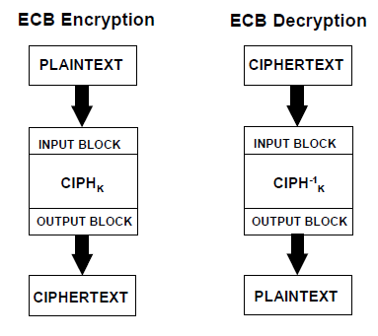
ECB Mode
Images from NIST (link Ch 5d)

Slide 4
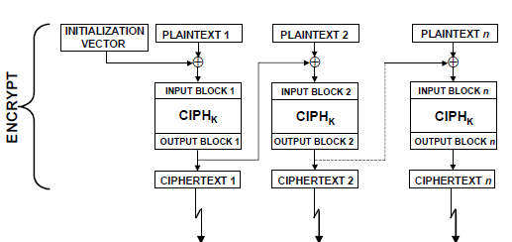
Block Cipher: Cipher-block Chaining (CBC)
Ciphertext output from each encrypted plaintext block is used in the encryption for the next block
First block encrypted with IV (initialization vector)

Slide 5
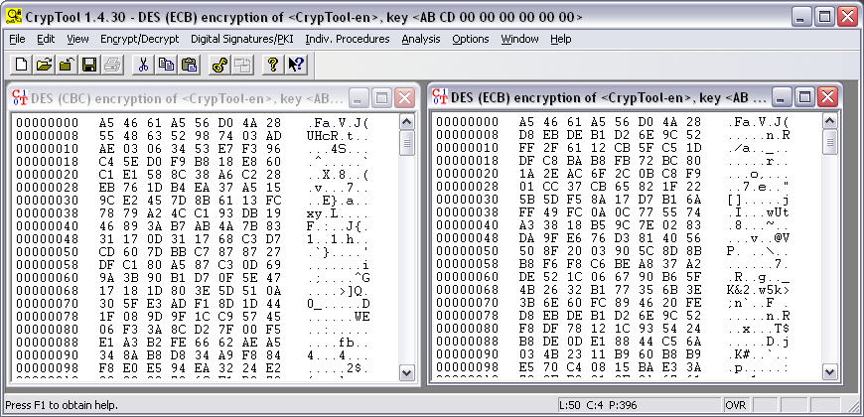
Cipher-Block Chaining v. Electronic Code Book
The first 8 bytes are the same, but after that they differ because the nonce changes
CBC ECB

Slide 6
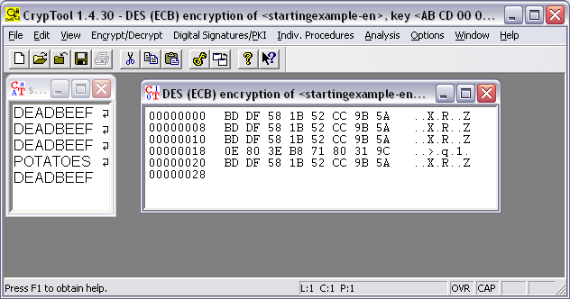
ECB and Repeated Blocks

Slide 7
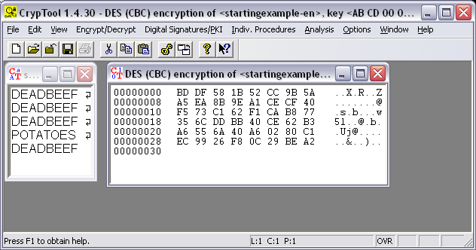
CBC and Repeated Blocks

Slide 8
Original Image

Slide 9
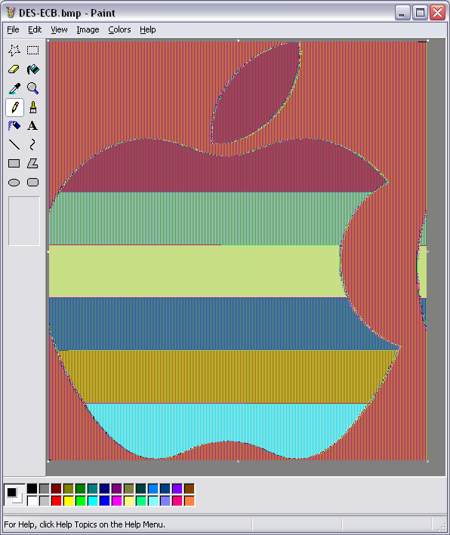
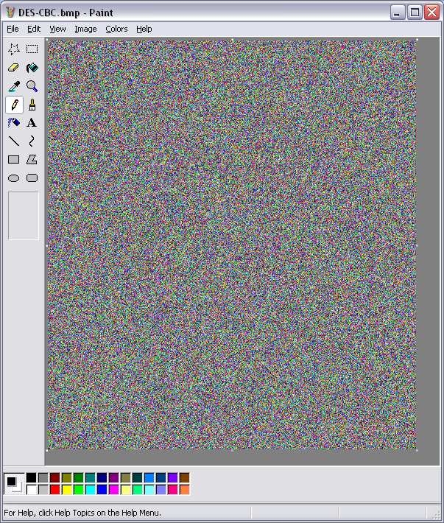
Encrypted Image
ECB CBC

Slide 10
Encrypted with RSA-512
RSA suffers from a problem similar to ECB, unless "padding" or "armoring" is used
http://rdist.root.org/2009/10/06/why-rsa-encryption-padding-is-critical/

Slide 11
WEP Crack with Cain
You need an AirPCap Wi-Fi card

Slide 12
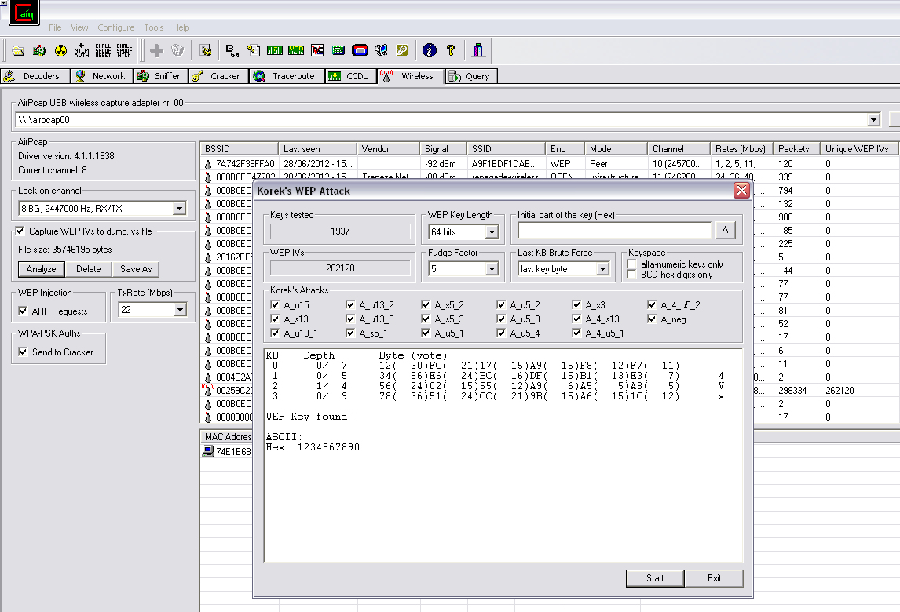
Cain from www.oxid.it/cain.html

Slide 13
Crypto Notes
http://samsclass.info/seminars/pacitpros-encryption.html

Slide 14
The Breach that Wasn't
Defcon 20
July 28, 2012

Slide 15
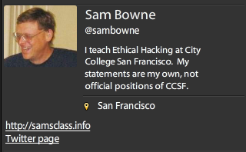
Bio

Slide 16
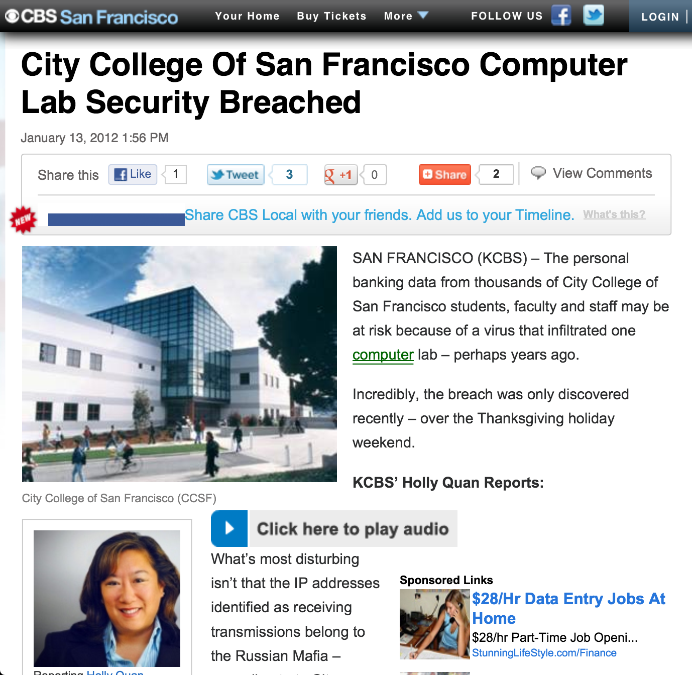

Slide 17
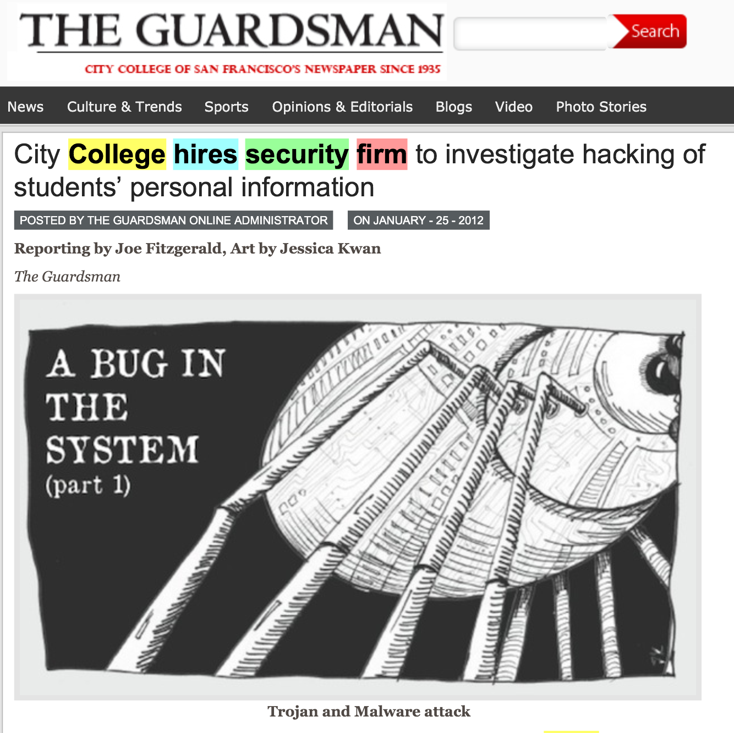

Slide 20
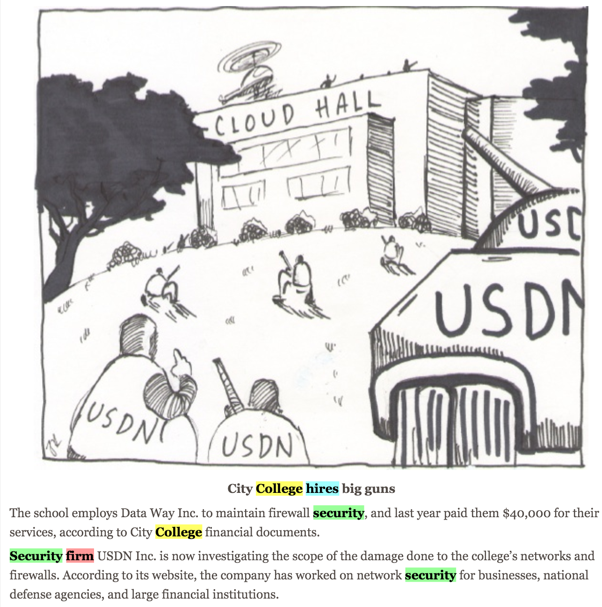

Slide 23
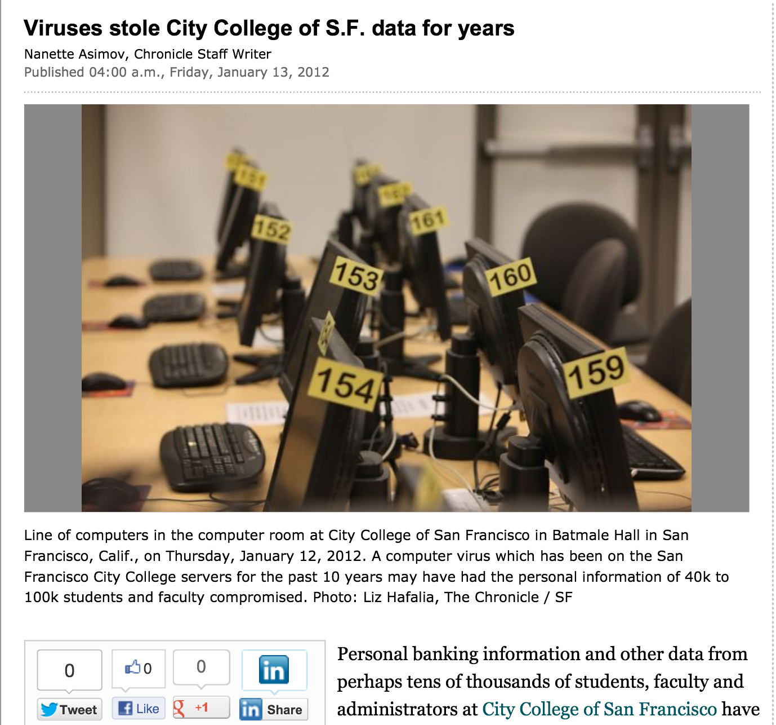

Slide 24
Outside attacks Insider threat Deluded Insider Threat

Slide 25
Security at CCSF
Two generations of complete hardware replacement in the last ten years
McAfee Enterprise antivirus
Deep Freeze
Palo Alto layer 7 firewall

Slide 26
Security Audits
There was a security audit and remediation process performed in 2007-2008 by a contractor
I did another security audit in 2010 with my CISSP students
No major problems found

Slide 27
Evidence for these "Viruses"
A report was supposedly prepared by USDN in Nov 2011, but we were never able to get a copy of it at all
The presentation from the CTO that went to the press was in Jan. 2011
We finally got a partial report on Jan. 31, lacking the appendices that were the evidence
"Proprietary and Confidential" but later published in the newspaper

Slide 28
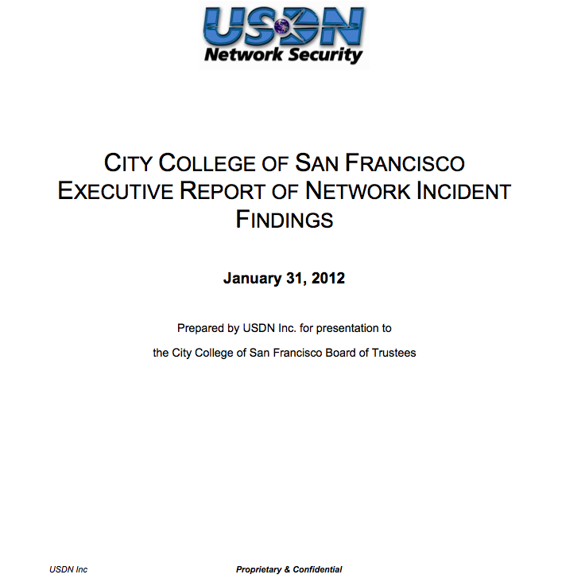

Slide 29
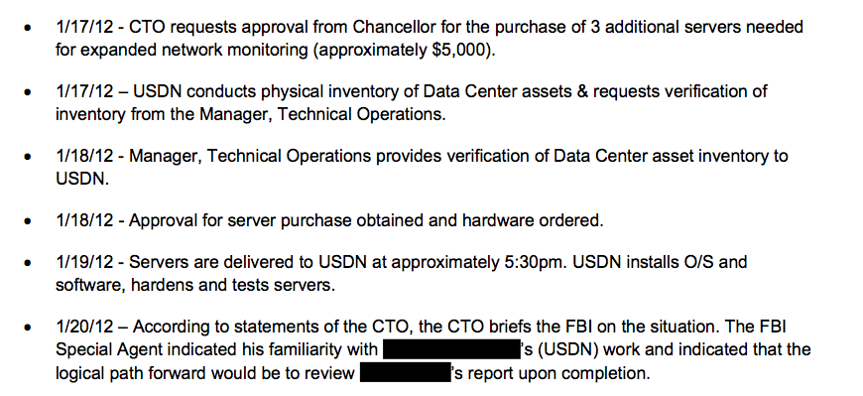

Slide 30
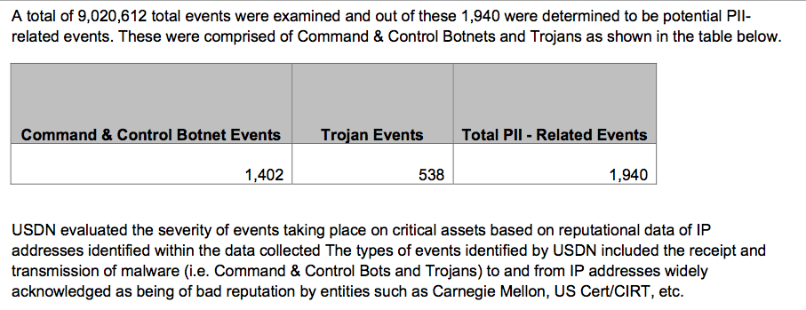

Slide 31
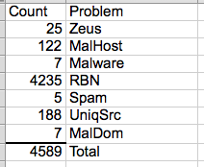
The List
On April 3, we finally got a list of the "infected machines"
Direct inspection of samples showed no real infections

Slide 32
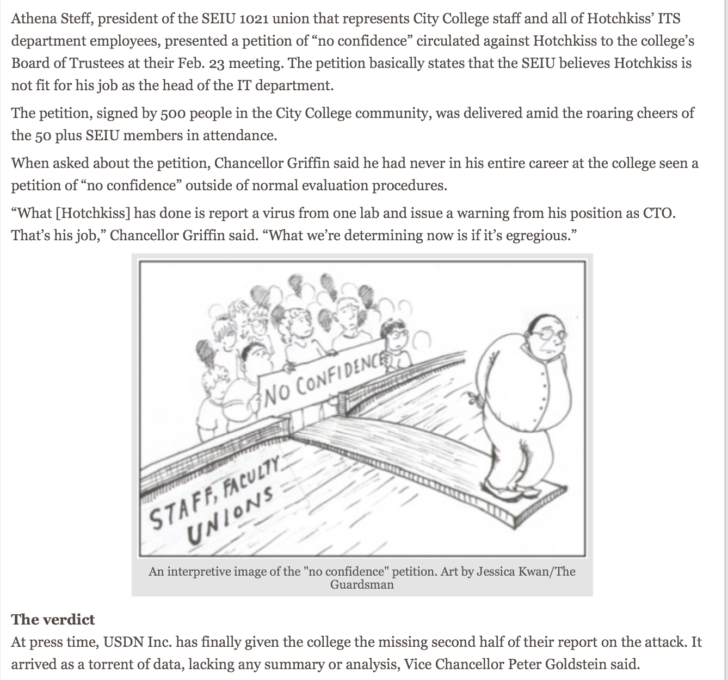

Slide 33
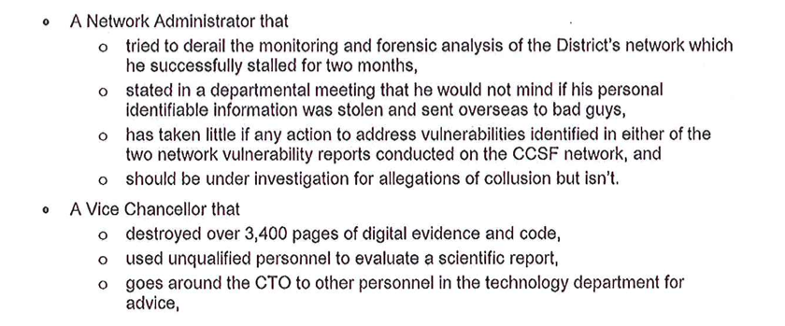
Letter to Trustees & Published in Newspaper

Slide 35
Falsified Breach in 2011

Slide 36
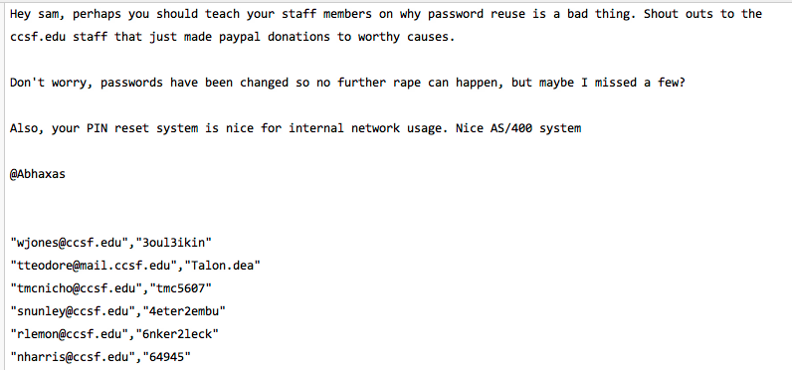
Proven False at the Time

Slide 37
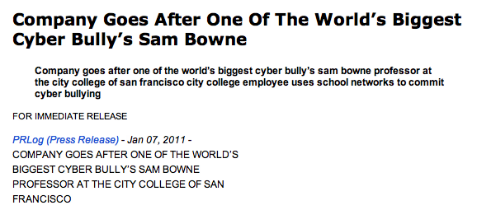
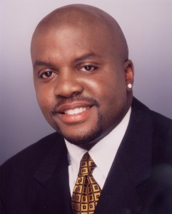
Cyber-Bullying

Slide 38
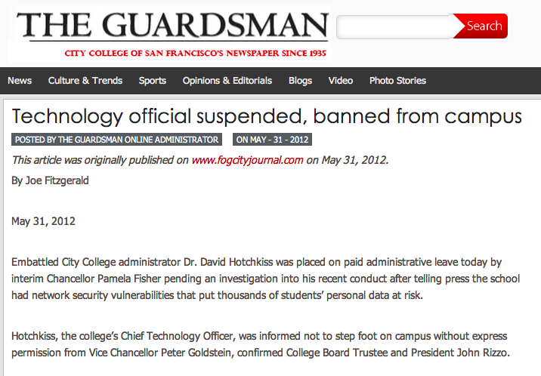

Slide 39
