Slide 1
When Vulnerability Disclosure Gets Ugly
Sam Bowne & Alex Muentz
July 22, 2016

Slide 2
Vulnerability Disclosures

Slide 3
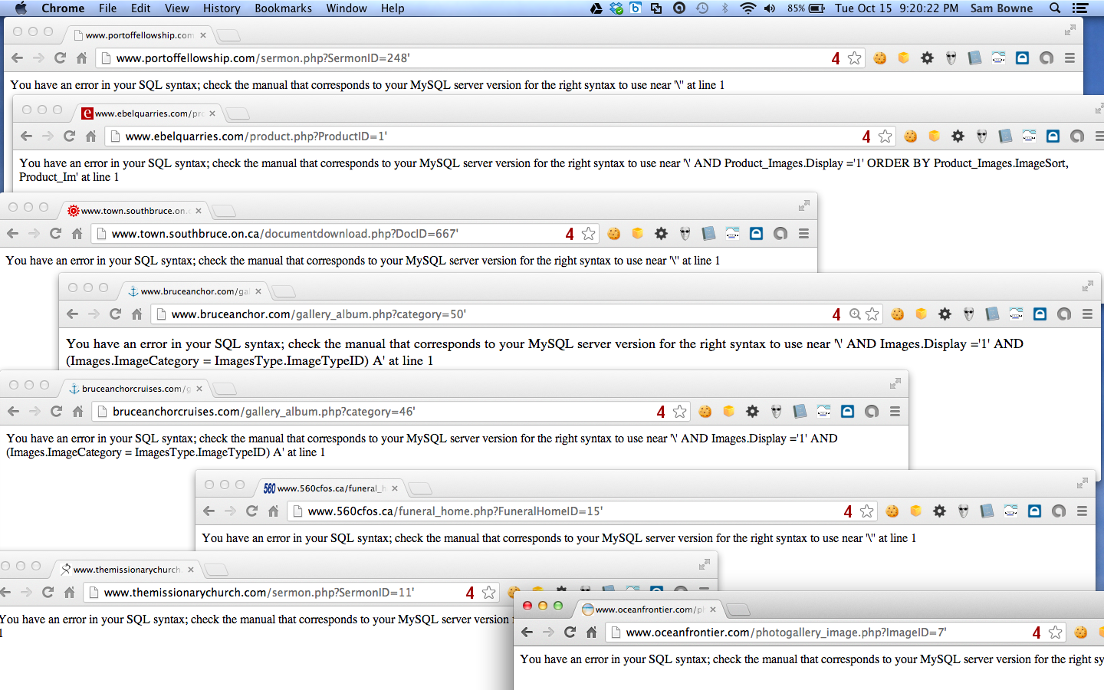
Websmart, Inc. and 100,000 Vulnerable Websites

Slide 4
Results
I notified vendor and some customers
Customers ignored me
Vendor demanded my silence, complained to CCSF, tried to get me fired
Press ignored me
My blog eventually pressured the vendor into admitting and fixing the problem

Slide 5
Pharma Infections at Colleges

Slide 6
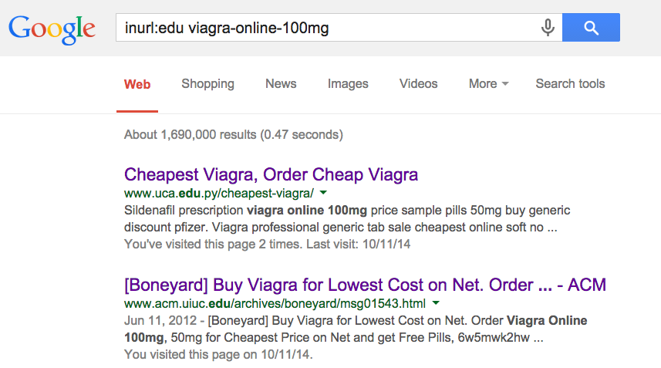

Slide 7
19 Colleges Infected with Pharma Spam in 2014
5 Fixed within a few weeks
7 Fixed within 8 months
7 Still Infected on 7-19-14
http://samsclass.info/125/proj11/subtle-infect.htm#19more

Slide 8
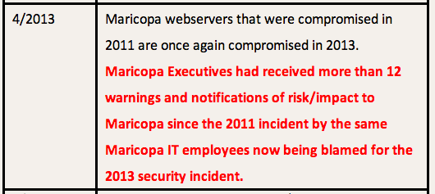

Slide 9
Infections at UC Santa Cruz

Slide 10
UCSC cleaned their server
Re-infected a week later
NEED ROOT CAUSE ANALYSIS

Slide 11
Many More Pharma Infections
Dozens of other schools, businesses, foreign sites, etc.
http://samsclass.info/125/proj11/subtle-infect.htm#19more
70 more infected schools notified in May 2016
https://samsclass.info/125/proj11/hacked-schools-2016.htm

Slide 12
Android App Vulns

Slide 13
OWASP Top Ten

Slide 14
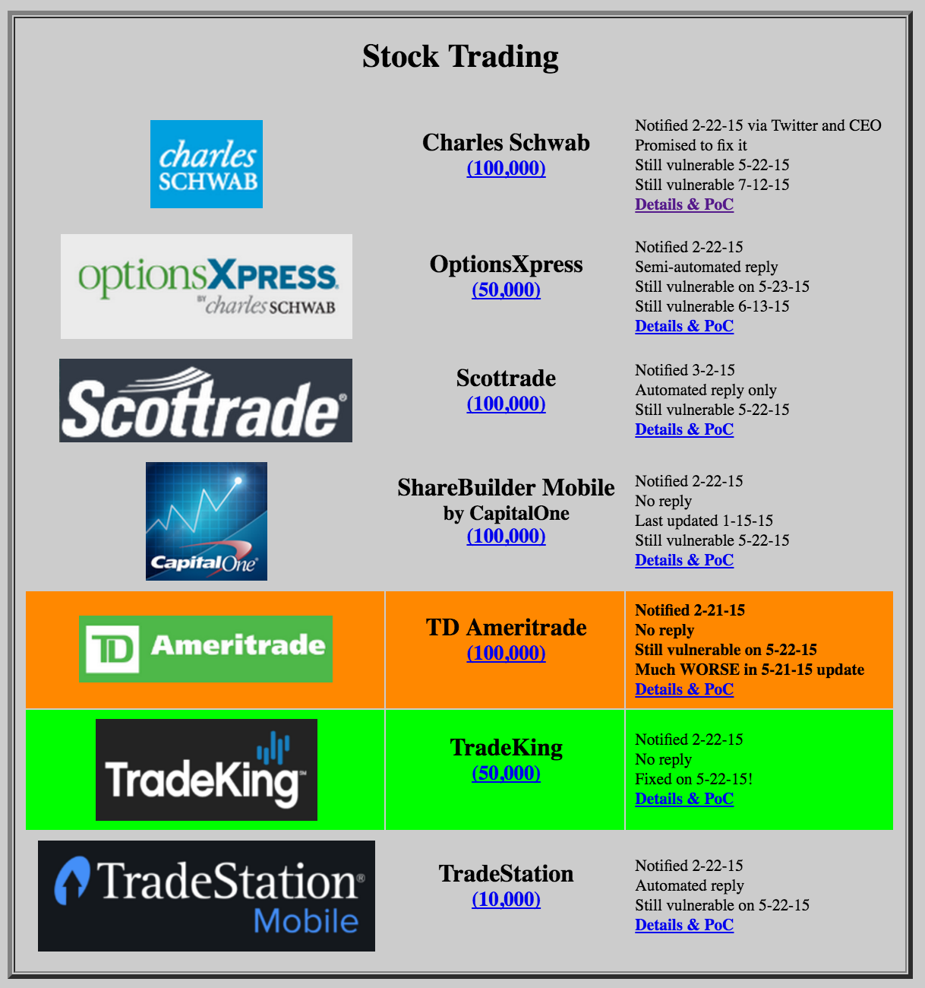
M10: Code Modification
All vulnerable; green = fixed

Slide 15
M10: Code Modification

Slide 16
Broken SSL Medical Apps

Slide 17
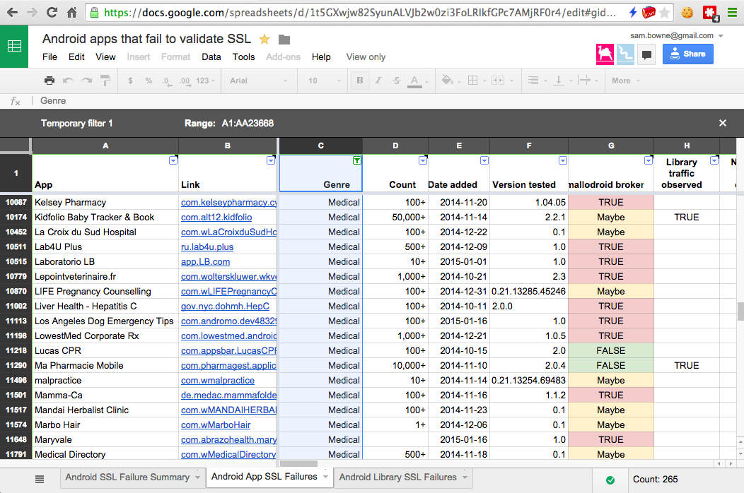
CERT found 265 Vulnerable Medical Apps

Slide 18
HIPAA

Slide 19
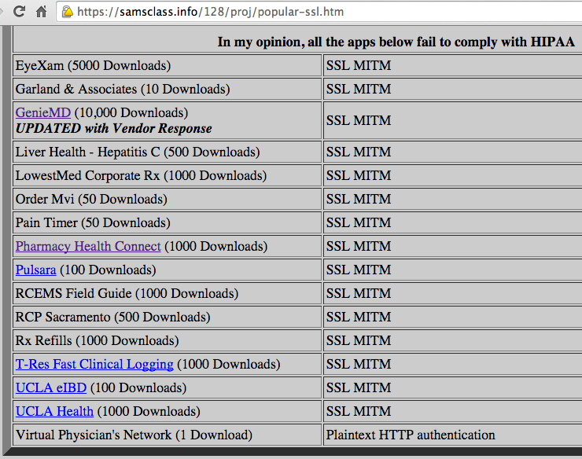
My Repeat of CERT Tests

Slide 20
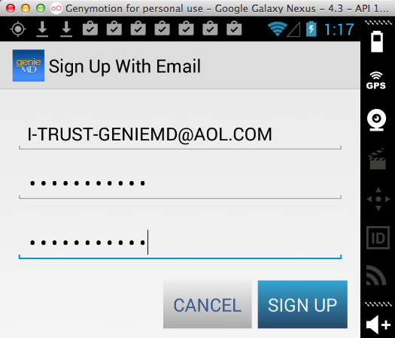
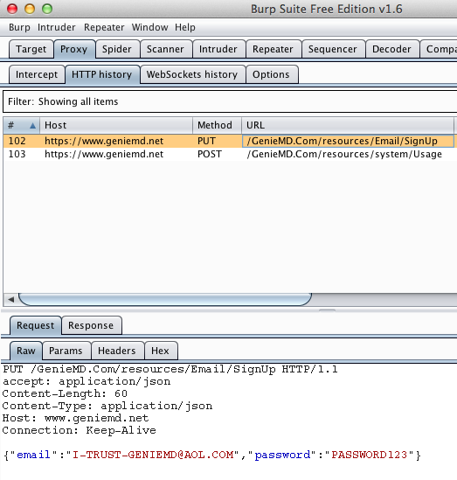
GenieMD

Slide 21
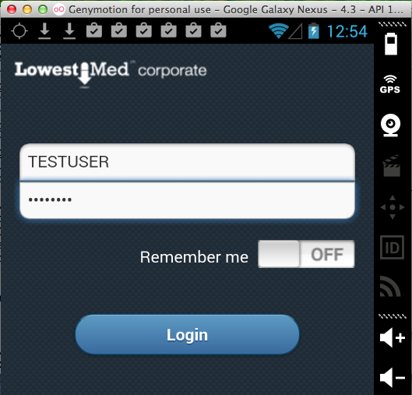
LowestMed corporate

Slide 22
LowestMed Response
Phone call to President of CCSF threatening a lawsuit
After I contacted their lawyer, he told me that there is no PII in the app beyond this point, so it is not a covered entity under HIPAA

Slide 23
Broken SSL Testing New Apps

Slide 24
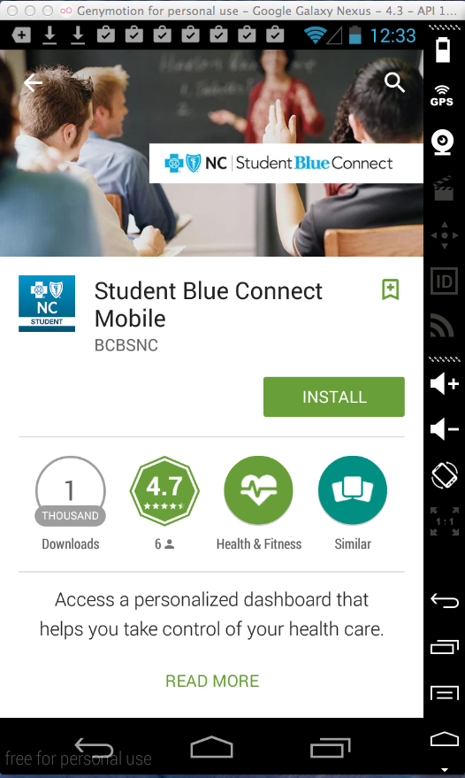
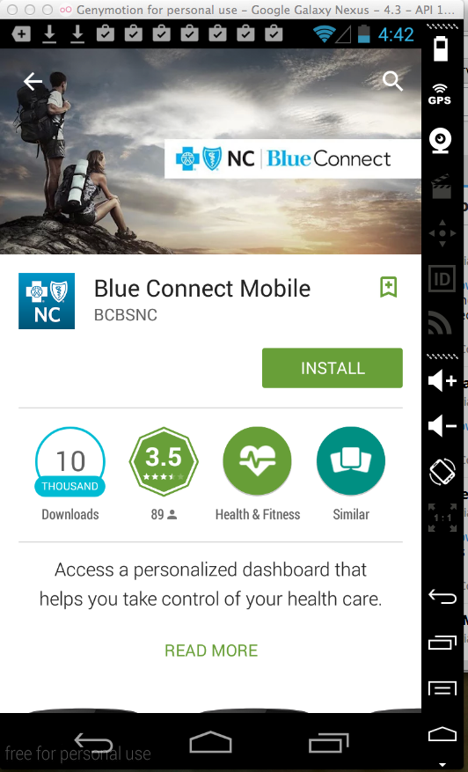
Blue Cross Blue Shield of North Carolina

Slide 25
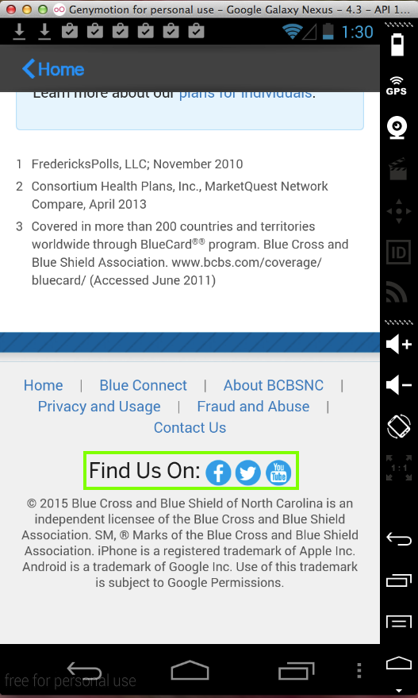
Leaked Blue Cross Credentials
Also leaked Facebook, Twitter, and YouTube credentials

Slide 26
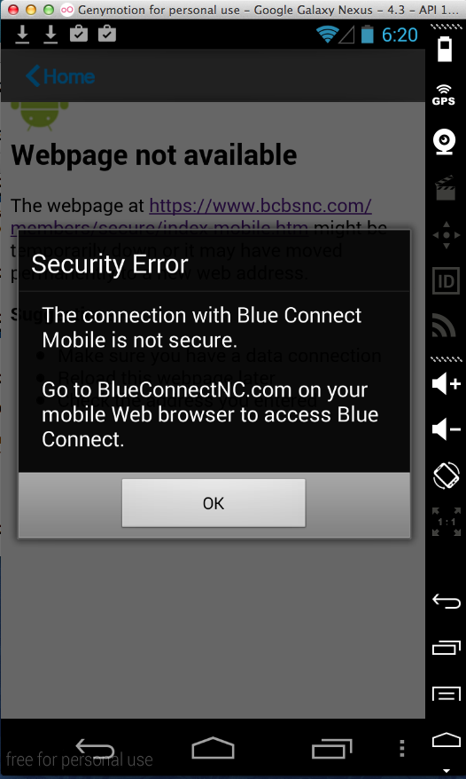
Fixed in Two Days
New version refuses to use invalid SSL certificates

Slide 27
HIPAA Violation at LSU

Slide 28
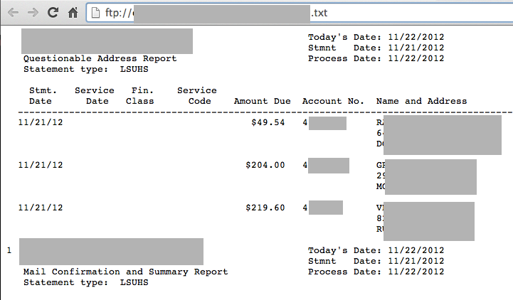
Open FTP Server with Medical Data

Slide 29
Reaction
I notified them on June 17, 2014
No reply, but server was down 4 hours later
Then on Aug. 28...

Slide 30
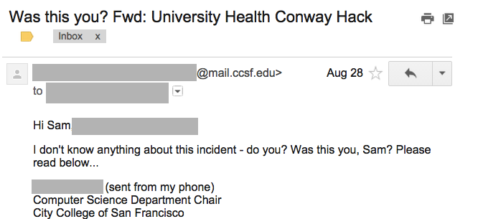
Reaction

Slide 31
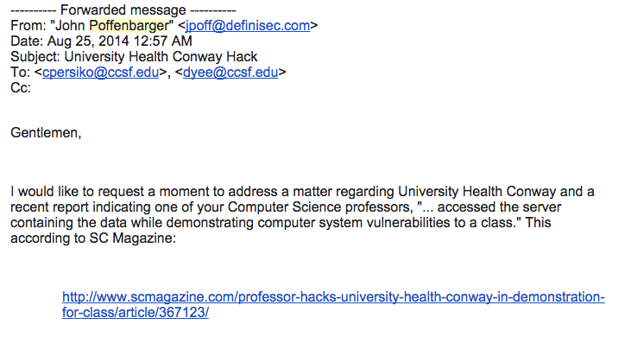
John Poffenbarger

Slide 32
John Poffenbarger
I encourage you to promptly investigate after publicly denouncing any such behaviors, as I would not expect an institution to accept, endorse, or tolerate any such actions.
I would have to wonder how this would affect the moral judgment of your graduating students entering the workforce.

Slide 34
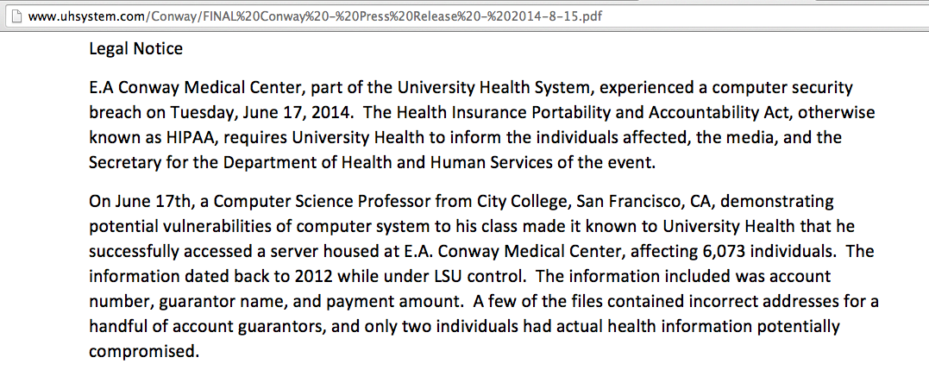
LSU Legal Notice

Slide 35
I Protested
To the reporter
To the CEO of his newspaper
To the Feds, against LSU, for HIPAA whistleblower retaliation
After a few days, it was clear that none of this was going to do any good

Slide 36
I Believed
My actions were 100% lawful
Newspapers can't just publish complete lies and get away with it
I enjoyed HIPAA whistleblower protection
I'm in real trouble now, time to call a lawyer

Slide 37
Part 2: Alex Muentz

Slide 38
Why am I here?
Who am I?
Teller of good stories
Law-talking-guy
A lawyer has to think strategically about pressure and motivations

Slide 39
Here’s how I see the story
Sam informs UH Conway
UH Conway’s compliance consultant informs local news
Generalist outlet, so details simplified and incorrect
But who cares, right? Anybody who cares can tell the difference

Slide 40
The story continues
Infosec picks up the local story-
Reads between the lines
Clickbait title
Now we care. People who can affect Sam are now reading (and reacting to) this.
CISSP pearl clutching

Slide 41
The right way, the legal way and the way we did it
The right way-
Appeal to the good and virtuous in people
Yep.
The legal way
Threaten litigation
Can get expensive
Repeats and reinforces the inaccuracy

Slide 42
The way we did it
Goal- suppress story or change narrative
Can’t appeal to best in humanity to amend story
Entrenched bureaucracy
Busy journalists

Slide 43
Threats don’t work
Defamation lawsuit == story is repeated (ad nauseum)
Even the most underpaid flack becomes Woodward and/or Bernstein when freedom of press is implicated

Slide 44
What we did
Most important coverage is trade rag
Trade rag has different motivations
Depth and accuracy
Exclusive with Sam is worthy chip
Which is traded for links from original articles and corrections

Slide 45
Legal stuff
Defamation
Slander (spoken), Libel (written)
Publication (transmission to a third person) of untrue, negative statement which damages reputation

Slide 46
Untrue, negative statements
“Sam hacked the server in class”
“Successfully accessed a server, affecting patient privacy”
Not untrue, negative statements: “UH Conway stated that Sam hacked the server in class”

Slide 47
Damage to reputation
Plaintiff (Sam) must either show economic harm
Contracts or business lost because of statement
Doesn’t have to be believed
Per Se Defamation
Accusation of crime
Professional reputation
Loathsome Disease

Slide 48
But the law cuts both ways…
Was Sam obeying the law?
18 USC 1030/CFAA
Unauthorized/exceeding authorized access
Networked computer
Obtaining information

Slide 49
Bitcoin & Blockchains

Slide 50
Why Should We Care?
Bitcoin itself is not very interesting
Scams
Pyramid schemes
High-risk investment
Money laundering

Slide 51
My Evolving Position

Slide 54
Blockchains
The technology behind Bitcoin
Everyone has a copy of the complete ledger
Very difficult to lie or cheat
Enables business dealings with people you don't trust
No trusted central authority
Bank, government, regulator, ...

Slide 55
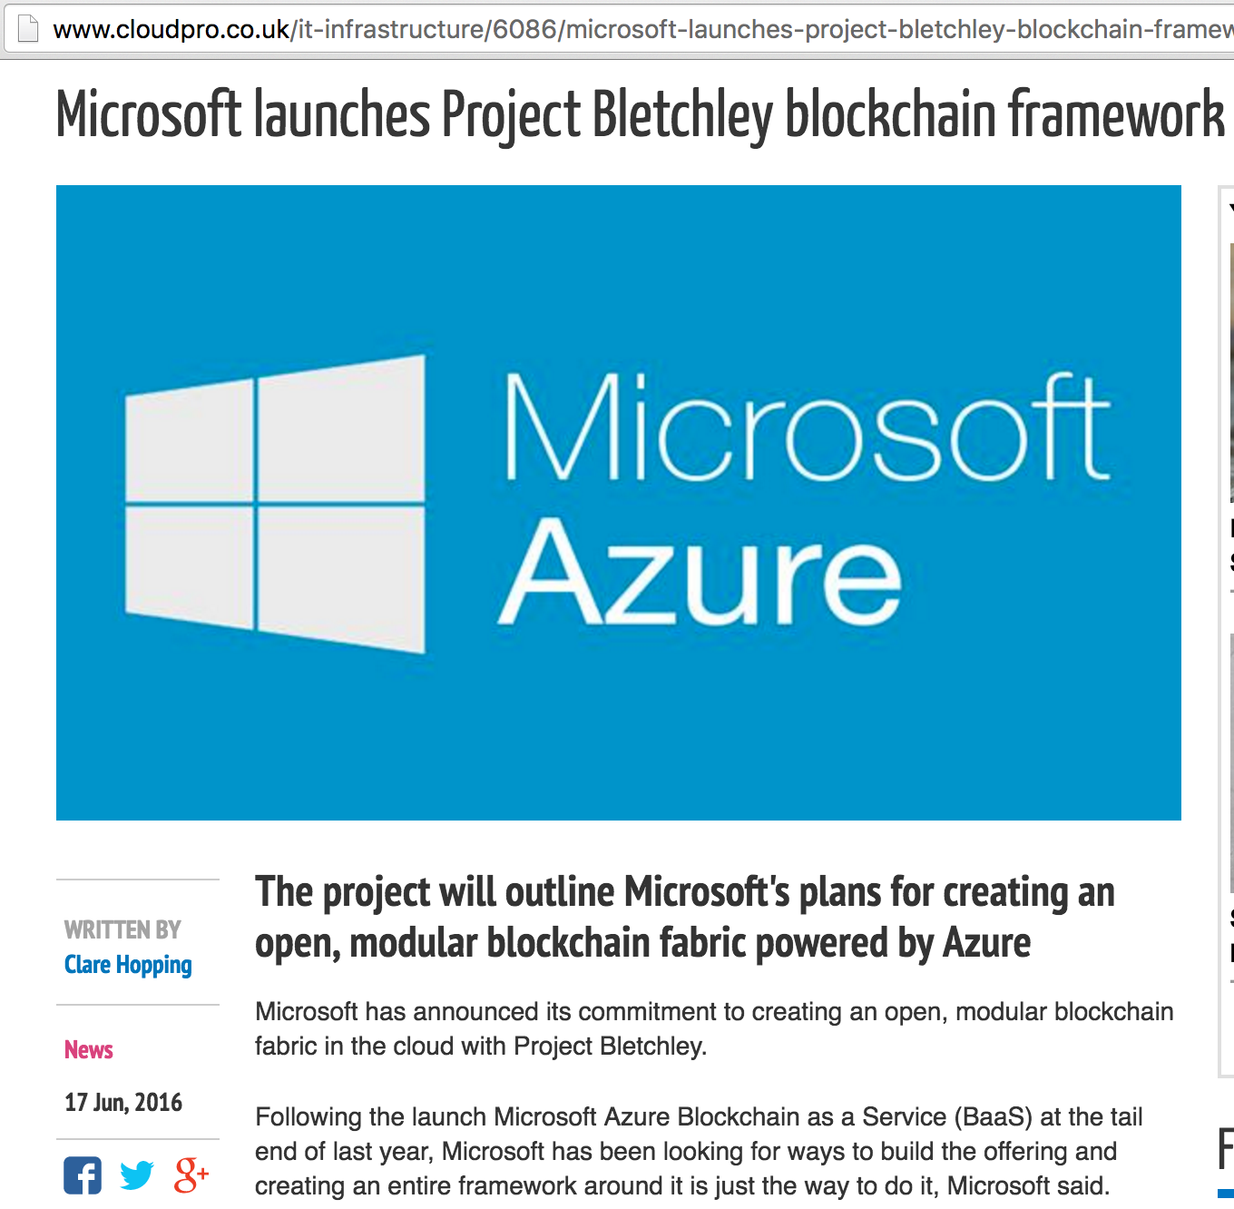

Slide 56
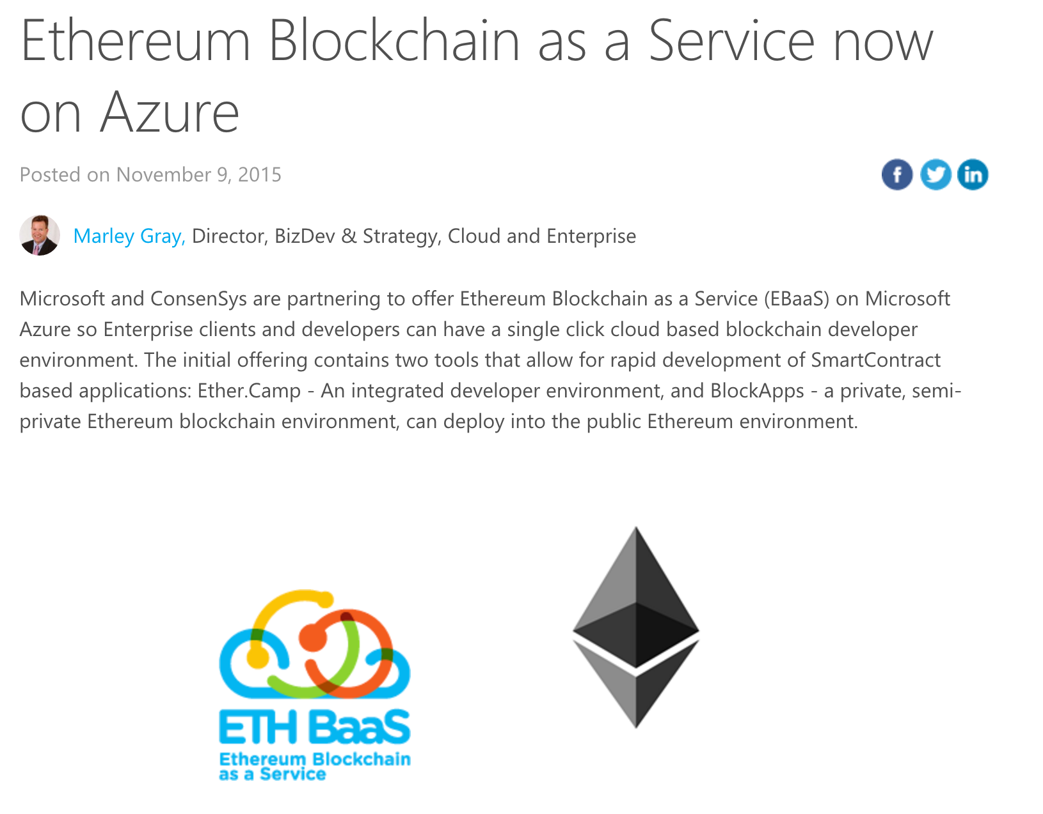

Slide 57
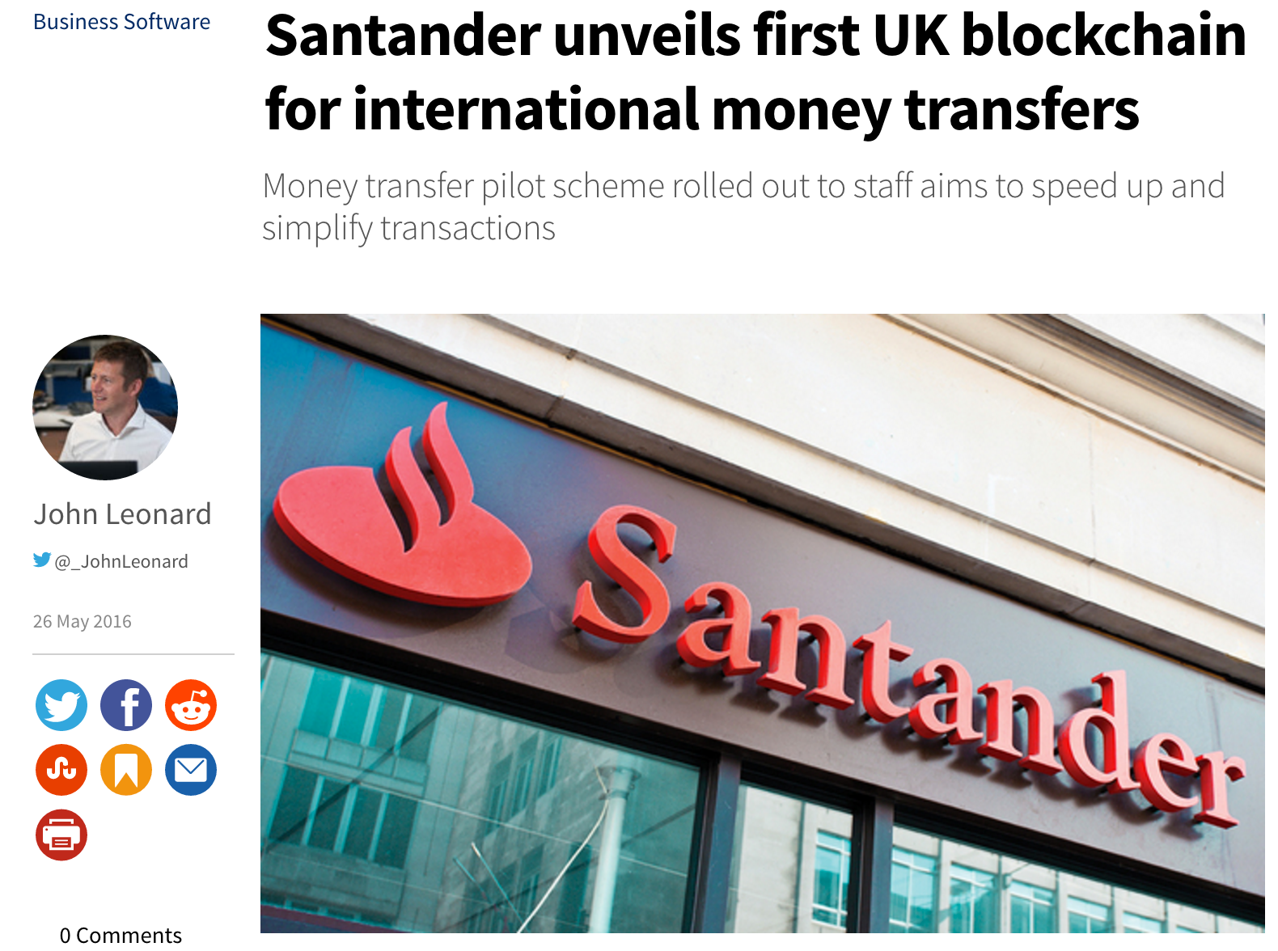

Slide 58
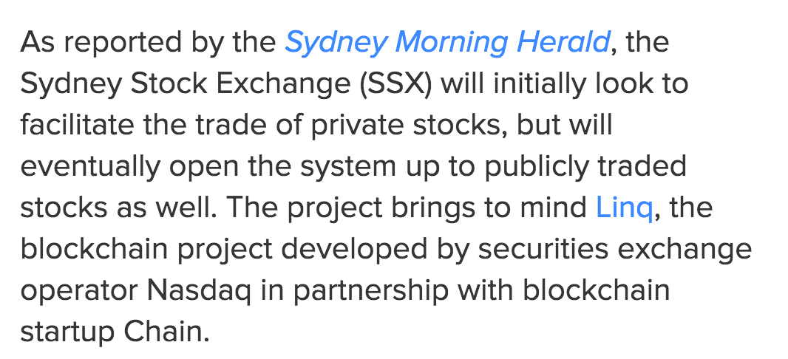

Slide 59
How Bitcoin Works
Blocks are signed by miners with a SHA-256(SHA-256(block)) hash
The hash must start with 69 bits of zero
Difficulty is adjusted to keep the time between successes near 10 min.
This makes forging signatures very difficult
Miners get an award (currently 25 bitcoins) plus transaction fees
Link Bitcoin 8

Slide 60
Bitcoin's Importance
Bitcoin is a real-world test of blockchain technology
A bunch of rebels, criminals, scammers, and suckers
Demonstrated how well blockchains work
AND THEY WORK

Slide 61
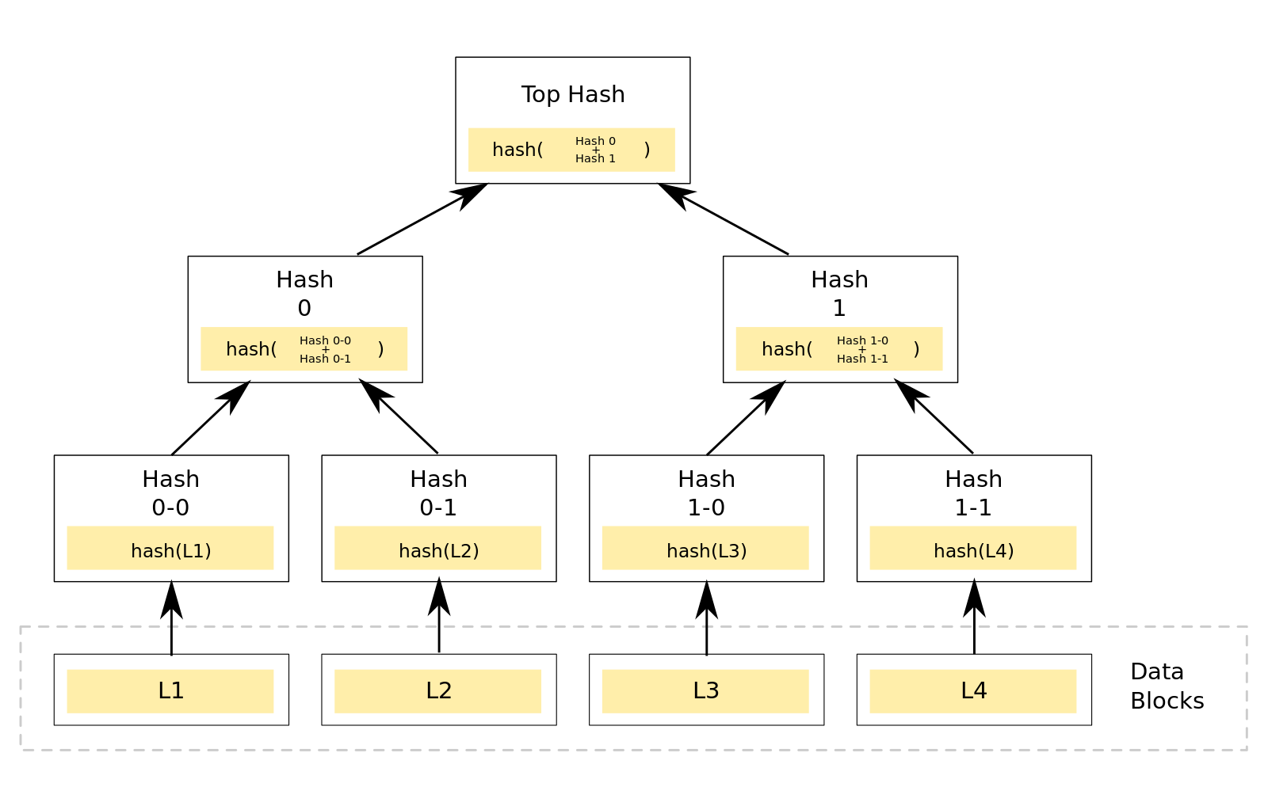
Merkle Tree
Designed to "allow efficient and secure verification of large data structures" -- Link Bitcoin 2

Slide 62
Block
A block is a public ledger of all bitcoin transactions
Every computer running the full bitcoin software has a copy of the entire blockchain
Every 10 minutes, the Bitcoin transactions are gathered together into a block and finalized by miners with proof of work
A hash value that's very difficult to compute, but easy to verify
Each mined block produces 25 new bitcoins (soon this value will halve)

Slide 63
Blockchain Voting
Vote at samsclass.info

Slide 64
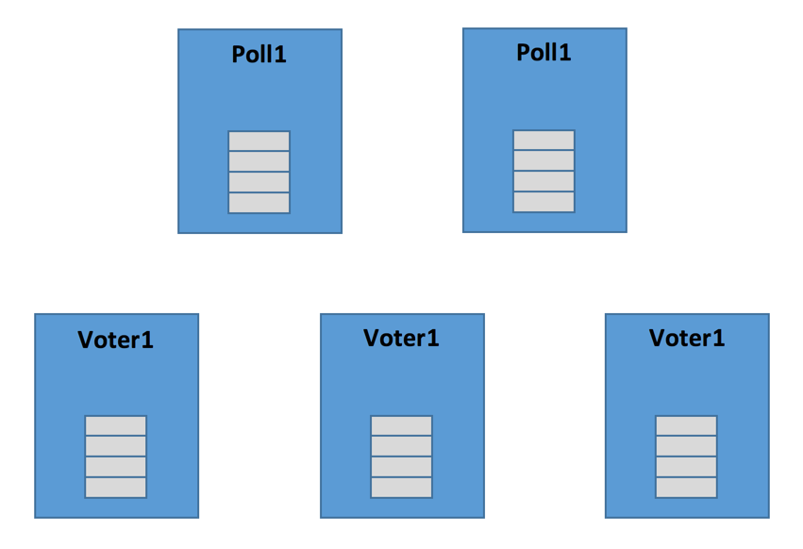
Blockchain Voting
Every stakeholder has the complete blockchain
Voters can verify that their voted were counted
Anyone can verify the totals at any time

