Slide 1
Adding Trojans to Apps

Slide 2
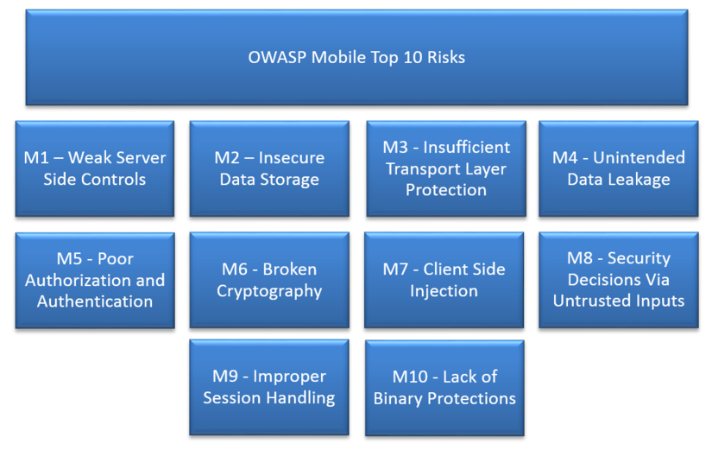

Slide 3
Broken SSL Repeating Old Work

Slide 4
CERT's Test in 2014
23,667 vulnerable apps
All warned in 2014 by CERT

Slide 5
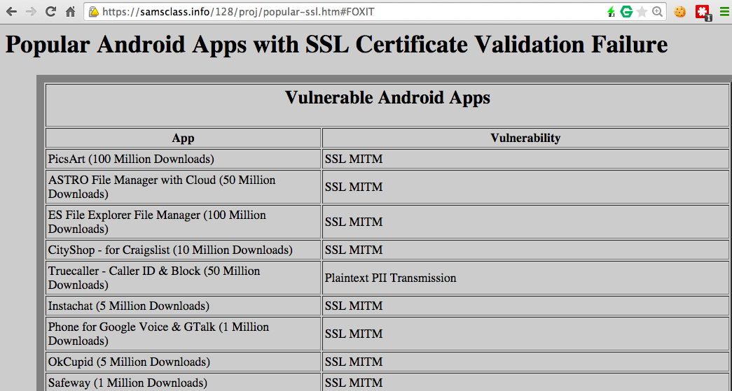
Still Vulnerable

Slide 6
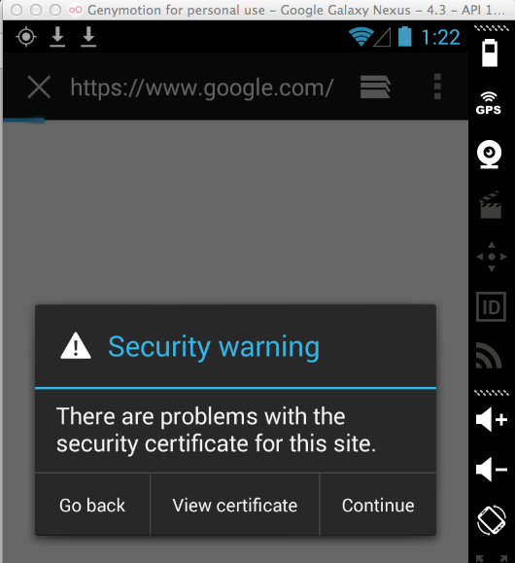
Simple SSL Test
Route Android traffic through Burp Proxy
Don't install the PortSwigger root certificate
This is a MITM attack
The default browser detects it

Slide 7
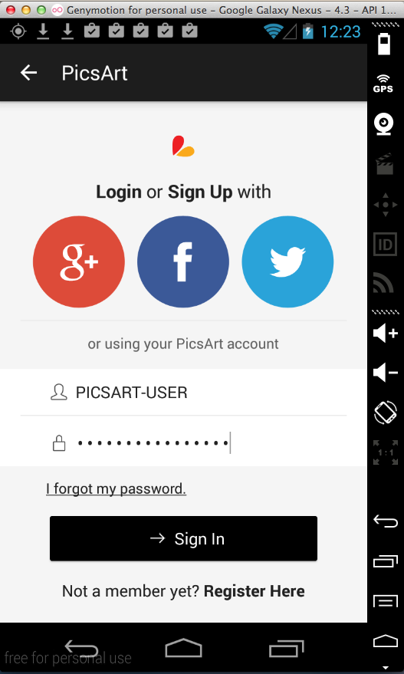
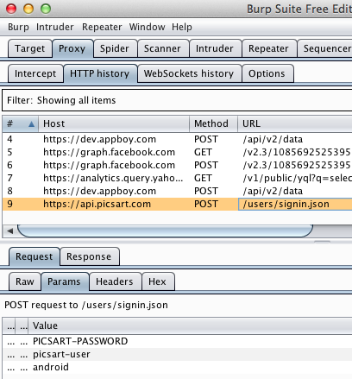
DEMO: PicsArt (100 Million)

Slide 8
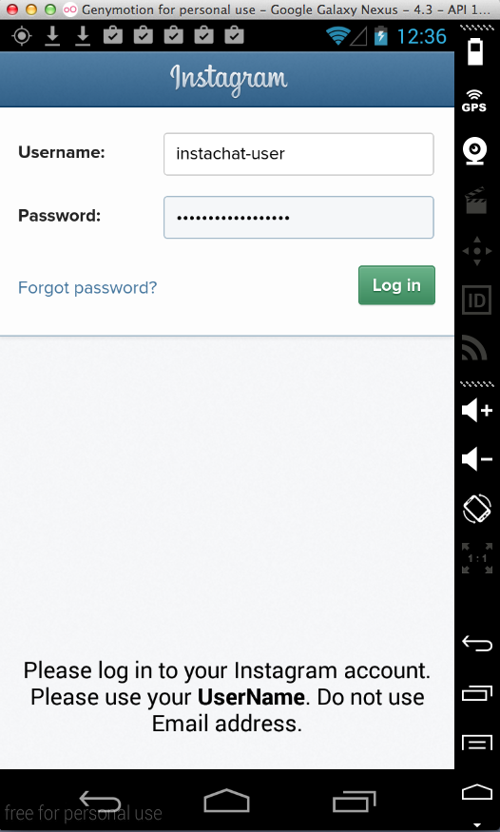
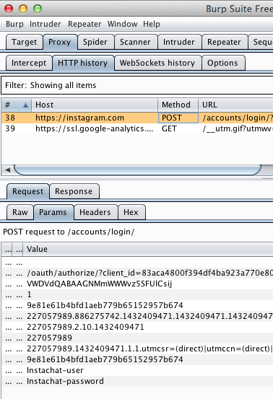
DEMO: InstaChat(100 Million)

Slide 9
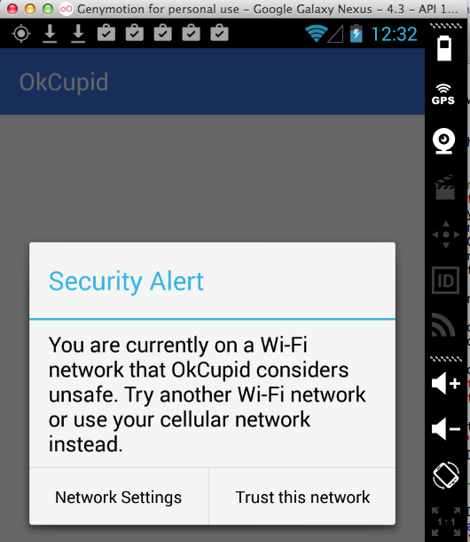
DEMO: OKCupid – FIXED!

Slide 10
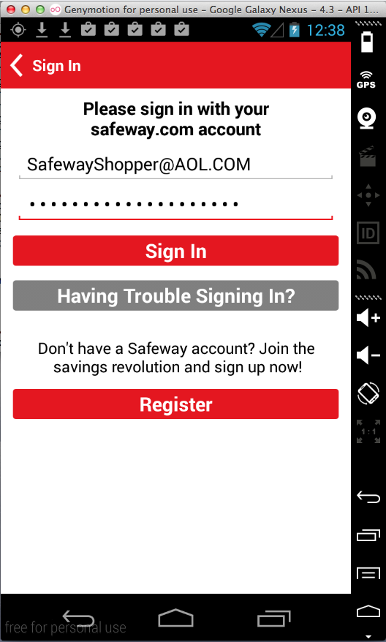
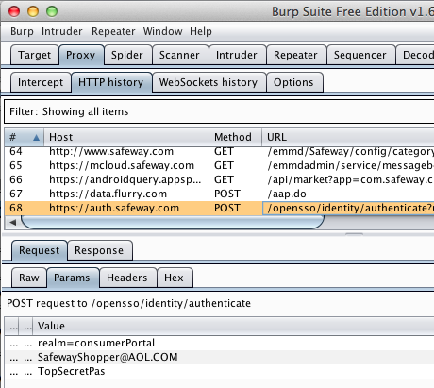
DEMO: Safeway (1 Million)

Slide 11
Broken SSL Medical Apps

Slide 12
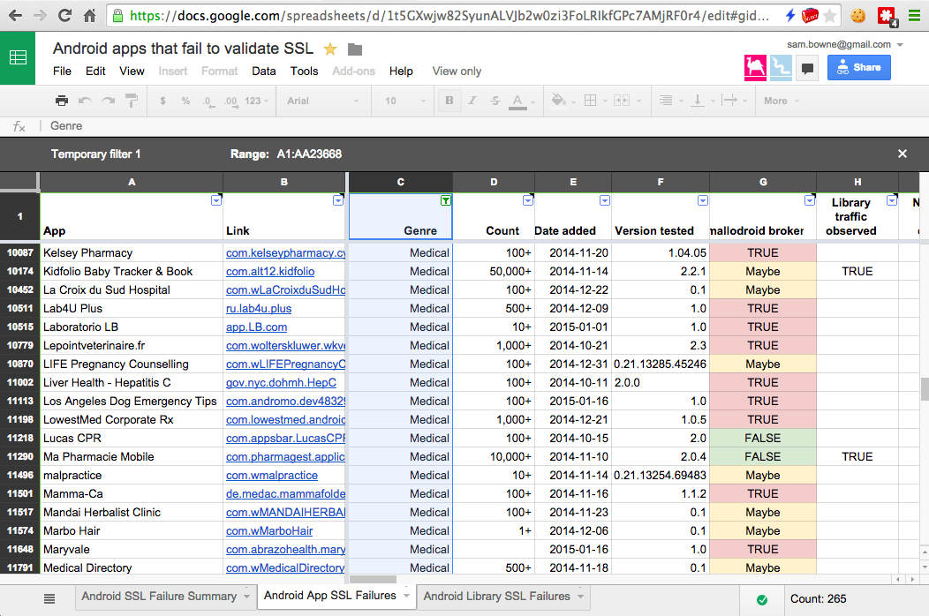
CERT found 265 Vulnerable Medical Apps

Slide 13
HIPAA

Slide 14
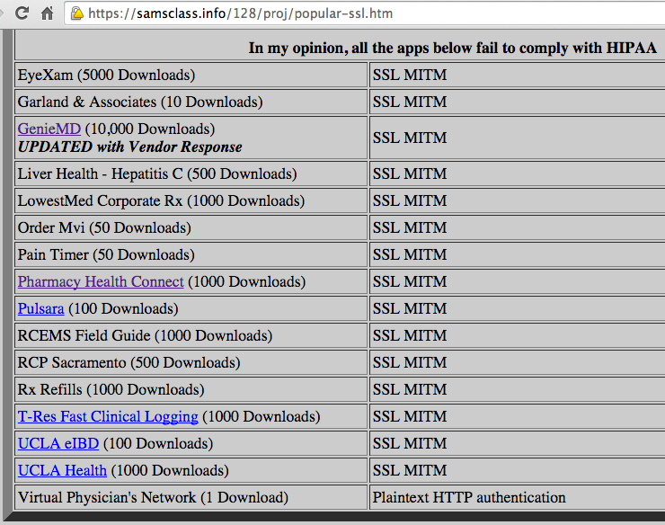
My Repeat of CERT Tests

Slide 15
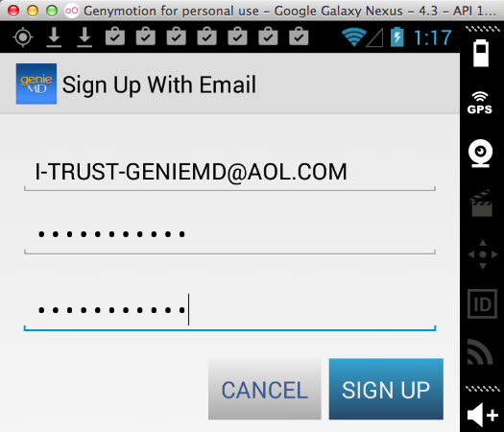
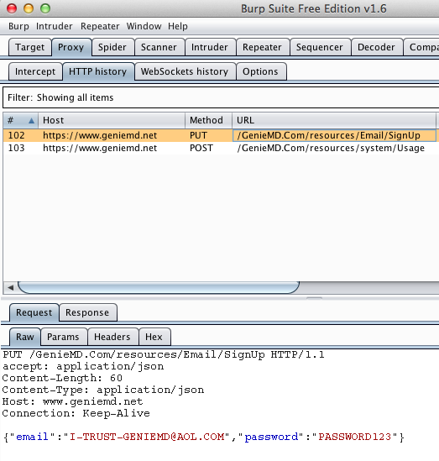
DEMO: GenieMD

Slide 16
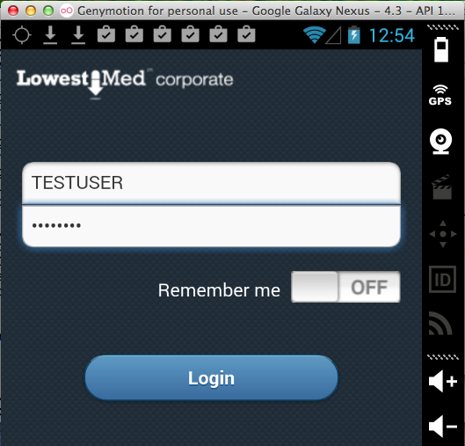
DEMO: LowestMed corporate

Slide 17
LowestMed Response
Phone call to President of CCSF threatening a lawsuit
After I contacted their lawyer, he told me that there is no PII in the app beyond this point, so it is not a covered entity under HIPAA

Slide 18
Broken SSL Testing New Apps

Slide 19
Responsible Disclosure
I need to give these guys time to respond, so most of them are still confidential
I can discuss one, because they fixed it really fast!

Slide 20
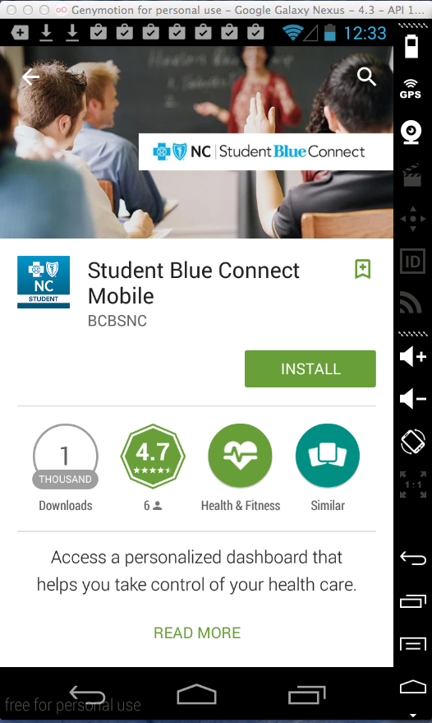
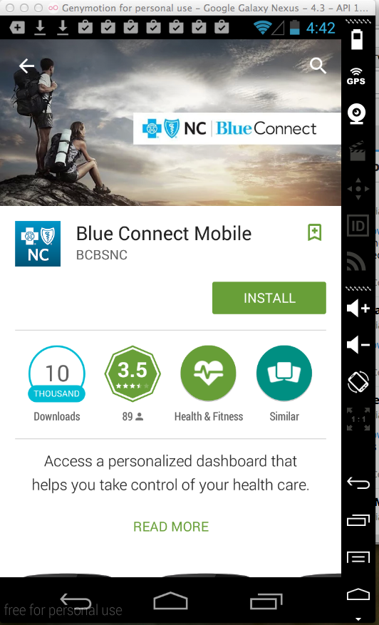
Blue Cross Blue Shield of North Carolina

Slide 21
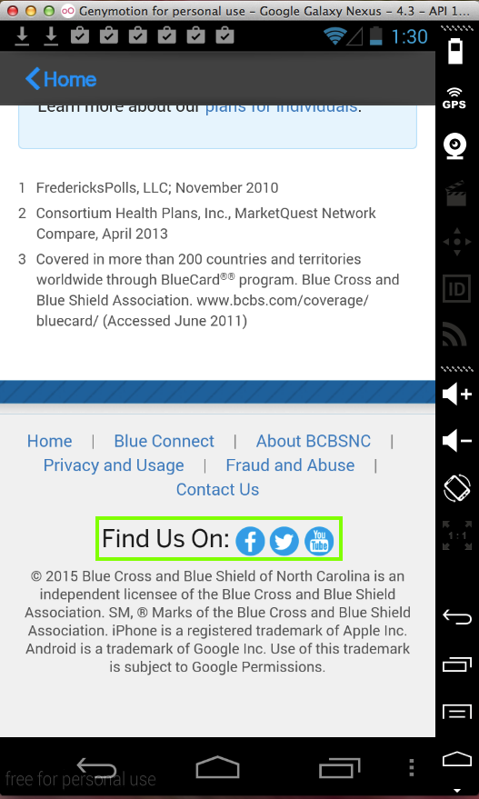
Leaked Blue Cross Credentials
Also leaked Facebook, Twitter, and YouTube credentials

Slide 22
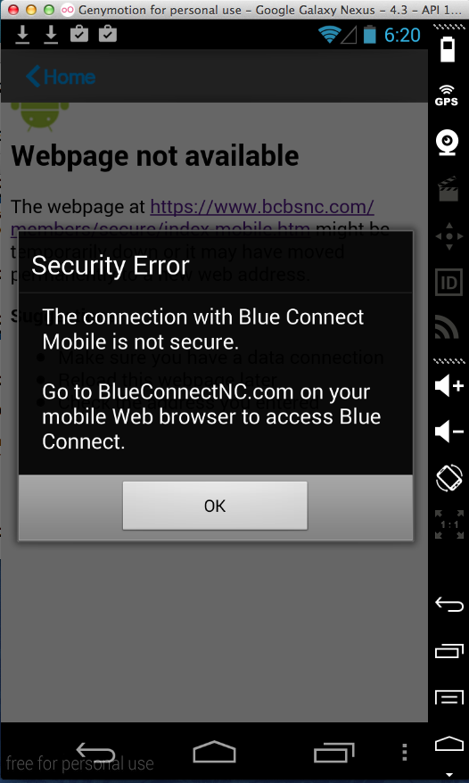
Fixed in Two Days
New version refuses to use invalid SSL certificates

Slide 23
Security Products

Slide 24
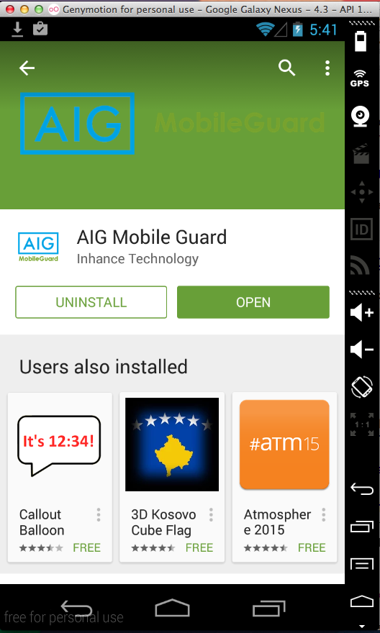
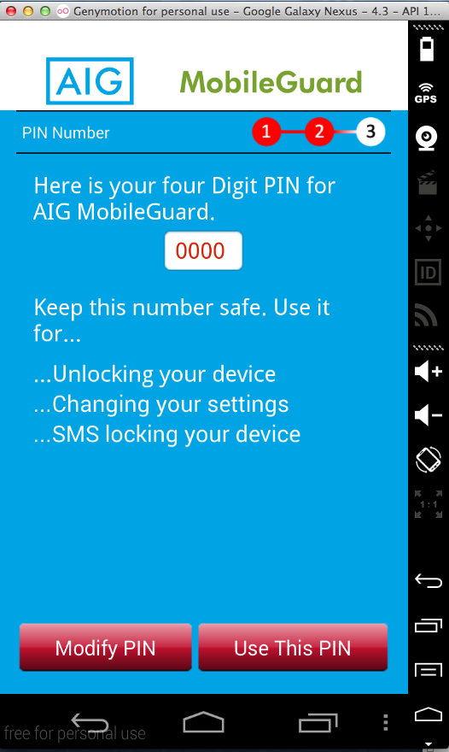
AIG MobileGuard
Security app required for insurance coverage
Removed from Google Play after my reports

Slide 25
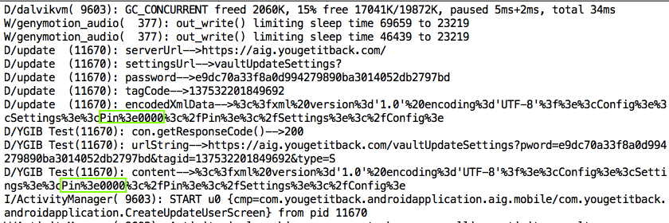
Already Trojaned ☺

Slide 26
Local Storage of Sensitive Data
Security Answer
Security Question
PIN

Slide 27
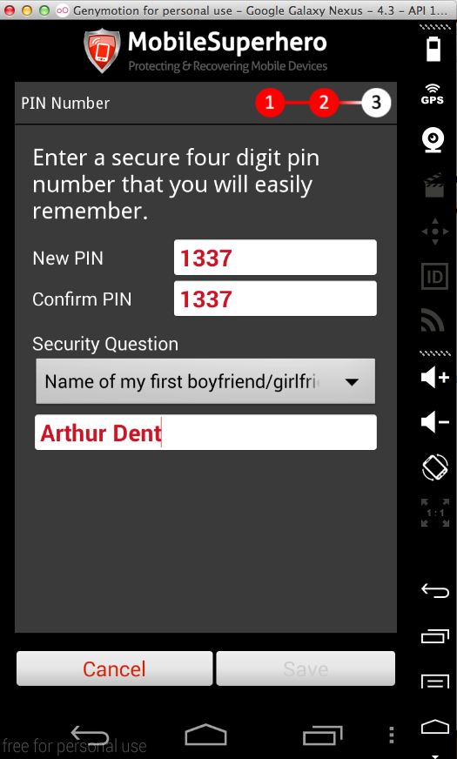
DEMO: MobileSuperHero (10,000)
Logs the PIN
Last update 12-13-12

Slide 28
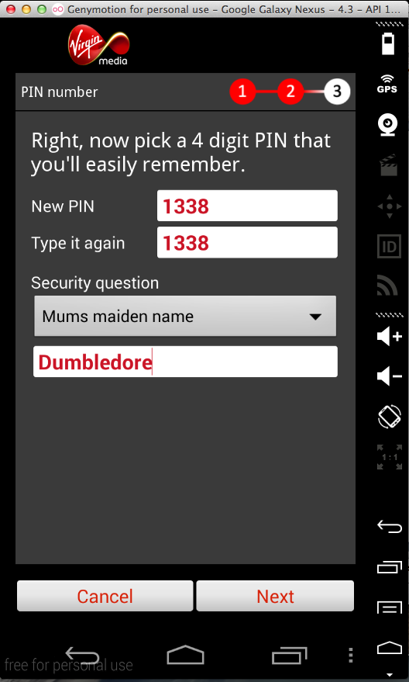
DEMO: Virgin Mobile Rescue (100,000)
Logs the PIN
Last update 7-22-13
Must uninstall Mobile Superhero to use it

Slide 29
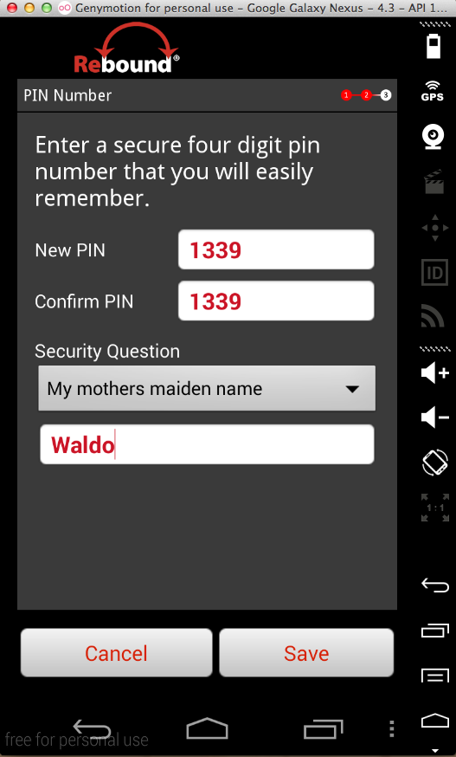
DEMO: Rebound (50)
Logs the PIN
Last update 7-16-13

Slide 30
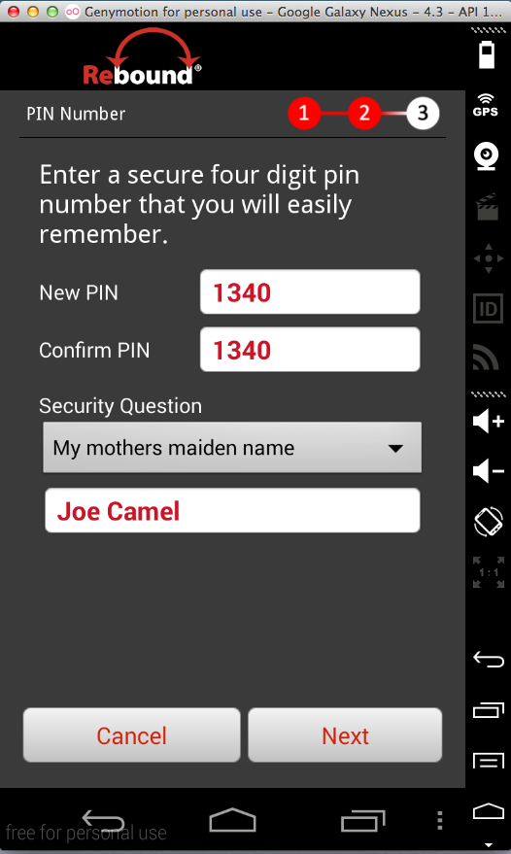
DEMO: Rebound Mobile Security (50)
Logs the PIN
Last updated 11-7-2013

