Slide 1
Ch 3: iOS
CNIT 128:
Hacking Mobile Devices
rev. 2-4-15

Slide 2
History of iOS
Very popular, 500 million sold as of 2013
Modern versions are very secure
Closed system: by default,
Third parties are not allowed to modify the OS in any way
Users cannot access their iThings remotely
Can only install apps from Apple's App Store, no third parties
Hackers work to overcome these restrictions

Slide 3
History of the iPhone
In the 1980s, Steve Jobs founder NeXT
The NeXTSTEP OS was based on the Mach kernel and BSD Unix
Used Objective-C for programming apps
1996: Apple purchased NeXT
NeXTSTEP used as the basis for OS X
2001: Mac OS X released

Slide 4
History of the iPhone
2007: iPhone introduced
Running iOS, a pared-down version of OS X
Over the next few years came the iPod, Apple TV, and iPad in various versions, all running iOS
All run on ARM processor
64-bit starting with iPhone 5s (link Ch 3b)
32-bit for earlier versions

Slide 5
How Secure is iOS?
First iPhone did not allow any third-party apps
Only a Web browser to allow Web apps
This lowered security requirements
2008: App Store introduced
Over 800,000 apps now
New security measures introduced

Slide 6
Early Versions of iOS
Very little security
All processes ran as root
No sandboxing or restriction on use of system resources
No code signing
No Address Space Layout Randomization (ASLR)
No Position Independent Executable (PIE) support

Slide 7
Security Measures Added
Third-party apps ran under a less-privileged user account named mobile
Sandboxing restricted apps to a limited set of system resources
Code signature verification supported
Apps must be signed by Apple to execute
Code signatures verified both at load time and runtime, to prevent injection of new code into memory

Slide 8
Security Measures Added
ASLR added for kernel, OS components, and libraries
PIE supported as a compile-time option in Xcode
PIE apps load at a different base address every time they execute
Makes exploitation of buffer overflows more difficult

Slide 9
Encryption
iPhone 3GS and later devices encrypt the file system with AES
Using a hardware AES cryptographic accelerator
The key is not available to the CPU
This makes wiping all data instantaneous
Simply delete the File System Key
In earlier devices, wiping the SSD took hours
Link Ch 3d

Slide 10
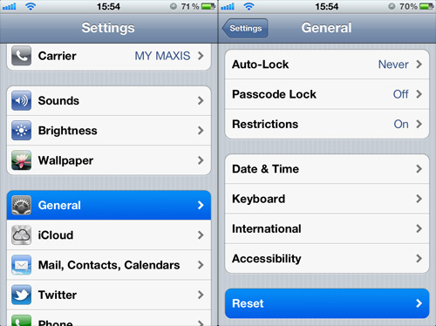
Wiping your iPhone
Image from hongkiat.com

Slide 11
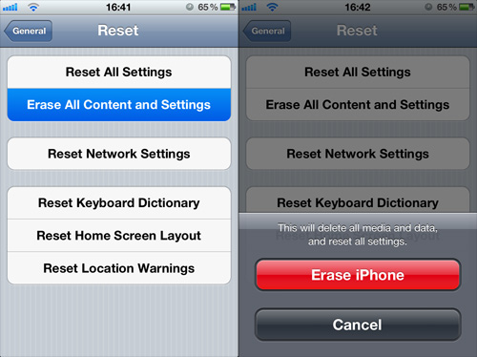
Wiping your iPhone
Image from hongkiat.com

Slide 12
Security of Modern iPhone (& other iThings)
The most secure consumer-grade operating system available
Unless you jailbreak it
No antivirus or firewall is available, because you don't need them
No spreading viruses
Limited, targeted attacks are still possible

Slide 13
Jailbreaking

Slide 14
Users Defeating Security
The owner of an iPhone does not have root access to their own device by default
You need to defeat Apple and hack your own phone to get it
This offends a lot of freedom-lovers, but it makes you a lot safer

Slide 15
Liberty or Death!
"Those who would give up essential Liberty, to purchase a little temporary Safety, deserve neither Liberty nor Safety." – Ben Franklin
A widely misunderstood quote (link Ch 3)

Slide 16
Jailbreaking
Taking full control of an iThing
May require downloading software, or, occasionally, just a visit to jailbreakme.com
You get access to Cydia, a large store of unauthorized apps
Also stolen commercial apps
Code signing is disabled, so you can run any app, good or bad

Slide 17
Risks of Jailbreaking
Jailbreaking is an exploit against a vulnerability
Trojaned Jailbreak apps could do anything to your device
Jailbroken phones may lose some functionality
Such as iBooks
You may "brick" your device
Voids your warranty

Slide 18
Point of No Return
Even if you back up your device first with iTunes
There is no way back to a completely clean system after jailbreaking
Except, possibly, reset to factory defaults

Slide 19
Security Becomes Your Responsibility
Your device is no longer protected by Apple
The jailbreak community is a very powerful security research force

Slide 20
Viruses on Jailbroken iPhones
Links Ch 3h, 3i, 3j

Slide 21
Jailbreaking and Unlocking iPhones are Legal Now
Jailbreaking
Gaining root access
Legal through 2015 through a time-limited exception to the DMCA (link Ch 3k, 3m)
Jailbreaking an iPad is now illegal again
Unlocking
Enabling you to switch carriers
Now legal (link Ch 3l)

Slide 22
Methods of Jailbreaking
Take control of the boot process
Push a custom firmware image to the device
Works on older devices: iPhone 3G/3GS/4G, iPod 4G, iPad 1
Remote jailbreaking
Load a file that
Exploits and takes control of a userland process
Then exploits and takes control of the kernel
jailbreakme.com

Slide 23
More Recent Methods
Corona or Absinthe jailbreak
Works on iPhone 4S and iPad 2/3 running iOS v. 5
Evasion
Works on iPhone 5, iPod 5G, iPad 4, and iPad mini running iOS v. 6.x
Newest version works on iOS v. 7 (link Ch 3n)

Slide 24
Tethered v. Untethered
A tethered jailbreak needs to be connected to a computer via USB on every reboot
Used only by people who demand the very latest versions, or jailbreak developers
An untethered jailbreak is far more convenient
iDevice can reboot on its own
Link Ch 3o

Slide 25
END OF PART 1

Slide 26
Boot-based Jailbreak

Slide 27
Steps for Boot-based Jailbreak
Download appropriate iOS firmware image from Apple (called IPSW)
Get the version for your device version and iOS version, such as "iPhone 4 firmware 4.3.3"
Download jailbreak software
Such as Redsn0w, greenpoisson, or limera1n
Connect iDevice to computer via USB

Slide 28
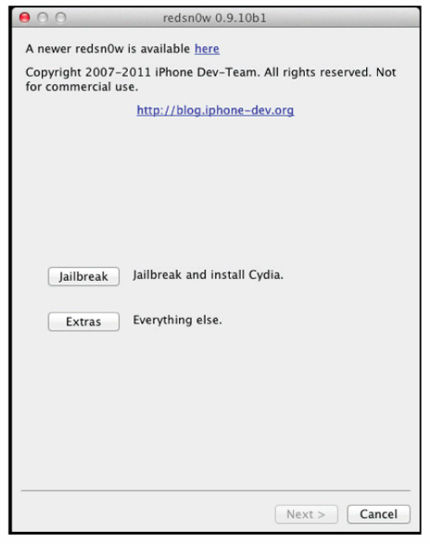
4. Launch the jailbreak app on the computer

Slide 29
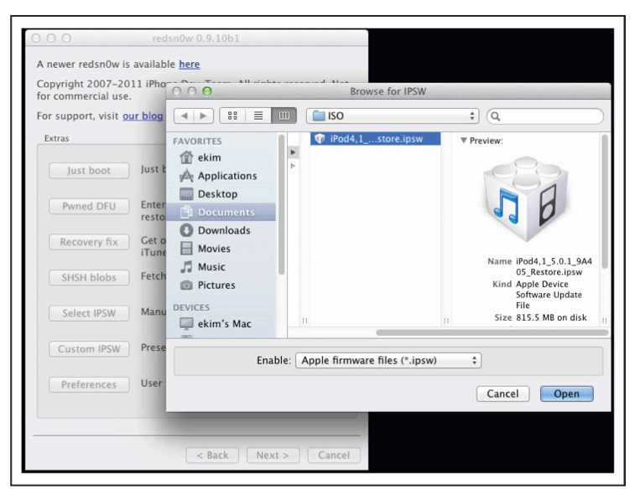
5. On the computer, select the IPSW file

Slide 30
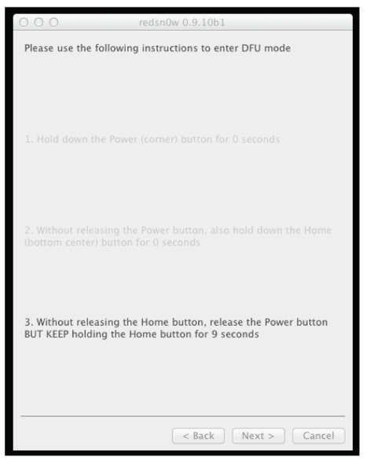
6. Put iDevice into Device Firmware Update (DFU) Mode
Hold power and home buttons down for 10 seconds
Release power and hold home down another 5 sec.

Slide 31
7. Wait
It takes a several minutes
Scary text scrolls by
I saw upside-down red error messages, then a totally black screen, then right-side-up green error messages, then another long black screen
Device reboots

Slide 32
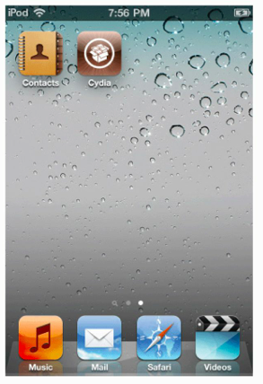
Cydia
Jailbroken iThings now have Cydia
The unrestricted App store

Slide 33
Remote Jailbreak

Slide 34
Much Easier
Boot-based jailbreaks require moderate technical expertise and a lot of time
Remote jailbreaks merely require loading a specially crafted PDF file into the iPhone's Mobile Safari web browser
Often hosted at jailbreakme.com

Slide 35
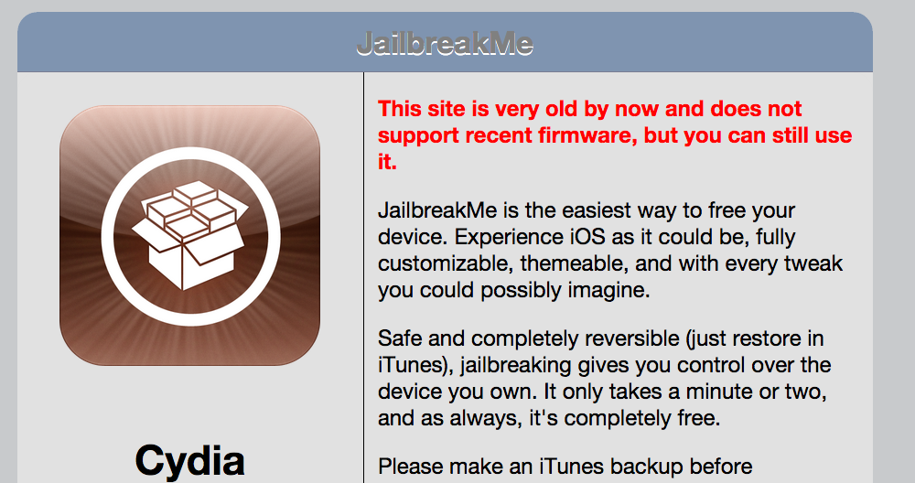
Jailbreakme.com
Only visible from an iDevice, or Google cache
Only works for older iOS (v4 and below)

Slide 36
Hacking into Someone Else's iPhone

Slide 37
Limited Attack Surface
Most network-based attacks are impossible
No browser plug-ins like Flash
No ability to download and execute a file, except from the App Store
Sneaking a malicious app into the App Store is not impossible, but very impractical
And you can only do it once, and then be banned

Slide 38
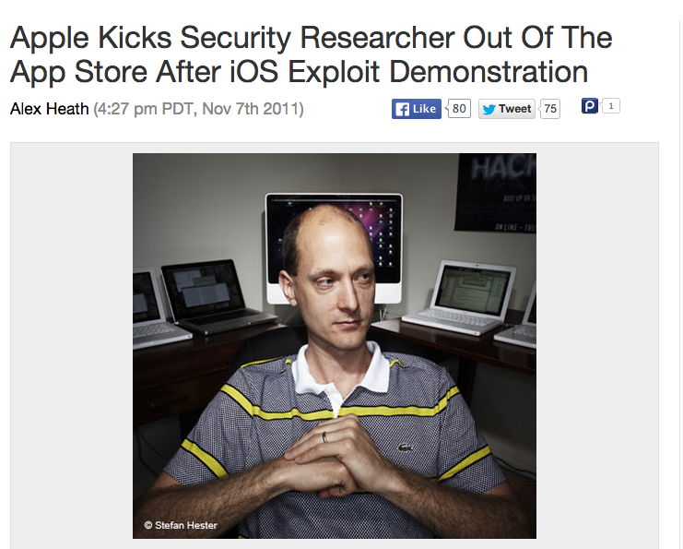

Slide 39
Network-Based Attacks
iOS has a minimal network profile
All or most access to network services is disabled by default
Some jailbroken devices have SSH running with the default password 'alpine'
A small but easily-exploited minority

Slide 40
Attack Vectors Available
Client-side vulnerabilities
Local network access
Typically by luring the device to connect to a malicious Wireless Access Point (WAP)
Physical access to a device
Can perform boot-based jailbreak
Requires a physical theft or seizure

Slide 41
Client-Side Attacks
Exploits have been found, mainly in Mobile Safari
Methods:
Host malicious files on Web servers
Deliver them via email

Slide 42
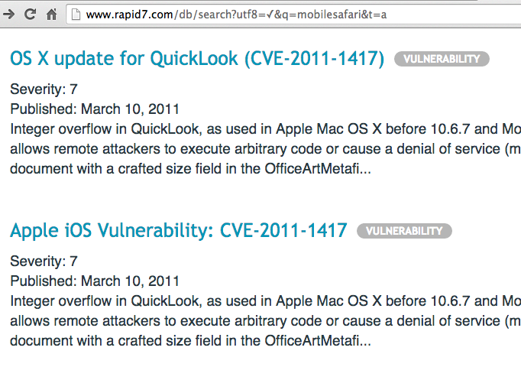
RCE Vulns in MobileSafari
Link Ch 3q

Slide 43
Sandbox
Third-party apps also have vulnerabilities
But exploit will be trapped in the app's sandbox
Enabling attacker to steal that app's data, but no more
Unless there is a kernel-level vuln to break out of sandbox
Kernel-level vulnerabilities are rare
Especially for modern iOS versions

Slide 44
Target Old Versions
Most practical measure
Use exploits when they are new, before users update their devices
Target users with old versions of iOS
iOS hacking tools are rare
Most effort goes into jailbreaking, which is usually done with the permission of the device's owner

Slide 45
Specific Attack Examples

Slide 46
The JailbreakMe 3.0 Vulns
Jailbreaking generally uses exploits locally
User downloads a file intentionally
But they can be used remotely
Trick user into downloading a malicious file
Deliver it via website, chat, email, etc.
JailbreakMe 3.0 exploited two vulns
A PDF bug
A kernel bug

Slide 47
Details
CVE-2011-0226
FreeType Type 1 Font-handling bug
Remote code execution
Specially crafted Type font in a PDF file
CVE-2011-0227
Invalid type conversion bug
Affecting IOMobileFrameBuffer
Leads to arbitrary code execution with system-level privileges (links Ch 3r, 3s)

Slide 48
Exploiting like JailbreakMe 3.0
View a malicious PDF in MobileSafari
Exploit logic takes over the app
Exploits the kernel to take full control of the device
Patched in iOS 4.3.4 (July, 2011)

Slide 49
JailBreakMe 3.0 Vuln Countermeasures
Updating iOS with latest patches is a security best practice
Jailbreaking requires you to stay behind, using a vulnerable version, and prevents you from putting on patches

Slide 50
Updates and Jailbreaking
Jailbreaking requires you to have an old, vulnerable iOS version
And you can't install patches from official sources
You either have to continue using an old, unpatched OS, or
Put patches on from unofficial sources, or
Update, and then re-jailbreak your device

Slide 51
Over-the-air Updates
iOS 5.0.1 and later introduces over-the-air patching for the OS and apps
You can install them on jailbroken devices

Slide 52
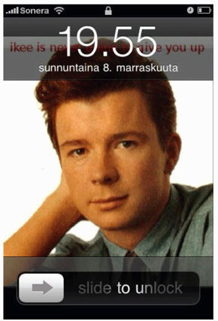
iKee Worm
Rickrolled people
Changed wallpaper to Rick Astley
Only affected iPhones that downloaded and ran SSH, and left the default password "alpine" unchanged

Slide 53
iKee
iKee was the first spreading worm on iOS
It scanned network blocks (in Netherlands and Australia) for open port 22
Attempted to log in with "root" and "alpine"
Once it got in:
Disabled SSH server
Change wallpaper
Make a local copy of the worm binary
Scan for and infect more devices

Slide 54
iKee Variants
Introduced botnet-like functionality
Remote control of infected devices via a command-and-control channel
A milestone
First and only publicly released , clear-cut, non-proof-of-concept example of malware successfully targeting iOS

Slide 55
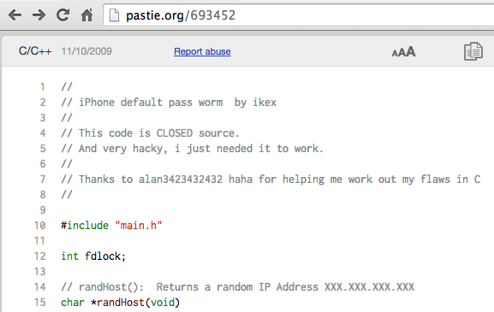
iKee Source Code
Link Ch 3t

Slide 56
iKee Countermeasures
Don't jailbreak your device
If you do, and install SSH, change the default password
Enable network services like SSH only when they are needed
Use SBSettings app
Upgrade to the latest jailbreakable version of iOS when possible
Install patches as soon as practicable

Slide 57
Attack Options for iOS
Remote network attacks exploiting vulnerable network services
Client-side attacks, including exploitation of app vulns
Local network attacks, such as MITM
Physical attacks that require access to the device

Slide 58
iOS Defenses
A fresh, new, iPhone has only one TCP port open
Port 62078
Port # incorrect in text (62087)
No known attacks for this service
Links Ch 3u, 3v

Slide 59
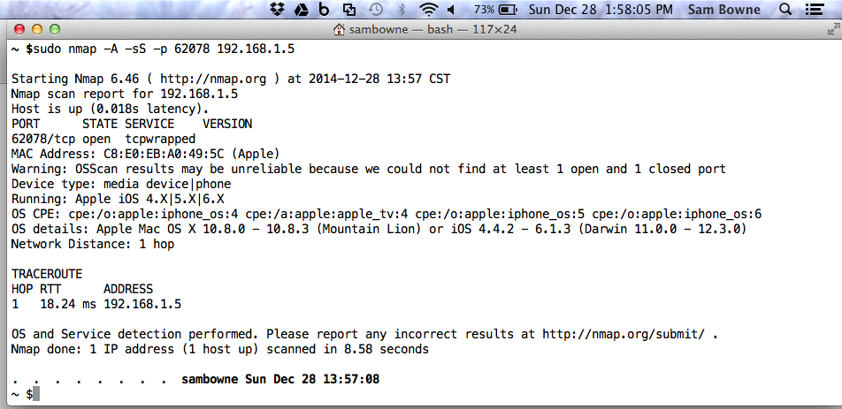
Port Scanning 62078
iPhone3 (Model A1429) with iOS 7.0.2

Slide 60
Remote Vulnerabilities
Reset device with ICMP request (ping of death)
CVE-2009-1683
Affected iOS 1.0 through 2.2.1
Link Ch 3w
Remote Code Execution via SMS
CVE-2009-2204
Affected iOS before 3.0.1
Links Ch 3x, 3y

Slide 61
Other Potentially Vulnerable Services
Bonjour (UDP 5353)
Other radio interfaces
Baseband
Cellular modem firmware (Link Ch 3z)
Wi-Fi driver
Bluetooth
etc.

Slide 62
Focus 11 MITM Attack
Attack laptop acts a rogue Wi-Fi access point
Target is tricked into connecting to it
Attacker is now in the middle
Attacker can intercept HTTPS traffic by exploiting the CVE-2011-0228 X.509 certificate chain validation vulnerability

Slide 63
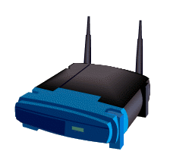
Focus11 MITM Attack
Attacker
Traffic to
Gmail
Modified
traffic
Target iPhone
Gateway
Google

Slide 64
Silent Exploitation
Attacker injected a JailbreakMe 3.0 PDF file into the Gmail page, modified to make no visible changes
No Cydia icon added
The PDF then loaded SSH and VNC servers on the device
The iPhone ends up owned, converted to a bot

Slide 65
Focus 2011 MITM Countermeasures
Update device
That stops the JailbreakMe 3.0 attack
And the HTTPS MITM attack
Don't join new, unknown Wi-Fi networks
Very impractical
Don't store sensitive data on your device
Also very impractical

Slide 66
App Store Security
To attack unjailbroken iDevices,
A malicious app must deceive the end-user, and also deceive Apple (to get into the App Store)
All apps must be signed by Apple
Apps can only be installed from the App Store
Review process is not detailed publicly
But it has been defeated a few times

Slide 67
Handy Light
Approved and placed in the store in 2010
Contained a hidden tethering feature
Use an iPhone as a wireless access point, for free
Violated an Apple policy against tethering apps
How did Apple miss that during the review process?

Slide 68
InstaStock
Approved in 2011
Charlie Miller wrote it
Exploited a zero-day vulnerability to place iPhones under remote control
Which allowed execution of unsigned apps

Slide 69
App Store Malware Countermeasures: Trust Apple
Risk is low, because of Apple policing the App Store
If there were antivirus or firewall products in the App Store, they might reduce this risk
But Apple won't approve them

Slide 70
Vulnerable Apps: Bundled and Third-Party
Bundled Apps
Included with iOS
Many vulns found, especially in Mobile Safari
Third-Party Apps
Not included, added later from the App Store
Very few important vulns found
But very few apps are universally installed
Like Flash on PC's

Slide 71
Third-Party App Vulns
CVE-2010-2913
Citi Mobile App v. 2.0.2 and below
Stored sensitive banking information on the device
A lost or stolen device could expose it
CVE-2010-4211
Paypal App X.509 certificate validation issue
Failure to validate server hostname values
Allows SSL MITM attacks

Slide 72
Third-Party App Vulns
Sept. 2011
XSS vuln in Skype app v. 3.0.1 and below
Script embedded in the "Full Name" field of messages could access the file system of Skype app users
Enabled an attacker to steal the contacts database

Slide 73
Third-Party App Vulns
April 2012
Multiple apps store authentication credentials insecurely
Including Facebook and Dropbox apps
Attacker could copy the credentials off the phone with an app such as iExplorer
And re-use the credentials to log in to others' accounts

Slide 74
Third-Party App Vulns
Jan. 2013
ESPN ScoreCenter app v. 3.0.0 had two issues
XSS vuln and cleartext authentication vuln
It did not sanitize user input, and transmitted it unencrypted over the network

Slide 75
Difficulty Exploiting Third-Party App Vulns
Gaining control over an app is only half the battle
Obtaining information from the target device, and persisting across app executions, are difficult, because of
App sandboxing
Code signature verification
True owning requires app-level vulns and kernel vulns

Slide 76
App Vulnerability Countermeasures
Update iOS and apps

Slide 77
Physical Access
Lots of important personal and business data is on iDevices these days
Devices are lost and stolen often
The encryption key did not depend on the passcode up through iOS 6.0.1
Enabling retrieval of stored passwords in just six minutes, by using a special boot script
Link Ch 3z2

Slide 78
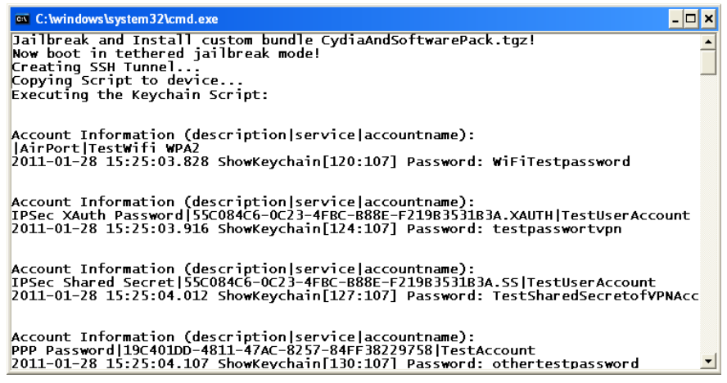

Slide 79
iExplorer
Installs on your computer
Connect iDevice with USB cable
Browse file system on iDevice and copy any files you like
But some are encrypted

Slide 80
Bypass Screen Lock
iOS versions through 8.0.2 allow a user to exploit them without knowing the passcode, by exploiting
Emergency call feature
Siri
Links Ch 3z3 – 3z5

Slide 81
Brute-Forcing Passcodes
Four-digit passcodes are intrinsically weak, and can be brute-forced
Link Ch 3z6
People often choose weak ones
Link Ch 3z7

Slide 82
IP-BOX iPhone Password Unlock Tool
Link Ch 3z8

Slide 83
Hacking iCloud
Not in textbook

Slide 84
Link Ch 3z9

Slide 89
iPhone 6 data is encrypted with a key based on the user's PIN
So Apple can't decrypt it, even in response to a court order
Link Ch 3z10

Slide 90
BUT Apple still has the keys to iCloud
Link Ch 3z11

Slide 91
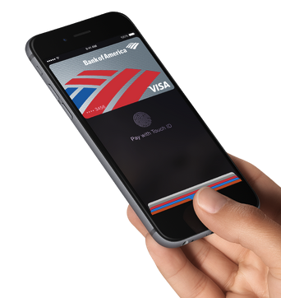
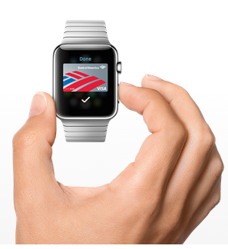
Apple Pay
Introduced with iPhone 6 in 2014
Uses NFC (Near Field Communication)
Better than Google Wallet (link Ch 3z13)

Slide 92
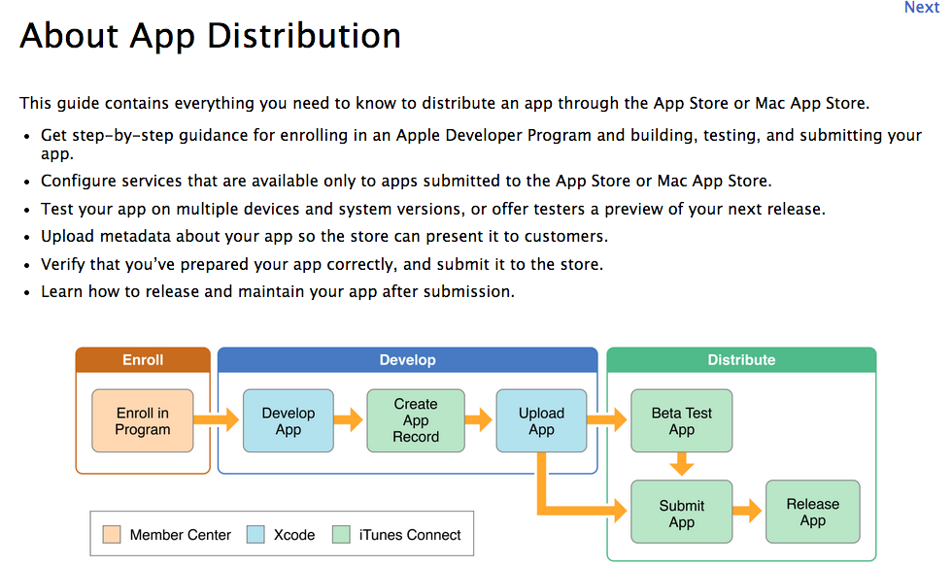
Making iPhone Apps
Links Ch 3z14, 15, 16

Slide 93
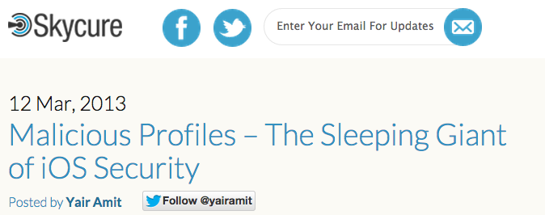
Malicious Configuration Files
Links Ch 3z17, 3z18, 3z19

Slide 94
Links Ch 3z17, 3z18, 3z19

Slide 96
