Slide 1
Developing Windows Exploits

Slide 2
Essential Steps
Fuzzing to find a crash
Debugging a crash
Targeting the EIP register
Identifying bad characters
Locating a vulnerable module with MONA
Generating exploit code with msfpayload
Creating final exploit code

Slide 3
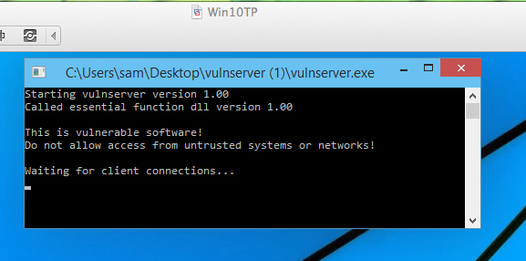
Vulnserver
Runs on Win 7 or later
Has many vulnerabilities

Slide 4
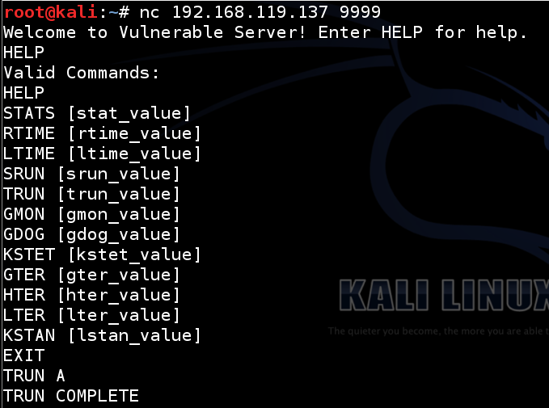

Slide 5
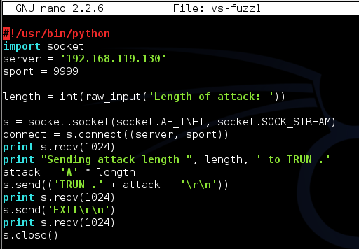
Fuzzing Program

Slide 6
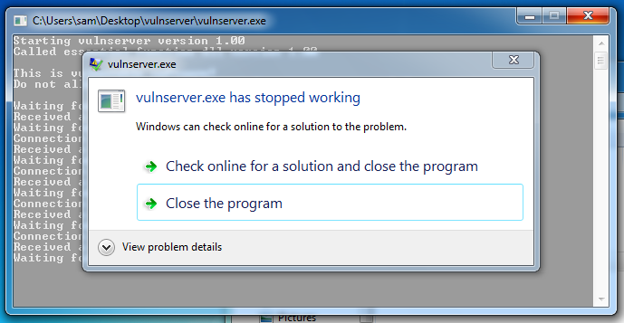
9000 "A" Causes a Crash

Slide 7
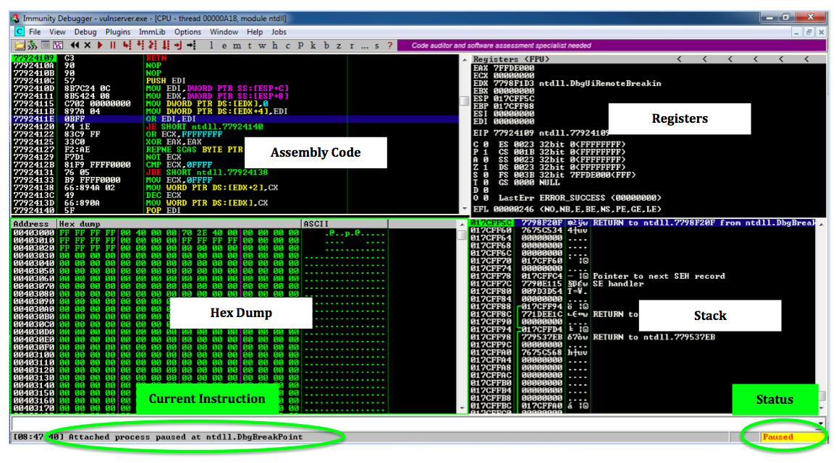
Immunity Debugger

Slide 8
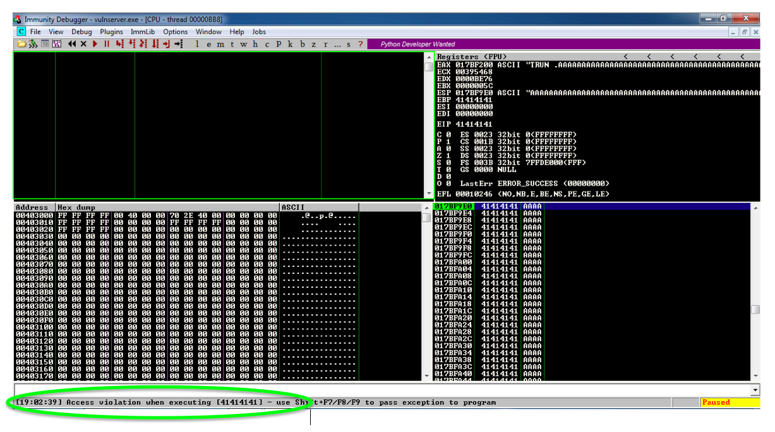
Exploitable Crash

Slide 9
Simple Buffer Overflow Exploit
We can control EIP
We'll use the simplest sort of buffer overflow
Inject code into exploit string
We can run code, if we can find it

Slide 10
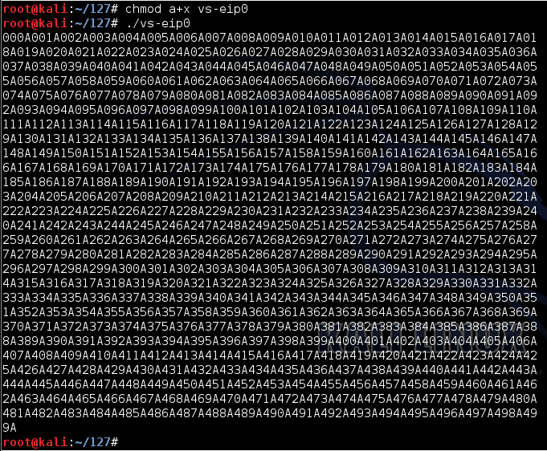
3000 Nonrepeating Characters

Slide 11
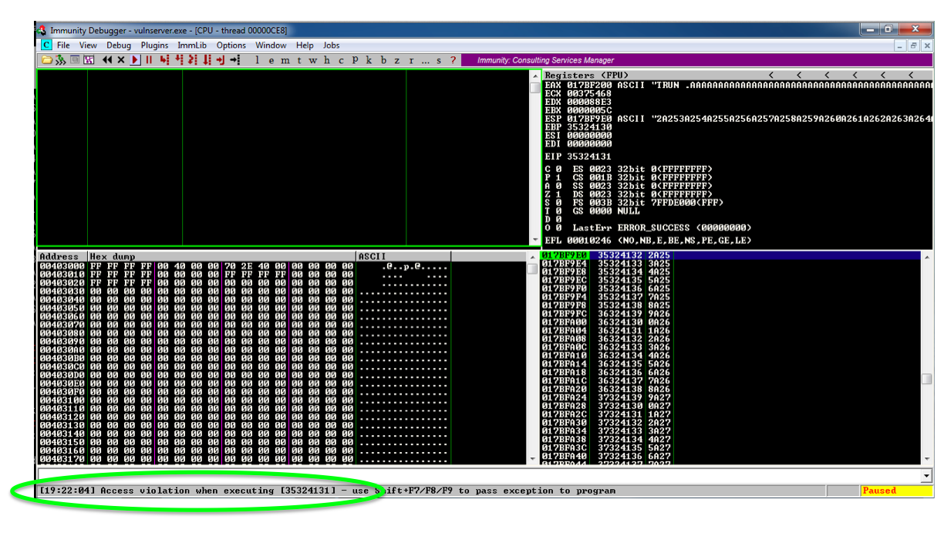
Locating EIP

Slide 12
Bad Characters

Slide 13
Vulnerable Module
Code must not move around in RAM

Slide 14
Finding a Vulnerable Module
We need code to be in a predictable RAM location
No ASLR, no Rebase
No null bytes in address (bad bytes)
Use essfunc.dll

Slide 15
JMP ESP in essfunc.dll

Slide 16
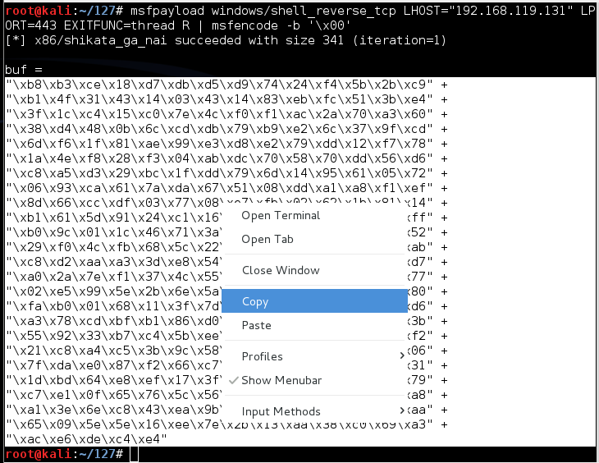
Create Exploit Code with Msfpayload

