Slide 1
Practical Malware Analysis
Ch 5: IDA Pro

Slide 2
IDA Pro Versions
Full-featured pay version
Old free version
Both support x86
Pay version supports x64 and other processors, such as cell phone processors
Both have code signatures for common library code in FLIRT (Fast Library identification and Recognition Technology)

Slide 3
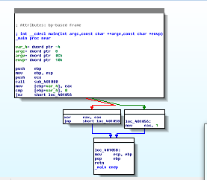
Graph and Text Mode
Spacebar switches mode

Slide 4
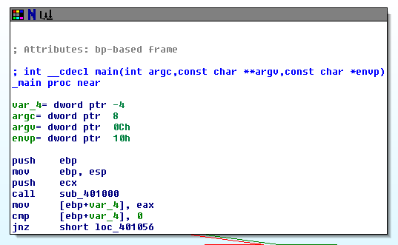
Default Graph Mode Display

Slide 5
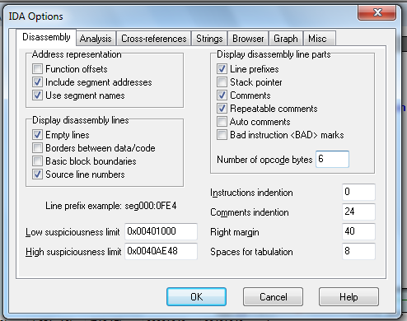
Options, General

Slide 6
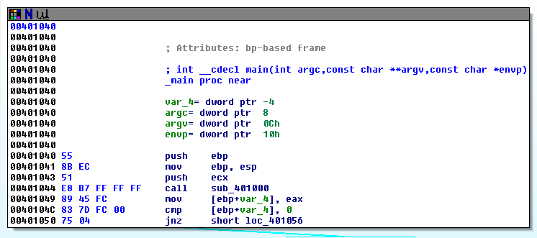
Better Graph Mode View

Slide 7
Arrows
Colors
Red Conditional jump not taken
Green Conditional jump taken
Blue Unconditional jump
Direction
Up Loop

Slide 8
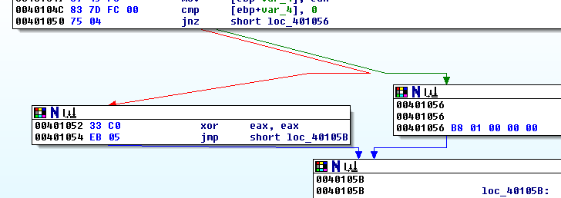
Arrow Color Example

Slide 9
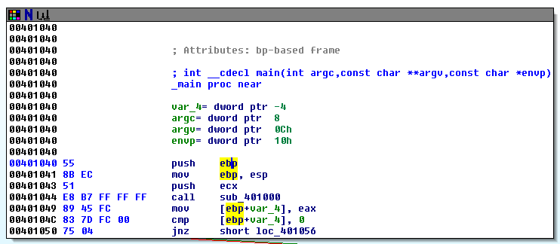
Highlighting
Highlighting text in graph mode highlights every instance of that text

Slide 10
Text Mode
Arrows
Solid = Unconditional
Dashed = Conditional
Up = Loop
Comment
Generated by
IDA Pro
Section
Address

Slide 11
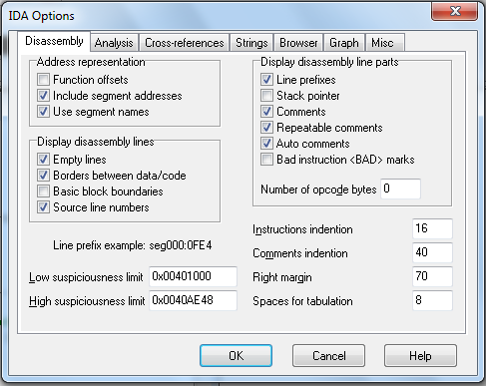
Options, General

Slide 12
Adds Comments to Each Instruction

Slide 13
Useful Windows for Analysis

Slide 14
Functions
Shows each function, length, and flags
L = Library functions
Sortable
Large functions usually more important

Slide 15
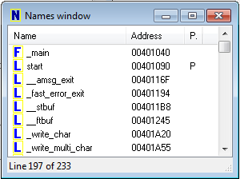
Names Window
Every address with a name
Functions, named code, named data, strings

Slide 16
Strings

Slide 17
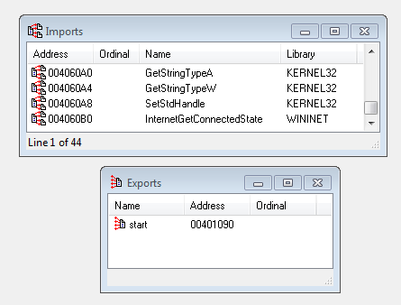
Imports & Exports

Slide 18
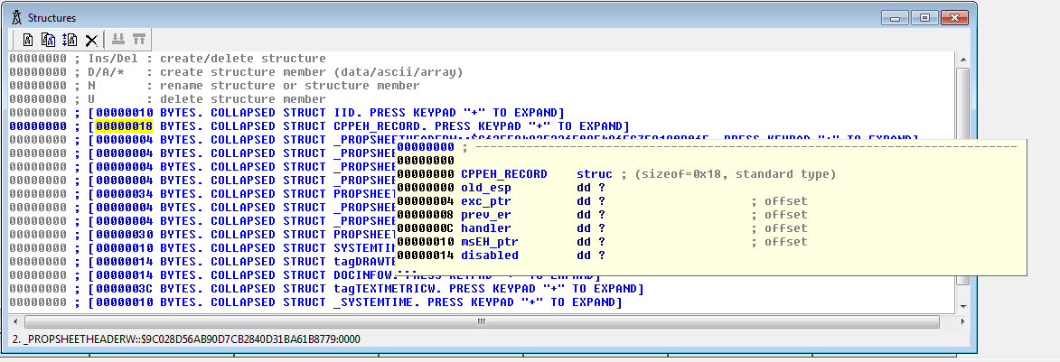
Structures
All active data structures
Hover to see yellow pop-up window

Slide 19
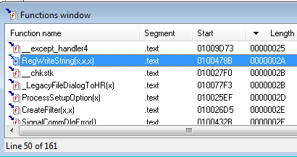
Cross- Reference
Double-click function
Jump to code in other views

Slide 20
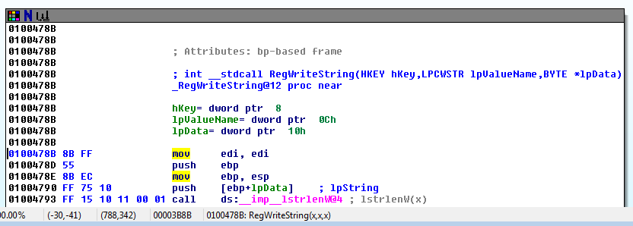
Function Call
Parameters pushed onto stack
CALL to start function

Slide 21
Returning to the Default View
Windows, Reset Desktop
Windows, Save Desktop
To save a new view

Slide 22
Navigating IDA Pro

Slide 23
Imports or Strings
Double-click any entry to display it in the disassembly window

Slide 24
Using Links
Double-click any address in the disassembly window to display that location

Slide 25
History
Forward and Back buttons work like a Web browser

Slide 26
Navigation Band
Light blue: Library code
Red: Compiler-generated code
Dark blue: User-written code – Analyze this

Slide 27
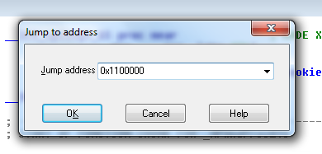
Jump to Location
Press G
Can jump to address or named location

Slide 28
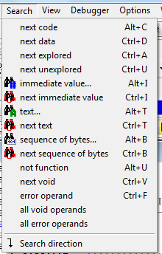
Searching
Many options
Search, Text is handy

Slide 29
Using Cross-References

Slide 30
Code Cross-References
XREF comment shows where this function is called
But it only shows a couple of cross-references by default

Slide 31
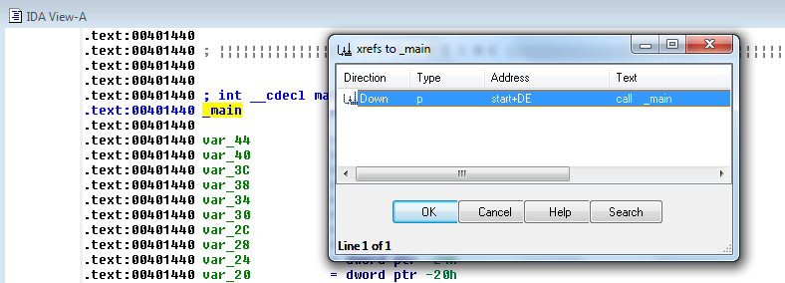
To See All Cross-References
Click function name and press X

Slide 32
Data Cross-References
Demo:
Start with strings
Double-click an interesting string
Hover over DATA XREF to see where that string is used
X shows all references

Slide 33
Analyzing Functions

Slide 34
Function and Argument Recognition
IDA Pro identifies a function, names it, and also names the local variables
It's not always correct

Slide 35
Using Graphing Options

Slide 36
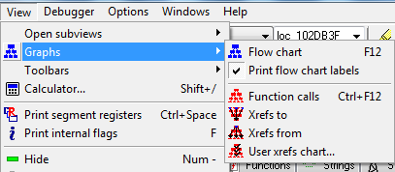
Graphing Options
+

Slide 37
Graphing Options
These are "Legacy Graphs" and cannot be manipulated with IDA
The first two seem obsolete
Flow chart
Create flow chart of current function
Function calls
Graph function calls for entire program

Slide 38
Graphing Options
Xrefs to
Graphs XREFs to get to selected XREF
Can show all the paths that get to a function

Slide 39
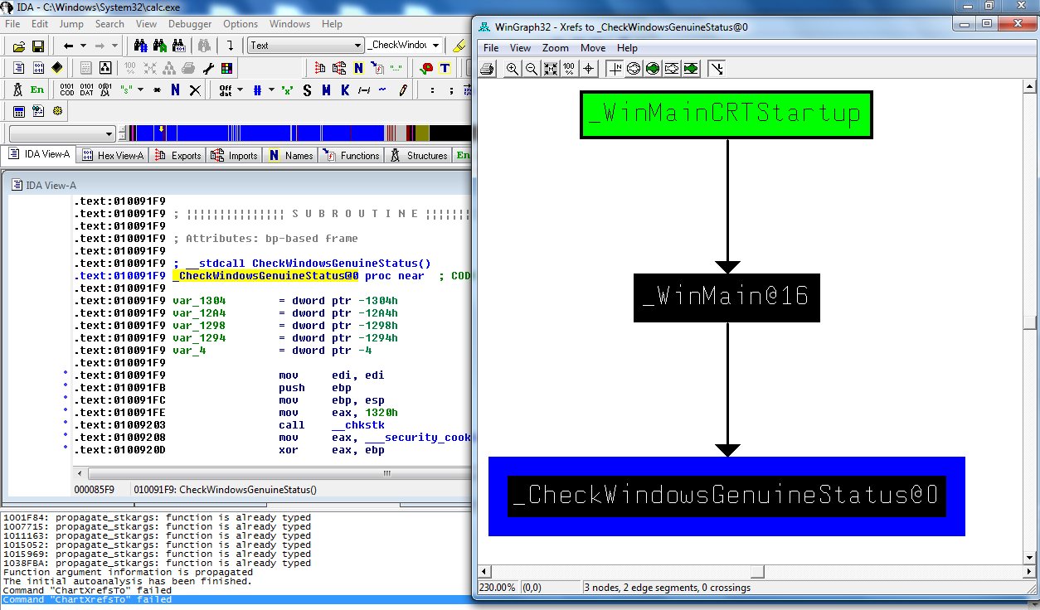
Windows Genuine Status in Calc.exe

Slide 40
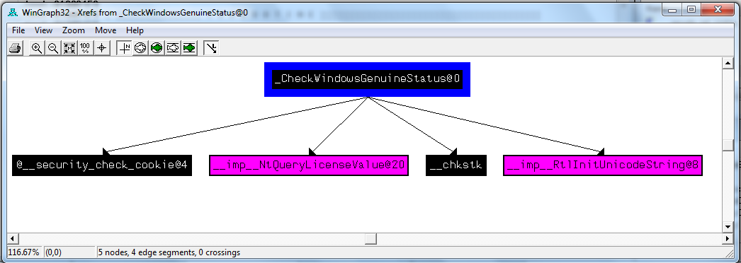
Graphing Options
Xrefs from
Graphs XREFs from selected XREF
Can show all the paths that exit from a function

Slide 41
Graphing Options
User xrefs chart...
Customize graph's recursive depth, symbols used, to or from symbol, etc.
The only way to modify legacy graphs

Slide 42
Enhancing Disassembly

Slide 43
Warning
There's no Undo, so if you make changes and mess them up, you may be sorry

Slide 44
Renaming Locations
You can change a name like sub_401000 to ReverseBackdoorThread
Change it in one place, IDA will change it everywhere else

Slide 45
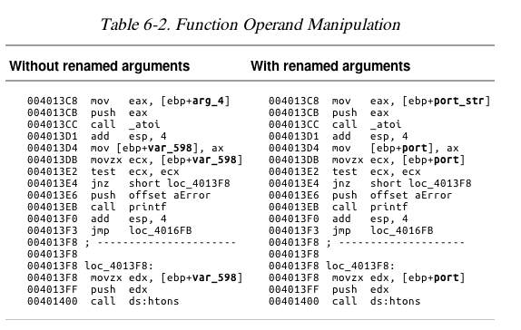

Slide 46
Comments
Press colon (:) to add a single comment
Press semicolon (;) to echo this comment to all Xrefs

Slide 47
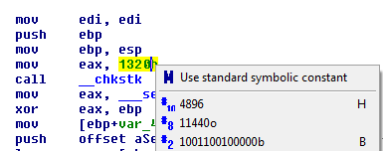
Formatting Operands
Hexadecimal by default
Right-click to use other formats

Slide 48
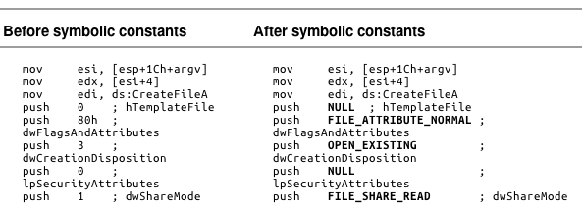
Using Named Constants
Makes Windows API arguments clearer

Slide 49
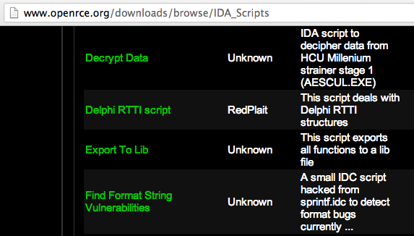
Extending IDA with Plug-ins
IDC (IDA's scripting language) and Python scripts available (link Ch 6a)

