Slide 1
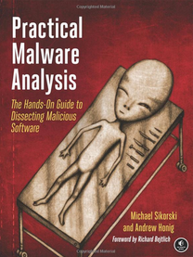
Practical Malware Analysis
Ch 13: Data Encoding
Revised 11-24-14

Slide 2
The Goal of Analyzing Encoding Algorithms

Slide 3
Reasons Malware Uses Encoding
Hide configuration information
Such as C&C domains
Save information to a staging file
Before stealing it
Store strings needed by malware
Decode them just before they are needed
Disguise malware as a legitimate tool
Hide suspicious strings

Slide 4
Simple Ciphers

Slide 5
Why Use Simple Ciphers?
They are easily broken, but
They are small, so they fit into space-constrained environments like exploit shellcode
Less obvious than more complex ciphers
Low overhead, little impact on performance
These are obfuscation, not encryption
They make it difficult to recognize the data, but can't stop a skilled analyst

Slide 6
Caesar Cipher
Move each letter forward 3 spaces in the alphabet
ABCDEFGHIJKLMNOPQRSTUVWXYZ
DEFGHIJKLMNOPQRSTUVWXYZABC
Example
ATTACK AT NOON
DWWDFN DW QRRQ

Slide 7
XOR
0 xor 0 = 0
0 xor 1 = 1
1 xor 0 = 1
1 xor 1 = 0
Uses a key to encrypt data
Uses one bit of data and one bit of the key at a time
Example: Encode HI with a key of 0x3c
HI = 0x48 0x49 (ASCII encoding)
Data: 0100 1000 0100 1001
Key: 0011 1100 0011 1100
Result: 0111 0100 0111 0101

Slide 8
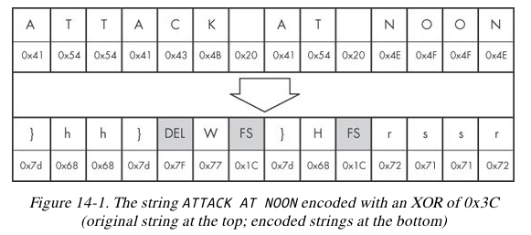

Slide 9
XOR Reverses Itself
0 xor 0 = 0
0 xor 1 = 1
1 xor 0 = 1
1 xor 1 = 0
Example: Encode HI with a key of 0x3c
HI = 0x48 0x49 (ASCII encoding)
Data: 0100 1000 0100 1001
Key: 0011 1100 0011 1100
Encode it again
Result: 0111 0100 0111 0101
Key: 0011 1100 0011 1100
Data: 0100 1000 0100 1001

Slide 10
Brute-Forcing XOR Encoding
If the key is a single byte, there are only 256 possible keys
Error in book; this should be "a.exe"
PE files begin with MZ

Slide 11
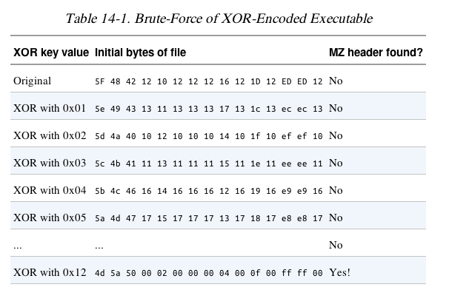
MZ = 0x4d 0x5a

Slide 13
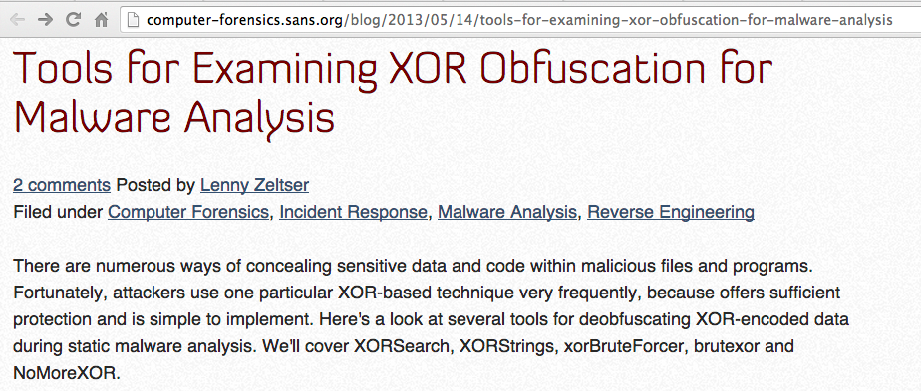
Link Ch 13a

Slide 14
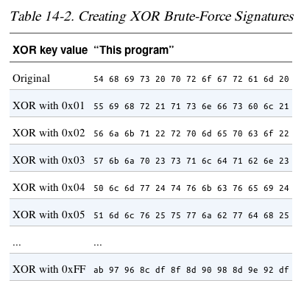
Brute-Forcing Many Files
Look for a common string, like "This Program"

Slide 15
XOR and Nulls
A null byte reveals the key, because
0x00 xor KEY = KEY
Obviously the key here is 0x12

Slide 16
NULL-Preserving Single-Byte XOR Encoding
Algorithm:
Use XOR encoding, EXCEPT
If the plaintext is NULL or the key itself, skip the byte

Slide 18
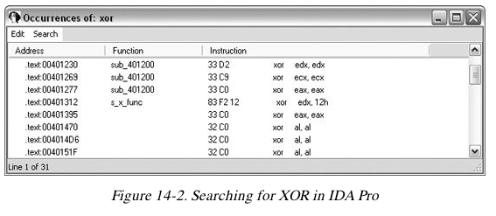
Identifying XOR Loops in IDA Pro
Small loops with an XOR instruction inside
Start in "IDA View" (seeing code)
Click Search, Text
Enter xor and Find all occurrences

Slide 19
Three Forms of XOR
XOR a register with itself, like xor edx, edx
Innocent, a common way to zero a register
XOR a register or memory reference with a constant
May be an encoding loop, and key is the constant
XOR a register or memory reference with a different register or memory reference
May be an encoding loop, key less obvious

Slide 20
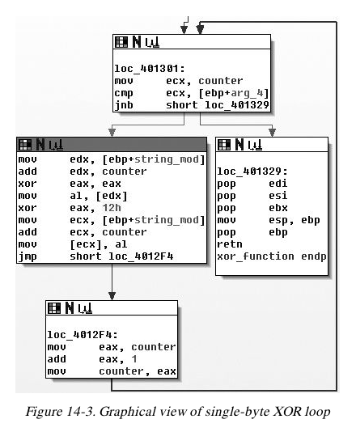

Slide 21
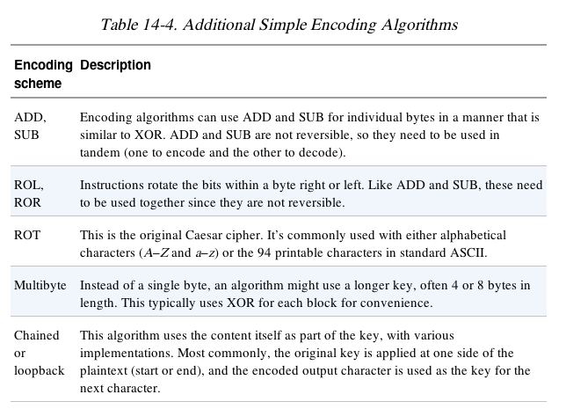

Slide 22
Base64
Converts 6 bits into one character in a 64-character alphabet
There are a few versions, but all use these 62 characters:
ABCDEFGHIJKLMNOPQRSTUVWXYZ
abcdefghijklmnopqrstuvwxyz
0123456789
MIME uses + and /
Also = to indicate padding

Slide 23
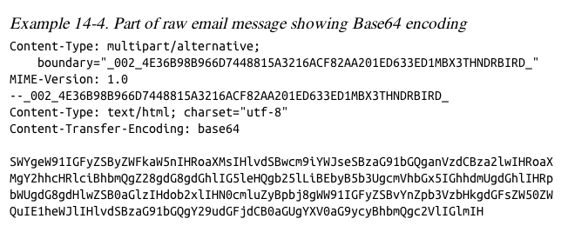

Slide 24
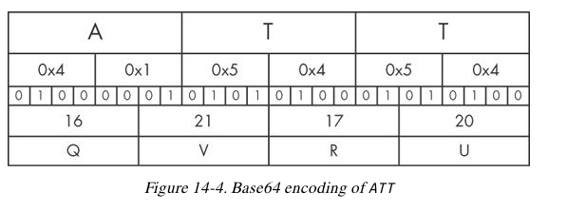
Transforming Data to Base64
Use 3-byte chunks (24 bits)
Break into four 6-bit fields
Convert each to Base64

Slide 25
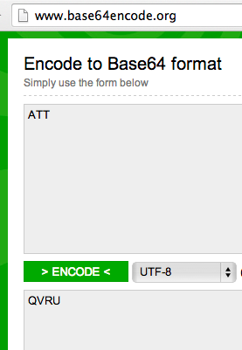
base64encode.org base64decode.org
3 bytes encode to 4 Base64 characters

Slide 26
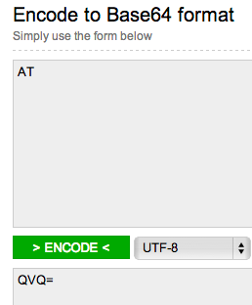
Padding
If input had only 2 characters, an = is appended

Slide 27
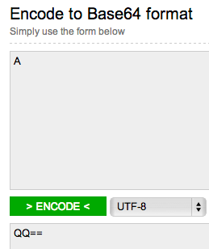
Padding
If input had only 1 character, == is appended

Slide 28
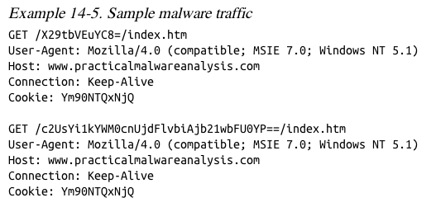
Example
URL and cookie are Base64-encoded

Slide 29
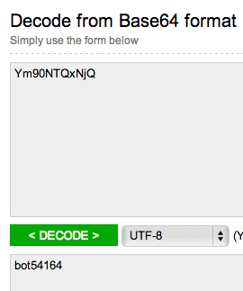
Cookie: Ym90NTQxNjQ
This has 11 characters—padding is omitted
Some Base64 decoders will fail, but this one just automatically adds the missing padding

Slide 30
Finding the Base64 Function
Look for this "indexing string"
ABCDEFGHIJKLMNOPQRSTUVWXYZabcdefghijklmnopqrstuvwxyz0123456789+/
Look for a lone padding character (typically =) hard-coded into the encoding function

Slide 31
Decoding the URLs
Custom indexing string
aABCDEFGHIJKLMNOPQRSTUVWXYZbcdefghijklmnopqrstuvwxyz0123456789+/
Look for a lone padding character (typically =) hard-coded into the encoding function

Slide 33
Common Cryptographic Algorithms

Slide 34
Strong Cryptography
Strong enough to resist brute-force attacks
Ex: SSL, AES, etc.
Disadvantages of strong encryption
Large cryptographic libraries required
May make code less portable
Standard cryptographic libraries are easily detected
Via function imports, function matching, or identification of cryptographic constants
Symmetric encryption requires a way to hide the key

Slide 35
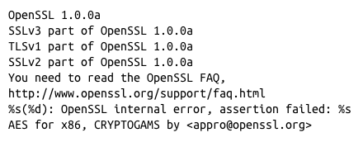
Recognizing Strings and Imports
Strings found in malware encrypted with OpenSSL

Slide 36
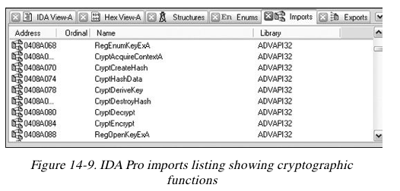
Recognizing Strings and Imports
Microsoft crypto functions usually start with Crypt or CP or Cert

Slide 37
Searching for Cryptographic Constants
IDA Pro's FindCrypt2 Plug-in (Link Ch 13c)
Finds magic constants (binary signatures of crypto routines)
Cannot find RC4 or IDEA routines because they don't use a magic constant
RC4 is commonly used in malware because it's small and easy to implement

Slide 38
FindCrypt2
Runs automatically on any new analysis
Can be run manually from the Plug-In Menu

Slide 39
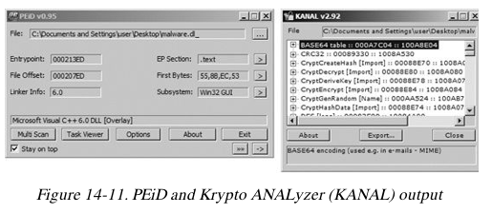
Krypto ANALyzer (PEiD Plug-in)
Download from link Ch 13d
Has wider range of constants than FindCrypt2
More false positives
Also finds Base64 tables and crypto function imports

Slide 40
Entropy
Entropy measures disorder
To calculate it, just count the number of occurrences of each byte from 0 to 255
Calculate Pi = Probability of value i
Then sum Pi log( Pi) for I = 0 to 255 (Link 13e)
If all the bytes are equally likely, the entropy is 8 (maximum disorder)
If all the bytes are the same, the entropy is zero

Slide 41
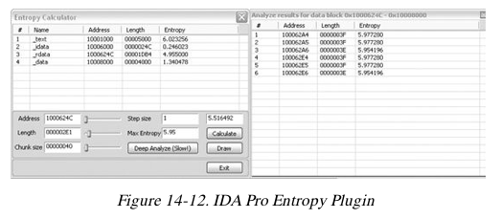
Searching for High-Entropy Content
IDA Pro Entropy Plugin
Finds regions of high entropy, indicating encryption (or compression)

Slide 42
Recommended Parameters
Chunk size: 64 Max. Entropy: 5.95
Good for finding many constants,
Including Base64-encoding strings (entropy 6)
Chunk size: 256 Max. Entropy: 7.9
Finds very random regions

Slide 43
Entropy Graph
IDA Pro Entropy Plugin
Download from link Ch 13g
Use StandAlone version
Double-click region, then Calculate, Draw
Lighter regions have high entropy
Hover over graph to see numerical value

Slide 44
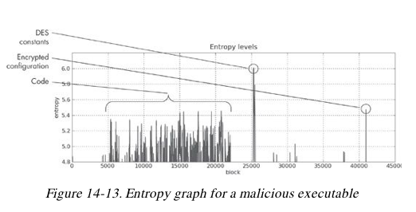

Slide 45
Custom Encoding

Slide 46
Homegrown Encoding Schemes
Examples
One round of XOR, then Base64
Custom algorithm, possibly similar to a published cryptographic algorithm

Slide 47
Identifying Custom Encoding
This sample makes a bunch of 700 KB files
Figure out the encoding from the code
Find CreateFileA and WriteFileA
In function sub_4011A9
Uses XOR with a pseudorandom stream

Slide 48
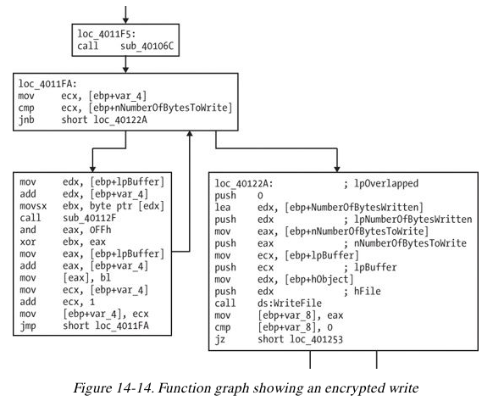

Slide 49
Advantages of Custom Encoding to the Attacker
Can be small and nonobvious
Harder to reverse-engineer

Slide 50
Decoding

Slide 51
Two Methods
Reprogram the functions
Use the functions in the malware itself

Slide 52
Self-Decoding
Stop the malware in a debugger with data decoded
Isolate the decryption function and set a breakpoint directly after it
BUT sometimes you can't figure out how to stop it with the data you need decoded

Slide 53
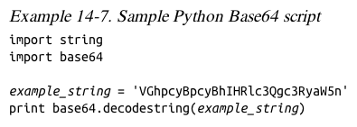
Manual Programming of Decoding Functions
Standard functions may be available

Slide 54
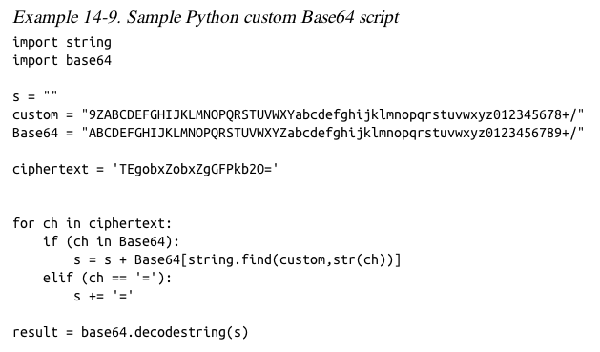

Slide 55
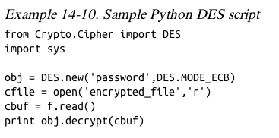
PyCrypto Library
Good for standard algorithms

Slide 56
How to Decrypt Using Malware

Slide 57
