Slide 1
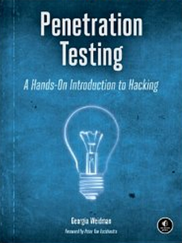
CNIT 124: Advanced Ethical Hacking
Ch 13: Post Exploitation
Part 2

Slide 2
Topics
Local Information Gathering
Lateral Movement
Pivoting
Persistence

Slide 3
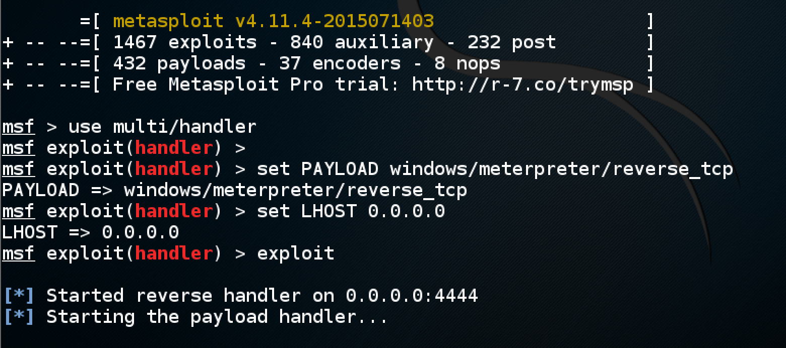
Creating Infectious Media

Slide 4
Local Information Gathering

Slide 5
Sensitive Information
Useful data to include in final report to customer
Installed software that stores passwords in plaintext
Or weakly hashed
Proprietary data or source code
Credit card information
CEO's email account
Information to pivot to other systems

Slide 6
Searching for Files

Slide 7
Keylogging
Meterpreter has keyscan_start and keyscan_dump
Only capture keystrokes from the process meterpreter is running in
From explorer.exe it gets one user's keystrokes
From winlogon it would get login passwords
Smartlocker will fool the user by waiting a while before locking the user out
to prompt a login (Link Ch 13g)

Slide 8
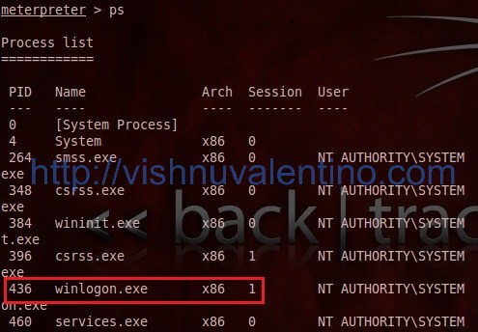
Migrating to Winlogin
Link Ch 13e

Slide 9
Gathering Credentials

Slide 10
WinSCP Can Store Passwords

Slide 11
WinSCP

Slide 12
Stealing WinSCP Passwords

Slide 13
credential_collector

Slide 14
credential_collector

Slide 15
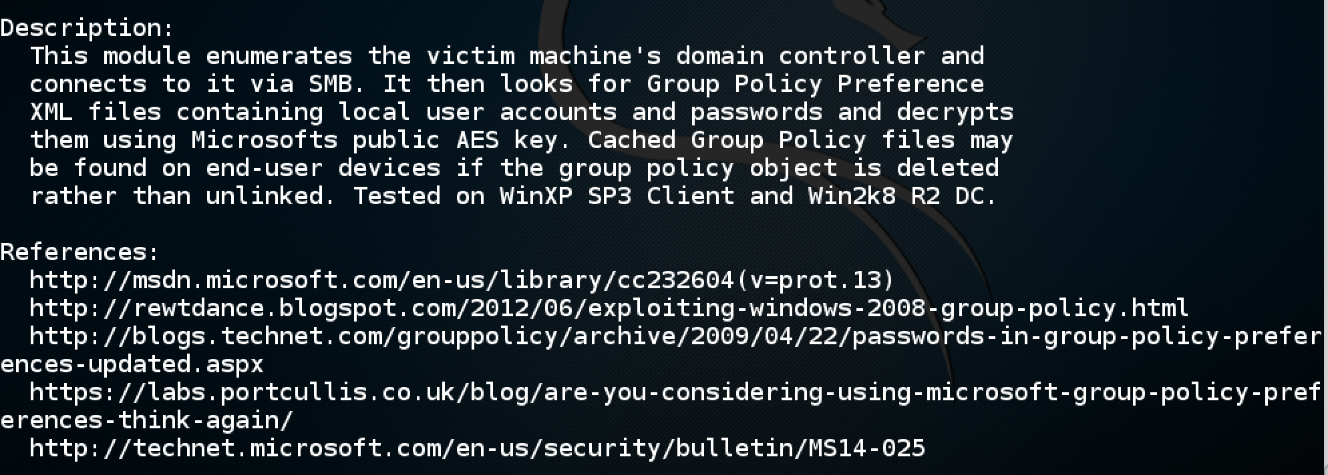
Group Policy Preference Saved Passwords

Slide 16
McAfee Virus Scan Enterprise Password Hashes

Slide 17
Outlook

Slide 18
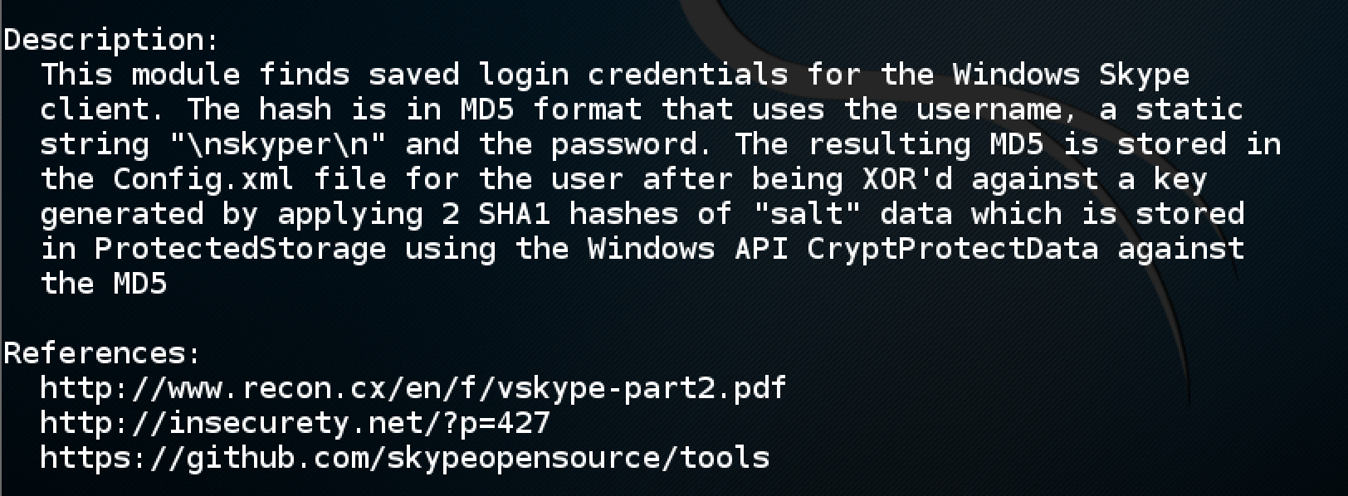
Skype

Slide 19
net
Windows command line
net users
Shows all local users
net localgroup Administrators
Shows local administrators
Also works for domain accounts
Can also add a user

Slide 20
Processes
ps shows processes
May reveal other vulnerable processes
Such as UDP listeners
Which can't easily be detected with nmap

Slide 21
Bash History
.bash_history in a user's home directory
May contain passwords or other useful information

Slide 22
Lateral Movement

Slide 23
Moving from One Host to Another
In a domain
Compromise a domain account; it will work on many computers
Get domain administrator account for full control of the whole domain
Non-domain computers
May have the same local administrator password because they are all from the same image
A user may have accounts on several computers with the same password

Slide 24
PSExec
Uploads a service executable to the ADMIN$ share
Connects to Windows Service Control Manager using RPC
Starts the service
Starts a SMB named pipe to send commands to remotely control the system

Slide 25
exploit/windows/smb/psexec
Metasploit module does something similar
Requires a running SMB server
And credentials that give access to the ADMIN$ share

Slide 27
Passwords v. Hashes
Notice that the SMB attack used the plaintext password
What if you only have a hash you can't crack?

Slide 28
Getting the Hashes
First you need the hash
Try all of these Meterpreter commands
hashdump
run post/windows/gather/hashdump
run post/windows/gather/smart_hashdump

Slide 29
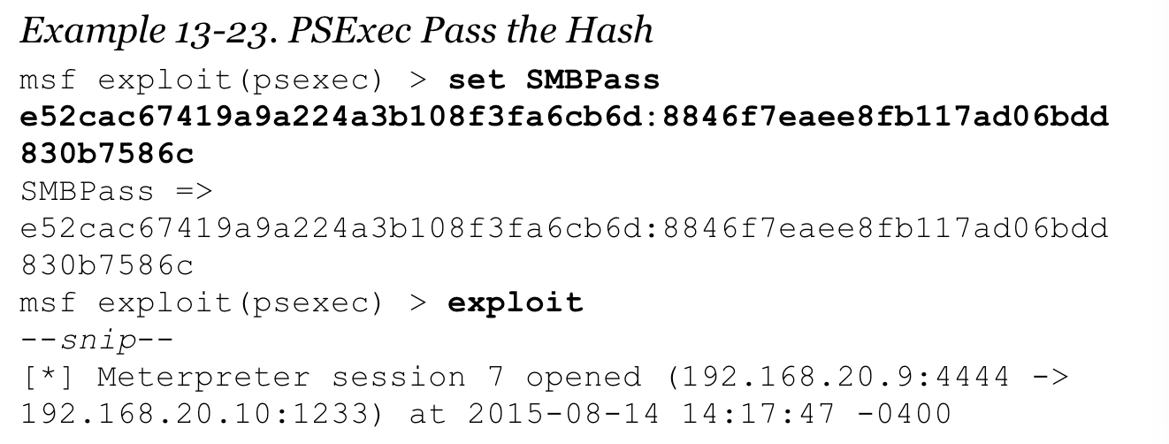
Pass the Hash Attack
Use hash instead of password
Works on most Windows systems

Slide 31
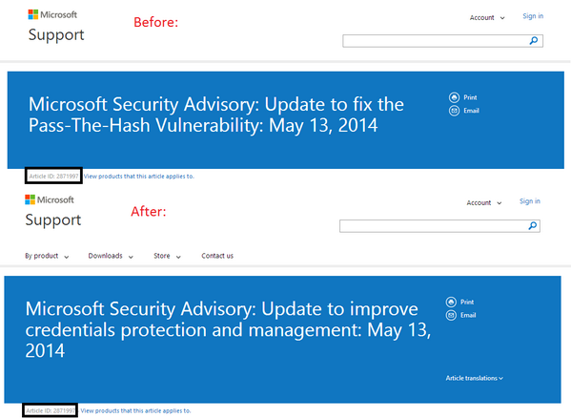
Pass the Hash: Fixed?
Microsoft changed the advisory title quickly

Slide 32
Pass the Hash Still Works
But it's more complicated, especially on the newest Windows systems
Links Ch 13h, 13i

Slide 33
SSHExec
Metasploit module allows one set of credentials to be used against other Linux systems
Requires plaintext password

Slide 36
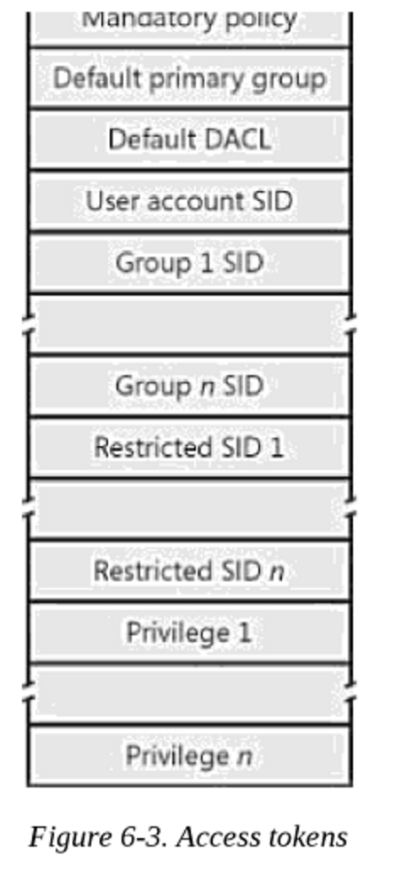
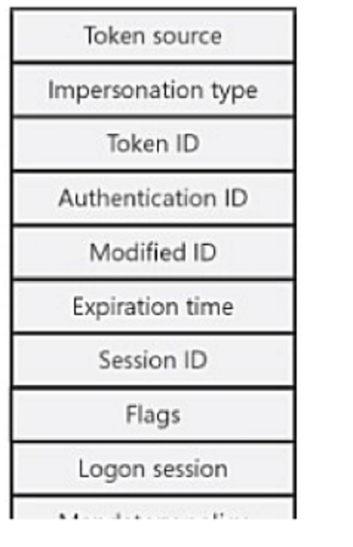
Windows Tokens
Created when a user logs on
By LSASS
Link Ch 13k

Slide 37
Token in Process Hacker

Slide 38
Token in Process Explorer

Slide 39
Token Identifies User
Like a cookie on a Web page
Two types of tokens
Delegation token
"Interactive" sessions
Users logged on locally or via Remote Desktop
Impersonation token
Non-interactive sessions
Attaching to a network drive
Domain logon script

Slide 40
Token Lifetime
Tokens persist until a reboot
User logoff doesn't invalidate them
"their delegate token is reported as a impersonate token, but will still hold all of the rights of a delegate token"
Link Ch 13o

Slide 41
Using Incognito

Slide 42
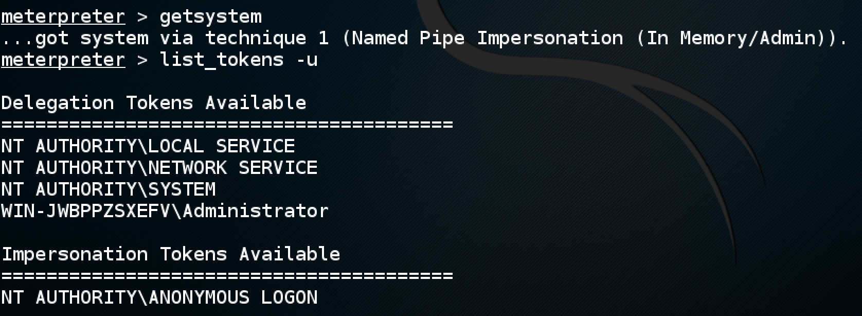

Slide 43
Impersonation

Slide 44
Available Tokens
This box is boring, not many tokens available
On a file server, there will be a token for each connected user

Slide 45
SMB Capture
Domain password hashes are only stored on the domain controller
hashdump on a workstation won't find them
You can steal the network hash by running a malicious SMB server with Metasploit

Slide 46
Metasploit's SMB Capture

Slide 47
Stolen Hashes

Slide 48
NTLMv2
Windows Vista and later use NTLMv2 over the network
It adds HMAC and challenges to the system
This makes it much slower to brute-force
Links Ch 13p, 13q

Slide 49
Pivoting

Slide 50
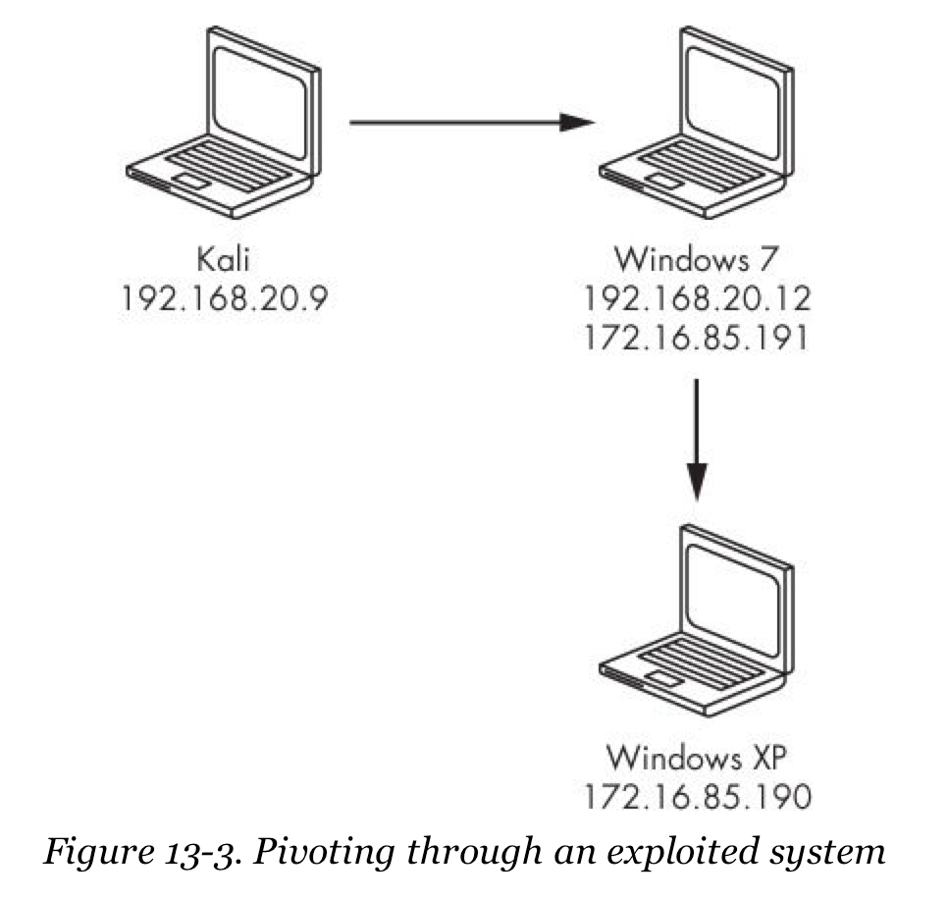
Pivoting Through an Exploited System
Needed in a properly segmented network
Won't allow traffic from the Internet directly to high-value systems

Slide 51
Metasploit Routing
route command sends all metasploit traffic through the exploited system
But this only affects traffic generated by metasploit

Slide 52
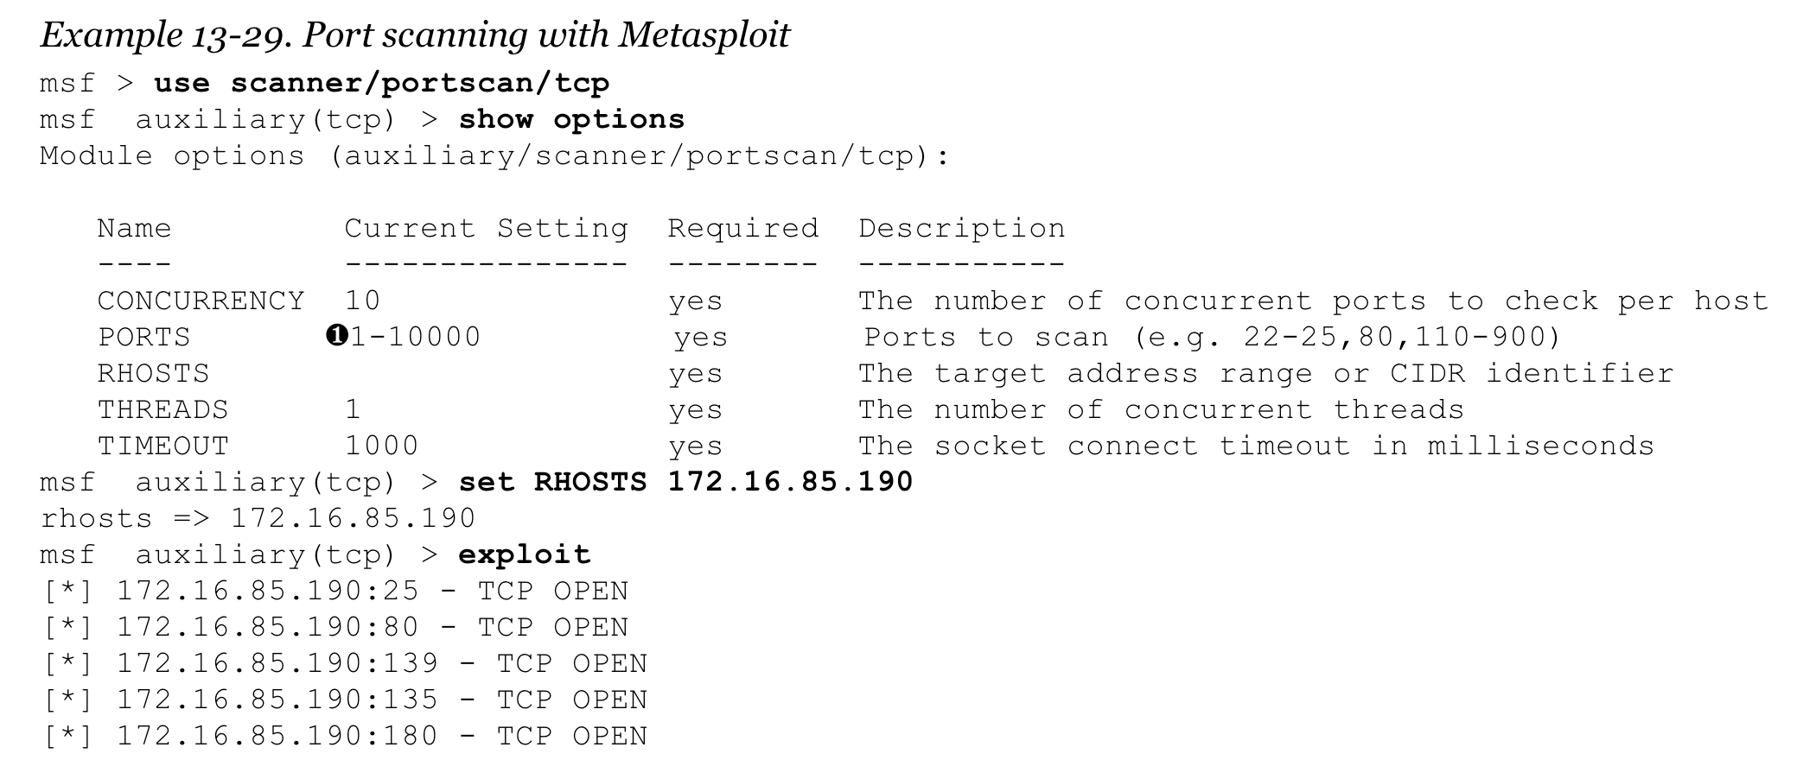
Metasploit Port Scanners
Very basic, fewer features than nmap

Slide 53
Running an Exploit Through a Pivot
Bind shell will work for traffic generated by Metasploit
It will be forwarded through the exploited system

Slide 54
Socks Proxy
An old way to make an Internet gateway, before Network Address Translation
Requires each client to run Socks client software
Client IP addresses are hidden
All Internet connections are initiated directly from the server
Link Ch 13r

Slide 55
Tor
Tor uses Socks proxies
Allow all network traffic to be passed through the proxies
Any protocol, any port

Slide 56
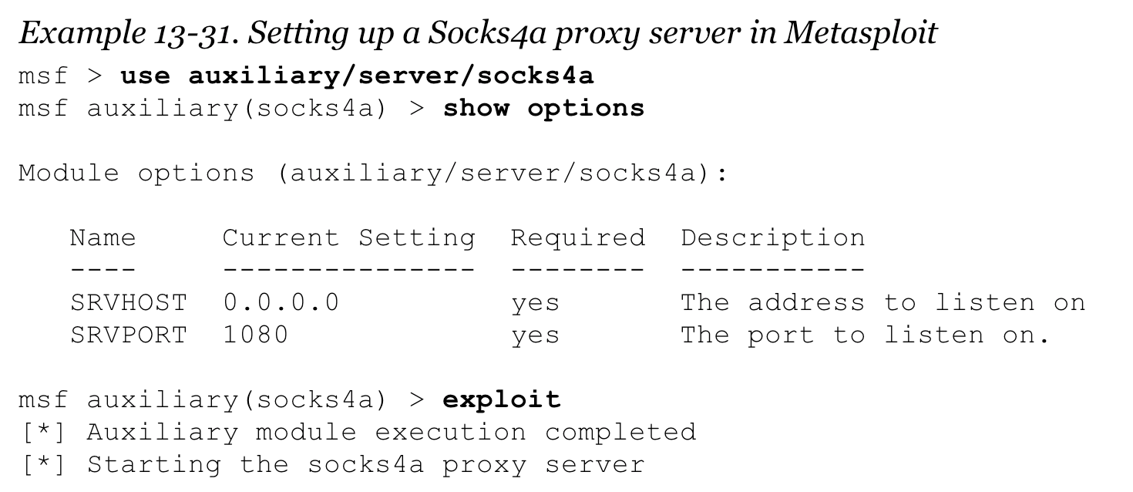
Socks4a in Metasploit
Sets up a Socks4a server in Metasploit
This uses proxychains

Slide 57
Proxychains
By default, configured to use Tor
Must change /etc/proxychains.conf to point to the Metasploit Socks4a listener

Slide 58
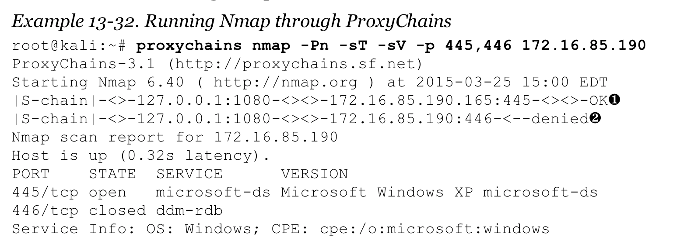
Nmap Through Proxychains
Run any tool through the pivot
Preface each command with proxychains

Slide 59
Persistence

Slide 60
Losing Access
A Metasploit session resides on RAM
Within the exploited process
When the user logs out, or closes the browser, the session may be lost
Even network interrupts may break the session
It's hard to re-exploit the target
Especially if the attack uses social engineering

Slide 61
Persistence
A way to control the machine after the Metasploit session ends
Should survive log-off and even reboot

Slide 62
Adding a User
Then connect directly via SSH, RDP, etc.
In a Windows Command Prompt
net user james password /add
net localgroup Administrators james /add
Can also be used to create a domain account
If you have domain administrator credentials
On Linux, use adduser and add the user to the sudoers group

Slide 63
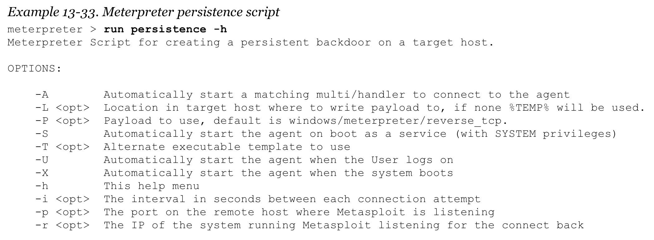
Metasploit Persistence
Automatically connects back to the attacker at every login, reboot, etc.

Slide 64
Disk Usage
Persistence agent is written to disk
VBscript script is uploaded to %TEMP%
Registry entry is made to automatically run it

Slide 65
Linux cron Job
Add this line to /etc/crontab
It will connect back every 10 minutes
Then restart the cron service
service cron restart

Slide 66
A Better cron Script
Tests to see if knockd is running
Only runs it again if necessary
#!/bin/bashp
ipgrep knockd
if [ $? -eq 1 ]; then
nohup /usr/sbin/knockd -c /etc/knockd.conf &
fi

Slide 67
A Simple Packet Forwarding Server
Makes it possible to log traffic to a server without altering it at all
Redirect the DNS record to this cloud server
echo 1 >/proc/sys/net/ipv4/ip_forward
iptables -t nat -A PREROUTING -p tcp --dport 80 -j DNAT --to-destination 1.2.3.4
iptables -t nat -A PREROUTING -p tcp --dport 20:21 -j DNAT --to-destination 1.2.3.4
iptables -t nat -A PREROUTING -p tcp --dport 1025:65535 -j DNAT --to-destination 1.2.3.4
iptables -t nat -A POSTROUTING -p tcp -d 1.2.3.4 --dport 80 -j MASQUERADE
iptables -t nat -A POSTROUTING -p tcp -d 1.2.3.4 --dport 20:21 -j MASQUERADE
iptables -t nat -A POSTROUTING -p tcp -d 1.2.3.4 --dport 1025:65535 -j MASQUERADE

