Slide 1
Computer Forensics Infosec Pro Guide
Ch 4
How to Approach a Computer Forensics Investigation
Revised 2-2-15

Slide 2
Topics
Investigative process
Testing your hypothesis
Assessing the forensic data landscape
How to determine what you have authority to access

Slide 3
Investigative process

Slide 4
Basics
Target of investigation is a suspect
Know what you are being asked to find ou
You need authorization to perform an investigation
Honey pot is a system designed to attract attackers, so their activities can be monitored

Slide 5
Where Would the Data Exist?
Ex: viewing indecent images at work
Outbound proxy or web-filtering log
Computer used for viewing the images
Firewalls logging outbound access
What applications might have been used to create the data?
Often a Web browser; Chrome, IE, Safari, etc.
Should you request to go beyond the scope of an investigation?

Slide 6
Data Carving
Reconstructing files from unallocated blocks of data
Also called latent data
Uses file headers and footers, also called file signatures
Active data
Files and folders that are in the directory
No carving needed to reconstruct them

Slide 7
Should You Request to Go Beyond the Scope of an Investigation?
Child Pornography: STOP THE INVESTIGATION
You are legally required to notify the National Center for Missing and Exploited Children
missingkids.com
Also notify your client

Slide 8
Ask the Person Requesting the Examination
"If I find an indication of something other than the original action as requested, would you like me to go forward in examining that issue?"
Don't assume you are allowed to investigate without approval

Slide 9
Index.dat and TypedURLs
Index.dat file contains Internet Explorer history
Link Ch 4a
TypedURLs is a registry key
Contains the last 25 addresses typed into Internet Explorer
Link Ch 4b
Textbook confuses these two at location 1537

Slide 10
Testing Your Hypothesis: Scientific Method
Characterization of artifacts
Ex: Index.dat file (IE History) shows forbidden URLs
Hypothesis
These represent actual Web browsing, not random pop-ups, because they were found in TypedURLs
Predictions
If I use a test machine and type a URL into the IE address bar, it goes into TypedURLs, but if I just click on a link, it doesn't
Experiments

Slide 11
Testing
Use a clean virtual machine
Get the same version of software the suspect used
Document your testing

Slide 12
Computer Forensic Tool Testing Project
Link Ch 4c

Slide 13
iClickers

Slide 14
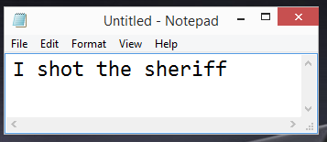
If you type text into Notepad, and have not yet saved it yet, where can that data be found on the hard disk?
Latent data
Active data
Both of the above
None of the above

Slide 15
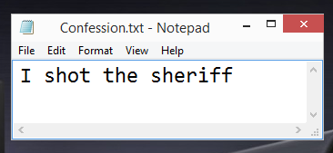
If you save a Notepad file on disk, where can that data be found on that hard disk?
Latent data
Active data
Both of the above
None of the above

Slide 16
If you move a file into the Recycle Bin, where can that data be found on the hard disk?
Latent data
Active data
Both of the above
None of the above

Slide 17
If you move a file into the Recycle Bin, and then empty the Recycle Bin, where can that data be found on the hard disk?
Latent data
Active data
Both of the above
None of the above

Slide 18
If you reformat your hard disk, where can that Notepad data be found on the hard disk?
Latent data
Active data
Both of the above
None of the above

Slide 19
What type of data requires file carving to collect?
Latent data
Active data
Both of the above
None of the above

Slide 20
Forensic Data Landscape
Active data
Unallocated space
Slack space
Mobile devices
External storage

Slide 21
Active data
Any nondeleted files or data
All files and folders
Logs, registry, email archives
File system objects such as $MFT
Master File Table, used to store the directory on NTFS volumes

Slide 22
Unallocated space
Parts of the disk that are not currently allocated to active data
Chunks of old data scattered randomly on the disk
Can be reconstructed into files with carving
But only if the file signature is intact
Can be searched for keywords
Even if the file cannot be reconstructed

Slide 23
Slack space
Portions of a cluster that are not used by the current active file
Left over at the end of many files
Almost always incomplete
Keywords are more effective than file carving for this data

Slide 24
NTFS Volume
4 KB clusters
512 Byte Sectors
8 sectors per cluster
The drive controller will only allow a read or write operation to a whole sector
The Master File Table will only assign complete clusters to a filename

Slide 25
Example of Slack
Save a 10,000 byte file containing "SPAM"
Uses 3 clusters
Delete, save many 1,000 byte files containing EGGS – usable slack space data is bold
SPAM
SPAM
SPAM
SPAM
SPAM
SPAM
SPAM
SPAM
SPAM
SPAM
SPAM
SPAM
SPAM
SPAM
SPAM
SPAM
SPAM
SPAM
SPAM
SPAM+0
0
0
0
0
EGGS
EGGS
EGGS+0
SPAM
SPAM
SPAM
SPAM
SPAM
EGGS
EGGS
EGGS+0
SPAM
SPAM
SPAM
SPAM
SPAM
EGGS
EGGS
EGGS+0
SPAM+0
0
0
0
0

Slide 26
Mobile devices
FTK & EnCase can acquire contents
Standard Cell Phones
Text messages & images & call records
SIM card reader can gather a forensic image of the SIM card
PDAs and Media Players
iPods, MP3 players, PDAs
Flash storage with recoverable deleted data

Slide 27
Mobile devices
Smart Phones
iPhone, Android, Windows Phone, Symbian?
Have flash storage and recoverable deleted data
Text messages & images & call records
Also emails, documents, Internet activity

Slide 28
Mobile Device Specialized Tools
Paraben Device Seizure
Oxygen Forensic Suite
Elcomsoft's iOS Toolkit

Slide 29
Password Protection
Blackberries will wipe themselves if too many wrong passwords are entered
Some devices have password bypass vulnerabilities
You may be able to get the password from the suspect or a corporate administrator

Slide 30
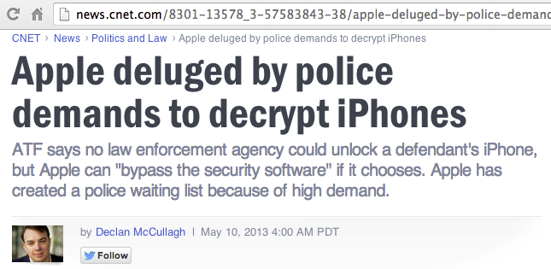
Link Ch 4d
Can also get iTunes data from a computer synced to the phone (link Ch 4e)

Slide 31
iPhone 6 data is encrypted with a key based on the user's PIN
So Apple can't decrypt it, even in response to a court order
CNIT 128, Link Ch 3z10

Slide 32
BUT Apple still has the keys to iCloud
CNIT 128, Link Ch 3z11

Slide 33
Tablets
iPad, Android tablets, Microsoft Surface
Similar information as a smart phone
But no call records or SMS

Slide 34
External Storage
USB thumb drives
USB hard disks
CDs and DVDs
All appear to be hard drives to OS, so hard disk imaging products work

Slide 35
How to Determine What You Have Authority to Access

Slide 36
Authority
Law enforcement authority is defined in search warrant
Private investigators get authority from company that hires them
Who Hosts the Data?
If company owns the server, no problem
Cloud resources may not grant the company the right to search the data, or may not grant administrator access to the machines

Slide 37
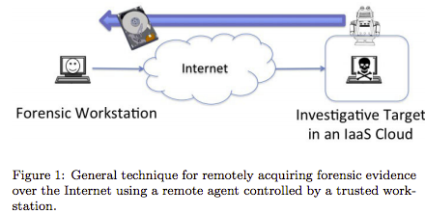
Imaging Cloud Servers
FTK and EnCase can do it, but there are many complications
Links Ch 4f, 4g

Slide 38
Who Owns the Device
Company-owned is simple: company can authorize a search
BYOD (Bring Your Own Device)
Personal device used for company business
Unclear what rights the company has to search the data on it
Need legal advice
BUT: if the suspect consents to a search, it's OK

Slide 39
Expectation of Privacy
Need legal advice: if company has not warned employees that there is no expectation of privacy, evidence may be inadmissible in court
Commonly part of a logon banner

Slide 40
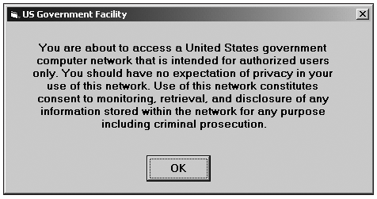
Logon Banner
From "Guide to Computer Forensics and Investigations , Fourth Edition", by Nelson, Phillips, Steuart

Slide 41
Privileged Communications
Attorney-client communications are not admissible in court
"This email communication may contain CONFIDENTIAL INFORMATION WHICH ALSO MAY BE LEGALLY PRIVILEGED and is intended only for the use of the intended recipients identified above..."

Slide 42
Personal Communications
Not protected in US unless there is a reasonable expectation of privacy
In Europe, data privacy laws require written consent from the suspect to make a forensic image of any system on which he or she may have stored private data

Slide 43
iClickers

Slide 44
Which item is usually 4096 bytes in size?
Sector
Cluster
$MFT
FAT
Slack

Slide 45
Which item records the names of files in Windows 7?
Sector
Cluster
$MFT
FAT
Slack

Slide 46
A suspect had all these devices, but smashed them all to tiny bits with a hammer. Which device's data is most likely to be recoverable?
CD
Hard disk
RAM
iPhone
USB flash memory stick

Slide 47
Which item removes the expectation of privacy?
BYOD
Honeypot
Child pormography
Logon banner
Attorney-client privilege

Slide 48
Which item is intended to attract attacks?
BYOD
Honeypot
Child pormography
Logon banner
Attorney-client privilege

Slide 49
Which item removes the burden of discovery?
BYOD
Honeypot
Child pormography
Logon banner
Attorney-client privilege

