Slide 1
Computer Forensics Infosec Pro Guide
Ch 14
Internal Leaks

Slide 2
Topics
Why internal leaks happen
How to investigate internal leaks
File system metadata

Slide 3
Why Internal Leaks Happen

Slide 4
Insider Threat
Insiders have easy access to critical data
Protections are focused on outside intruders

Slide 5
Types of Internal Leaks
Corporate espionage
Intellectual property theft
Stolen business processes
Stolen pricing schedules, vendor agreements, and customer relationship management (CRM) data
Finance and accounting information to guide stock investments in public companies

Slide 6
Types of Internal Leaks
Disgruntled employees may steal information as revenge
Poor information security practices can lead to theft
Should use strong group policy settings, digital rights management, Active Directory (AD) auditing, and Internet usage tracking
Negligence or incompetence leading to theft
Laptops can be stolen from cars, etc.

Slide 7
Insider Threat Countermeasures
Insiders dare to steal because
They see poor security practices and limited internal reviews and audits
Security review and auditing of business practices
Using a competent outside consultancy
Let people know you have tools, training, and processes in place to track what they have done

Slide 8
Investigating Internal Leaks

Slide 9
Preserve Evidence
Forensic artifacts are time-sensitive
Because normal computer use will overwrite data
Use proper forensic methods to acquire and preserve evidence promptly
Hard drive, external devices, file server
Cell phone, email, tape backups, etc.
Best if suspect does not know you are gathering evidence
So they can’t hide or destroy evidence

Slide 10
Avoid Risky Shortcuts
Don't examine a suspect's PC to look for smoking guns before taking a forensic image
Such actions could destroy the data you are looking for
Copying files changes their timestamps
And overwrites latent data

Slide 11
Court Order
If a judge has issued a protective order to preserve a computer
Your snooping around, even merely booting up the machine, violates that order
Make a forensic image and work with the copy

Slide 12
File System Metadata

Slide 13
Metadata
Data about the data
Creation, modification, and access times
Some applications also record
Author's name
Name of computer that created the file
Which printer the file was sent to
Who the file was emailed to
Original filename

Slide 14
Looking for Files Copied to External Media
Review registry files
User activity in UserAssist and RecentDocs in NTUSER.DAT
USBStor in SYSTEM shows use of external storage devices
File activity in LNK files
Obtain and examine any involved external storage devices

Slide 15
Registry Files
Review each user's NTUSER.DAT
Compare creation date of NTUSER.DAT
With creation dates of \Windows, \Users, and \Program Files
Determines the age of the system and user profiles

Slide 16
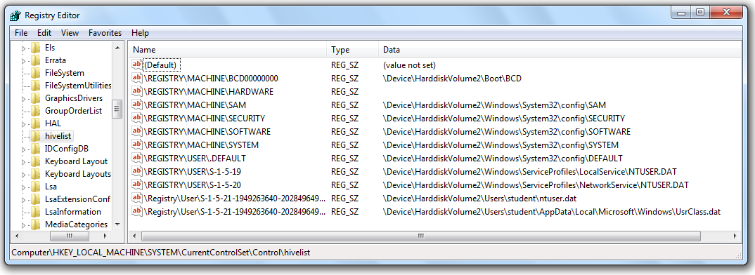
Registry Hive Files

Slide 17
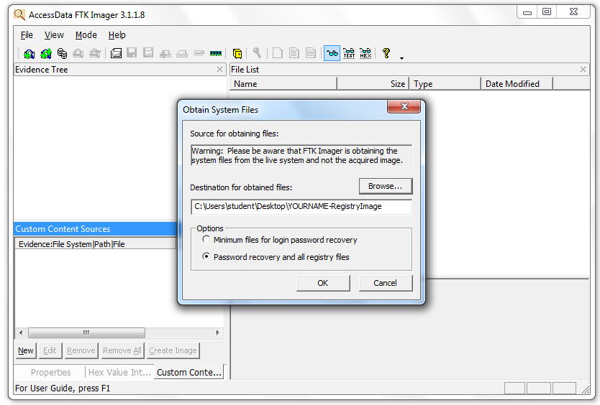
Live Imaging of the Registry

Slide 18
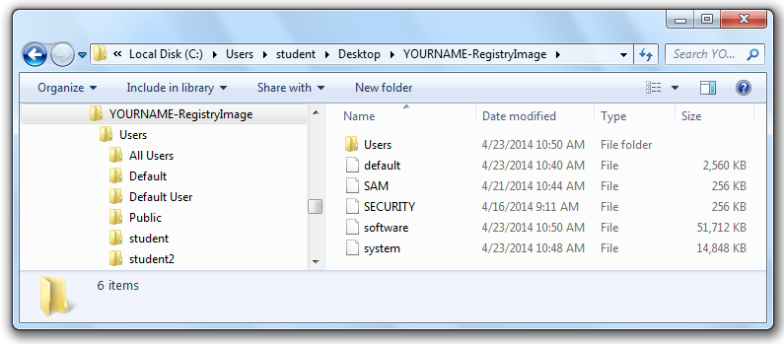
Acquired Registry Files

Slide 19
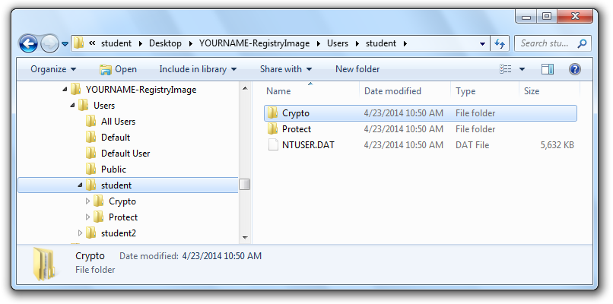
NTUSER.DAT Files

Slide 20
Important Registry Files
For Windows Vista and Win 7
C:\Users\username\NTUSER.DAT
For Windows XP
C:\Documents and Settings\username\NTUSER.DAT
C:\Windows\System32\Config\SYSTEM
C:\Windows\System32\Config\SOFTWARE

Slide 21
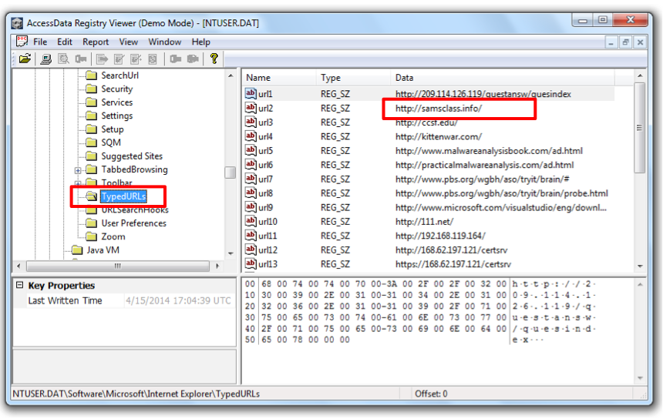
TypedURLs

Slide 22
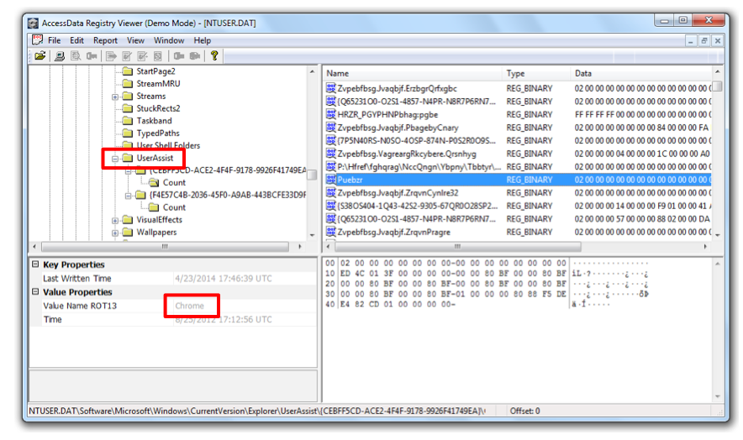
UserAssist

Slide 23
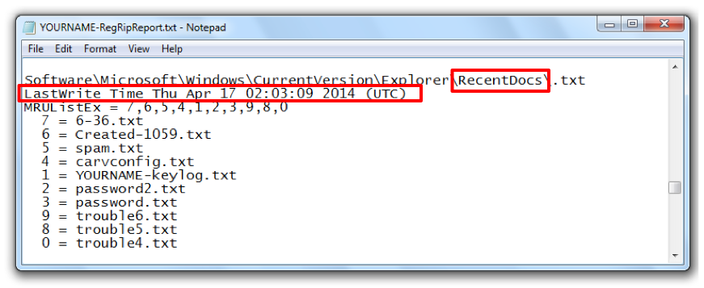
RecentDocs

Slide 24
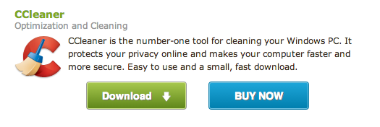
CCleaner
Free tool
Often used to empty these registry keys
Link Ch 14a

Slide 25
Important Registry Locations
NTUSER.DAT\Software\Microsoft\Internet Explorer\TypedURLs
NTUSER.DAT\Software\Microsoft\Windows\CurrentVersion\Explorer\UserAssist
NTUSER.DAT\Software\Microsoft\Windows\CurrentVersion\Explorer\RecentDocs
Also referenced starting with HKCU
How they appear in RegEdit

Slide 26
Important Registry Locations
SYSTEM\CurrentControlSet\Enum\USBSTOR
Also referenced starting with HKLM
How it appears in RegEdit

Slide 27
Error in Textbook
The UserAssist key is in HKCU, not HKLM as stated at location 4291.

Slide 28
Restore Points
Windows makes automatic backups called Shadow Copies
Shadow Explorer will let you examine them
Very useful; contain copies of files and the Registry before they were deleted
Link Ch 14b

Slide 29
Metadata for Special File Types

Slide 30
Special File Types
These filetypes all may contain metadata, such as last time they were printed
CAD drawings
Microsoft Office files
PDF files
EXIF Images (many JPEGs)

Slide 31
Microsoft Office Metadata
Some examples of metadata that may be stored in your documents
Your name
Your initials
Your company or organization name
The name of your computer
The name of the network server or hard disk where you saved the document
Other file properties and summary information
Non-visible portions of embedded OLE objects
The names of previous document authors
Document revisions
Document versions
Template information
Hidden text or cells
Personalized views
Comments (from link Ch 14c)

