Slide 1
Whitehat Vigilante
BayThreat
Dec. 10, 2011

Slide 2
Executive Summary
This talk has no
Demos
Exploits
1337ness
It's just a sermon about social skills
Ethics
Legality
Attitude

Slide 3
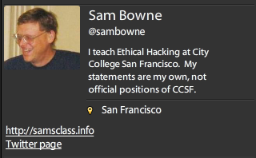
Bio

Slide 4
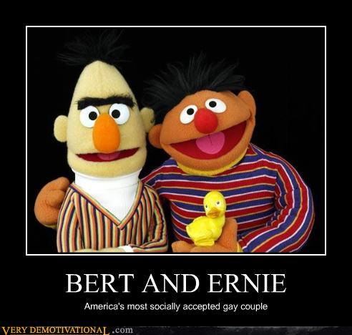

Slide 5
PBS Hacked

Slide 6
PBS Hacked

Slide 7
Attitudes

Slide 8
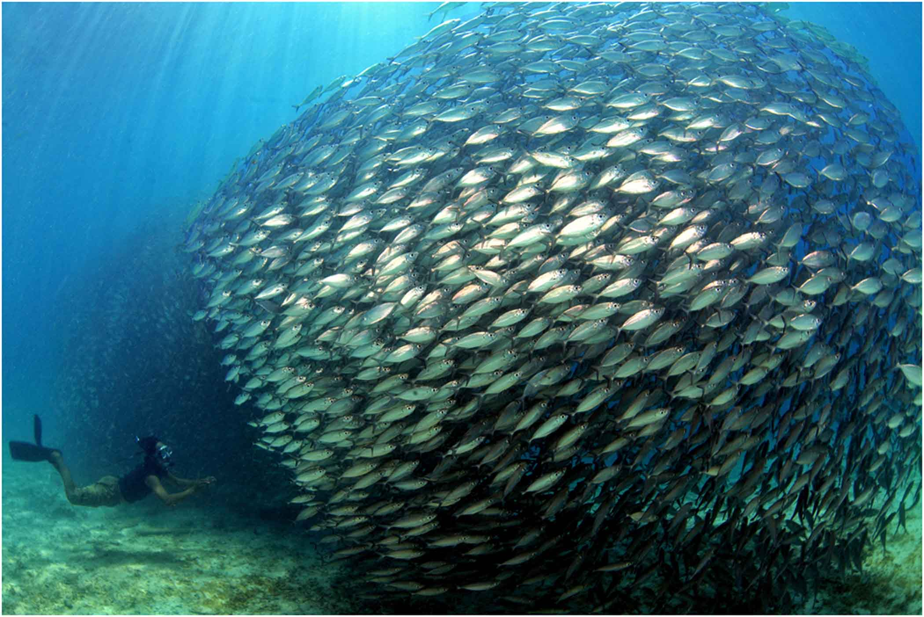
Blend In: Hide
Image from presenceinbusiness.com

Slide 9
Make Your Own Rules
Images from listentoleon.net & anpop.com

Slide 10
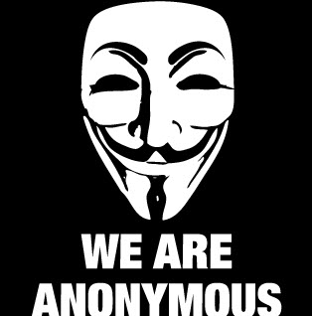
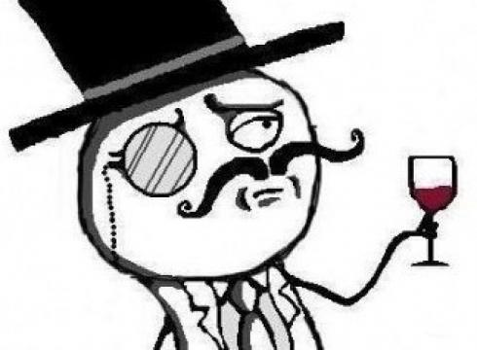
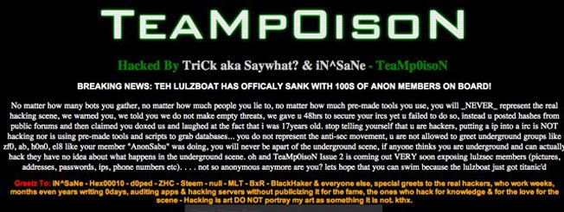
Cyber-Terrorists Masked Mobs
Create fear
Cause paranoia
Intimidate critics into silence

Slide 11
Lone Vigilantes

Slide 12
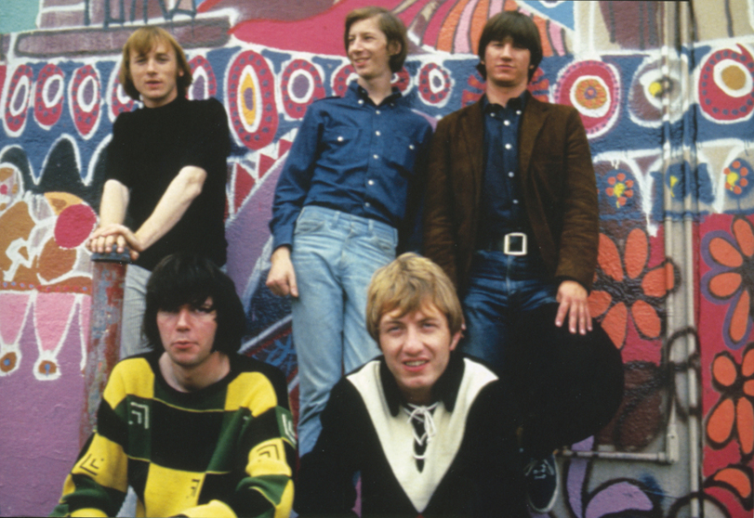
Nobody's Right if Everybody's Wrong
Buffalo Springfield image from freewebs.com

Slide 13
The Middle Way

Slide 14
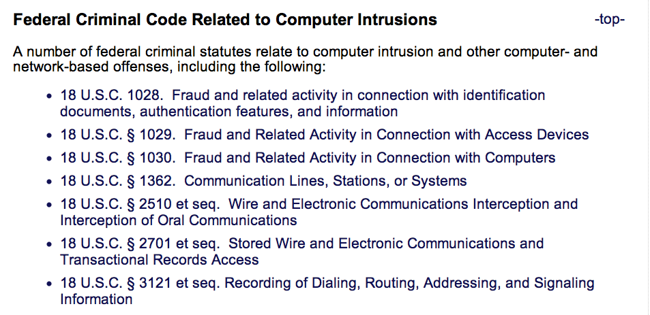
Laws
From cybercrime.gov

Slide 15
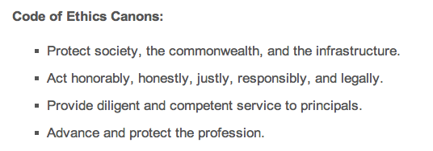
CISSP Code of Ethics

Slide 16
Cold Calls

Slide 17
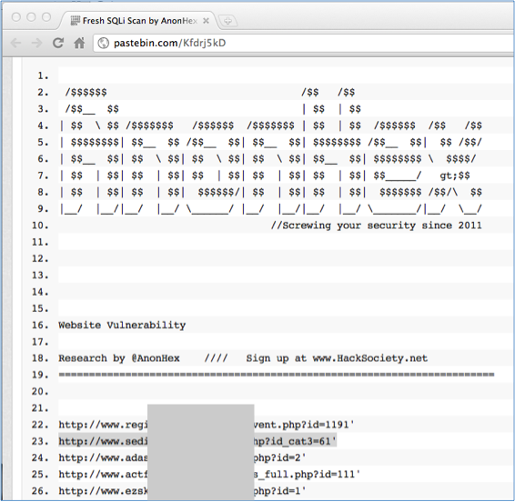
Find Vulnerable Sites Dumped on Pastebin

Slide 18
Verify the Vulnerability
Do NOT explore any further
Actually injecting commands is a crime

Slide 19
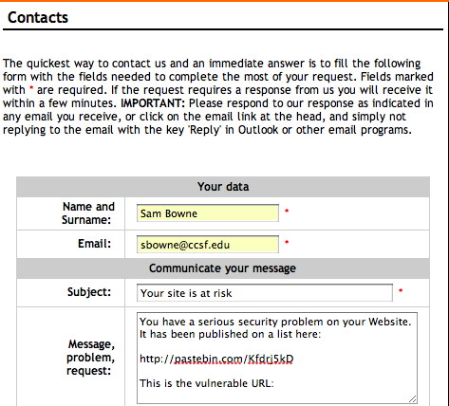
Find a Contact Address

Slide 20
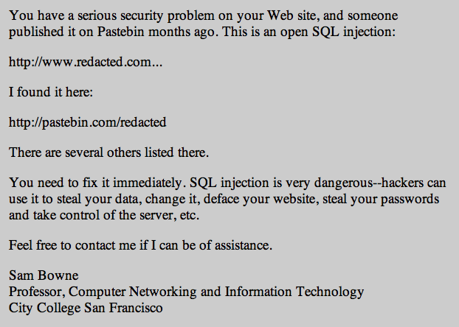
My Letter

Slide 21
Letter Design
Simple management-level summary of the problem
No technical details
Give your real name & contact information
Don't demand anything
Don't make any threats

Slide 22
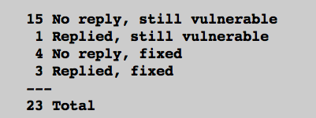
Pilot Study
3 days after notification
7/23 Fixed (30%)
http://samsclass.info/lulz/cold-calls.htm

Slide 23
Student Projects
Done by CISSP-prep students at CCSF
Contacted over 200 sites with SQL injections
> 15% of them were fixed

Slide 24
Major Breaches or Vulnerabilities

Slide 25
Breaches or Vulnerabilities I Reported
FBI (many times)
UK Supreme Court
Chinese Government
Police departments (many of them)
Other Courts
CNN, PBS
Apple
Schools (many of them)

Slide 26
I Sought Personal Contacts

Slide 27
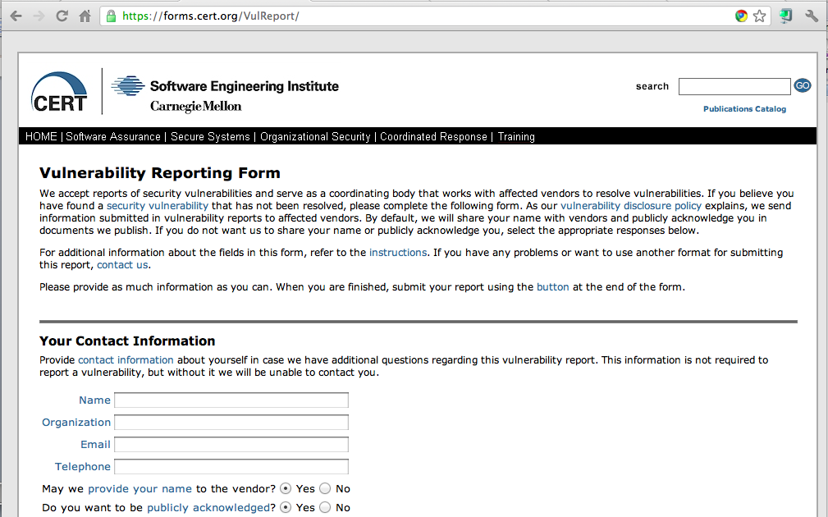
CERT

Slide 28
Positive Results
Several good security contacts inside corporations, law enforcement, and government agencies
Many problems fixed, several before they were exploited

Slide 29
Negative Results
A few of my Twitter followers were offended and suspicious when I found so many high-profile vulnerabilities so fast
Accusations
Performing unauthorized vulnerability scans
Peddling bogus security services
Betraying the USA
All 100% false & baseless

Slide 30
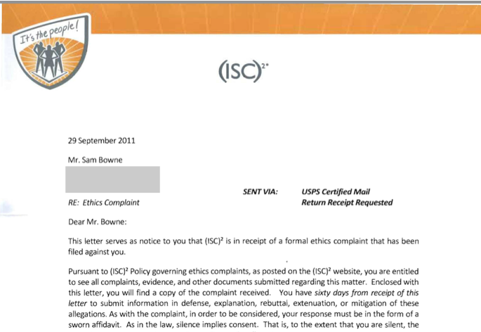
Ethics Complaint

Slide 31
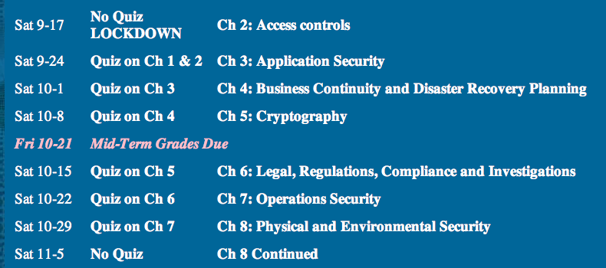
Fortuitous Timing

Slide 32
Recommendations for Cold Calls

Slide 33
Be Respectful
No abuse or criticism
Sincere desire to help
Accept being ignored without protest
Demand nothing
Respect their right to leave their servers unpatched

Slide 34
Be Right
Report clear-cut vulnerabilities, widely understood and important, like SQL Injection
Do nothing illegal or suspicious
No vulnerability scans
No intrusion or exploits
Report only vulnerabilities that are already published by others

Slide 35
Clarity of Purpose
Genuine desire to help the people you are contacting
No hidden agenda
Desire to sell a product
Desire to belittle or mock
Dominate and control others
Plans to attack sites yourself
Revenge

Slide 36
Expect Abuse
If you become visible in the hacking community, you are a target
It doesn't matter what you say or do
Many hackers are arrogant, insecure, and emotionally immature

Slide 37
Be Fearless
Understand the importance of the sites you are helping
Are they worth more than your
Inconvenience
Time expended
Exposure to criticism and humiliation

Slide 38
Acknowledgements
I am very grateful for the support of CNIT, MPICT, and CCSF
Especially
Carmen Lamha
Maura Devlin-Clancy
Pierre Thiry
James Jones
Tim Ryan
It would be much simpler to just fire me than to support my mad actions

