Slide 1
IPv6 Security
TechDays
May 3, 2013

Slide 2
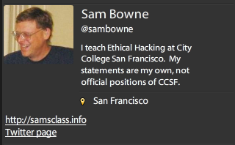
Bio

Slide 3
IPv4 Exhaustion

Slide 4
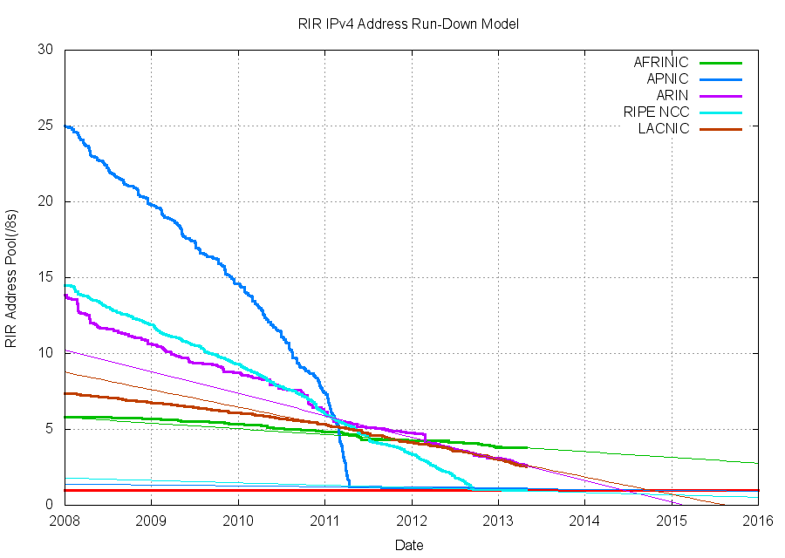
IPv4 Exhaustion

Slide 5
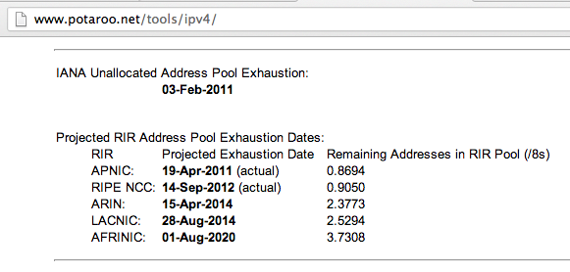
One Year Left

Slide 6
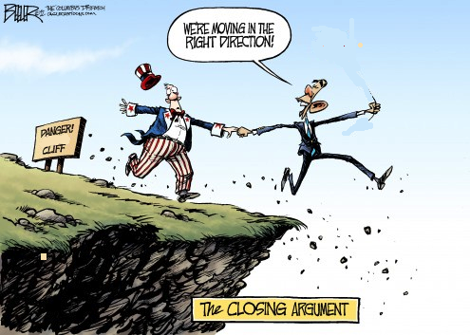
Image modified from http://blogs.denverpost.com/opinion/files/2012/12/fiscal-cliff-cartoon-beeler4-495x353.jpg

Slide 7
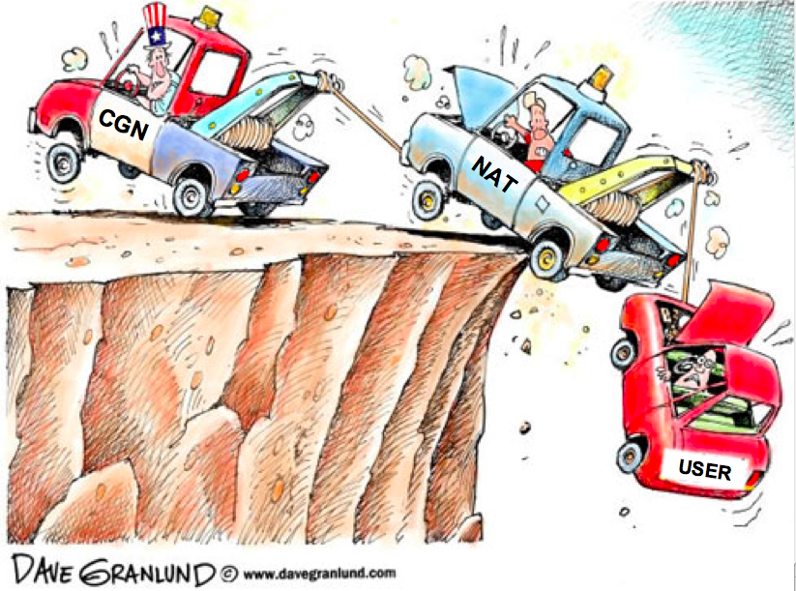
Image modified from http://www.kaiserhealthnews.org/~/media/Images/KHN%20Features/2011/February/21%2025/cliff512.jpg?w=512&h=370&as=1

Slide 8
IPv6 Exhaustion

Slide 9
IPv6 Adoption

Slide 10
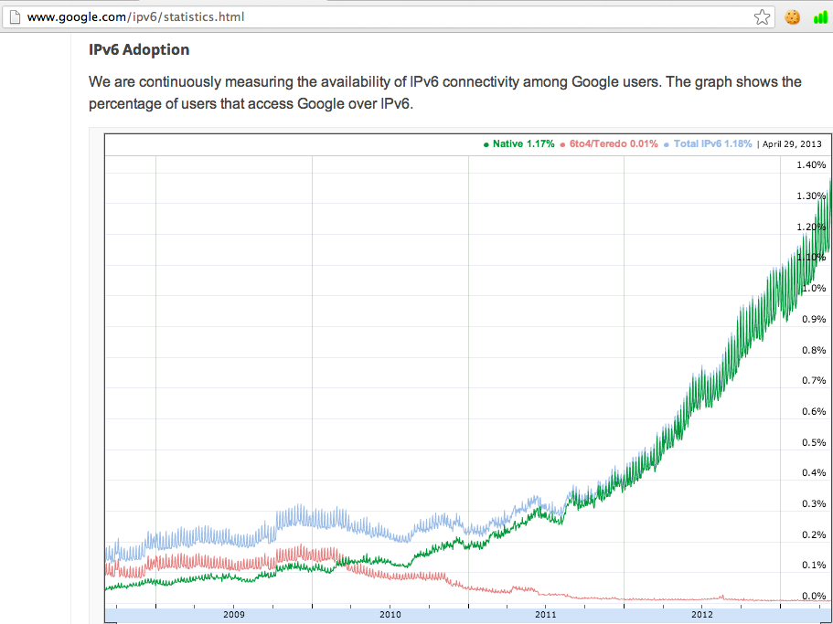

Slide 11
Security Issues

Slide 12
Security
Confidentiality
Integrity
Availability

Slide 13
Availability of IPv6
☑ OS: Windows, OS X, Linux, Unix
☑ Google
☒ ISPs
☒ Azure
☒ Home & Small Business Routers

Slide 14
IPv6 Security Step 1
Get rid of the IPv6 you don’t want to use
Disable automatic tunnels
netsh interface ipv6 6to4 set state state=disabled
netsh interface ipv6 set teredo disable
netsh interface ipv6 isatap set state state=disabled
From http://www.howfunky.com/2011/02/useful-windows-7-ipv6-netsh-commands.html

Slide 15
Remove Side Channels
Make sure your firewall, IDS, logging, monitoring, VPN, load-balancing, etc. all handle IPv6 properly

Slide 16
Link-Local DoS
IPv6 Router Advertisements

Slide 17
Old Attack (from 2011)
Image from forumlane.org

Slide 18
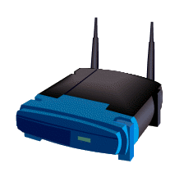
IPv4: DHCP
PULL process
Client requests an IP
Router provides one
I need an IP
Use this IP
Host
Router

Slide 19
IPv6: Router Advertisements
PUSH process
Router announces its presence
Every client on the LAN creates an address and joins the network
JOIN MY NETWORK
Yes, SIR
Host
Router

Slide 20
Router Advertisement Packet

Slide 21
RA Flood (from 2011) flood_router6

Slide 22
Effects of flood_router6
Drives Windows to 100% CPU
Also affects FreeBSD
No effect on Mac OS X or Ubuntu Linux

Slide 23
The New RA Flood
Image from guntech.com/

Slide 24
MORE IS BETTER
Each RA now contains
17 Route Information sections
18 Prefix Information sections

Slide 26
Flood Does Not Work Alone
Before the flood, you must send some normal RA packets
This puts Windows into a vulnerable state

Slide 27
How to Perform this Attack
For best results, use a gigabit Ethernet NIC on attacker and a gigabit switch
Use thc-ipv6 2.1 on Linux
Three Terminal windows:
./fake_router6 eth1 a::/64
./fake_router6 eth1 b::/64
./flood_router26 eth1
Windows dies within 30 seconds

Slide 28
Effects of New RA Flood
Win 8 & Server 2012 die (BSOD)
Microsoft Surface RT dies (BSOD)
Mac OS X dies
Win 7 & Server 2008 R2, with the "IPv6 Readiness Update" freeze during attack
iPad 3 slows and sometimes crashes
Android phone slows and sometimes crashes
Ubuntu Linux suffers no harm

Slide 29
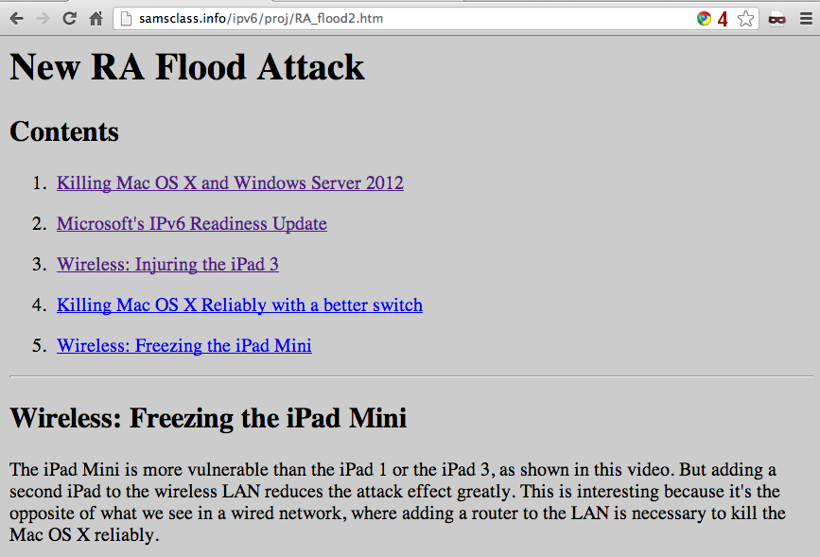
Videos and Details

Slide 30
Mitigation
Disable IPv6
Turn off Router Discovery with netsh
Use a firewall to block rogue RAs
Get a switch with RA Guard
Microsoft's "IPv6 Readiness Update" provides some protection for Win 7 & Server 2008 R2
Released Nov. 13, 2012
KB 2750841
But NOT for Win 8 or Server 2012!!

Slide 31
DEMO

