Slide 1
The Breach that Wasn't
Defcon 20
July 28, 2012

Slide 2
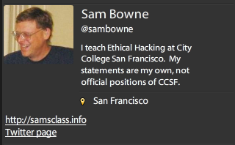
Bio

Slide 3
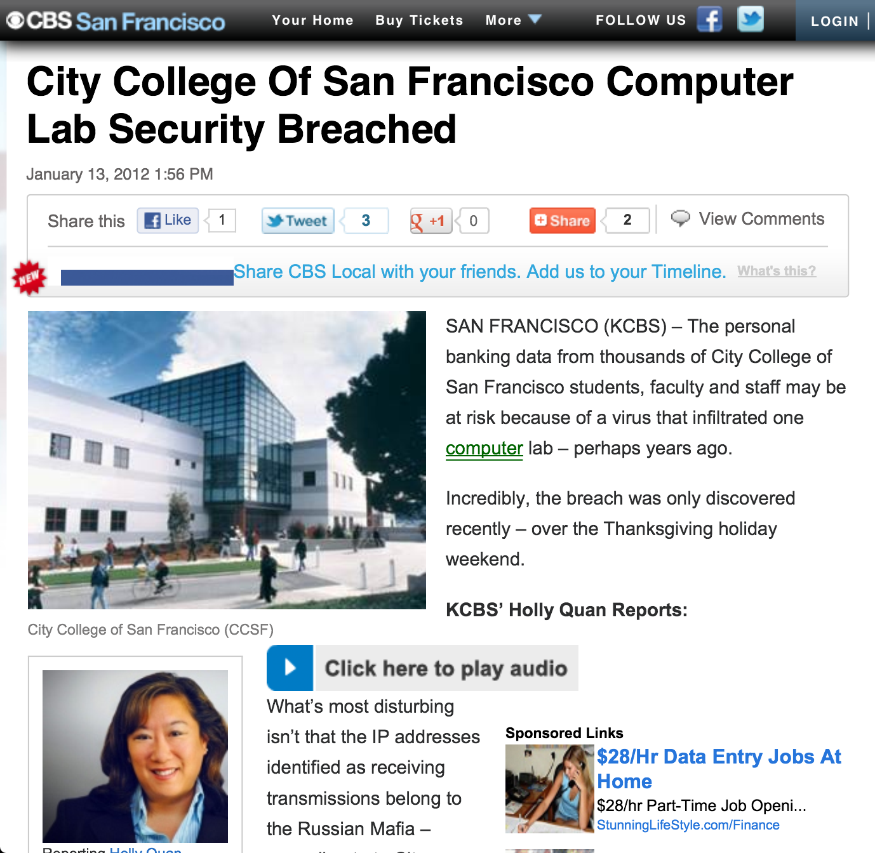

Slide 4
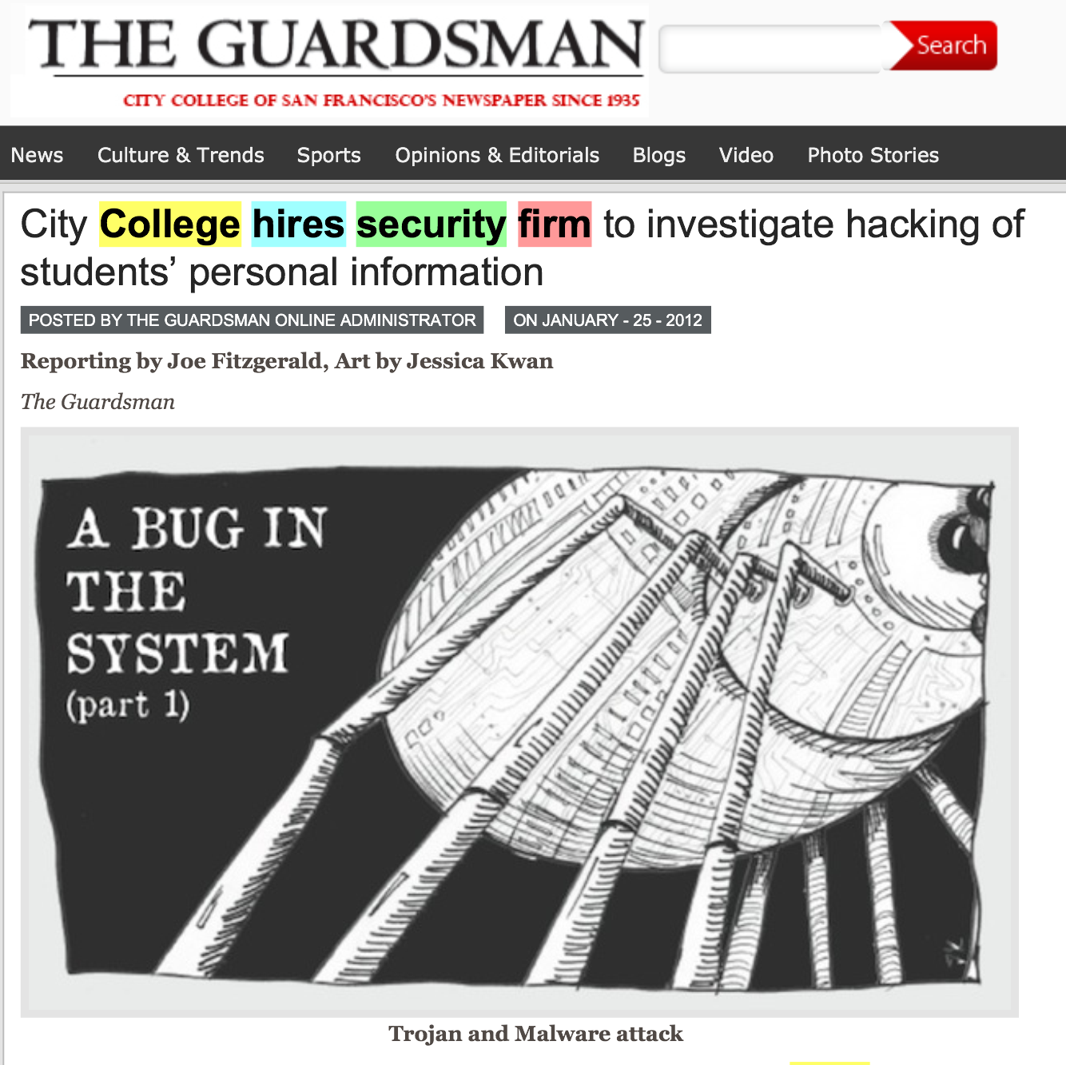

Slide 7
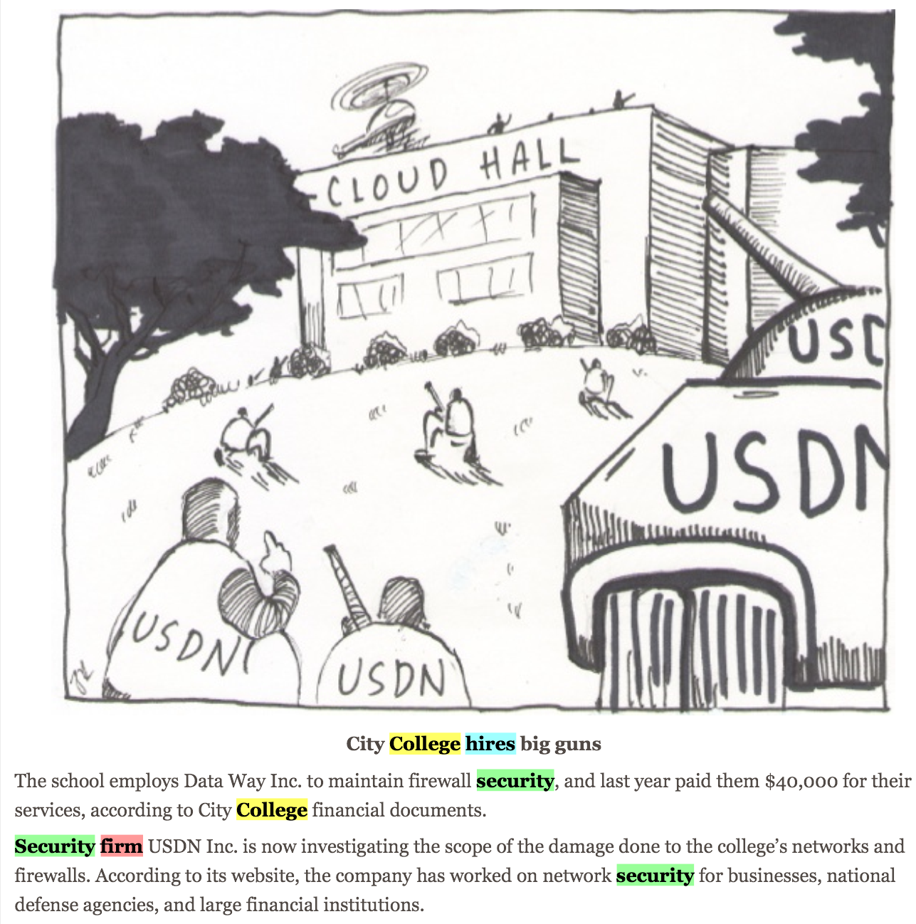

Slide 10
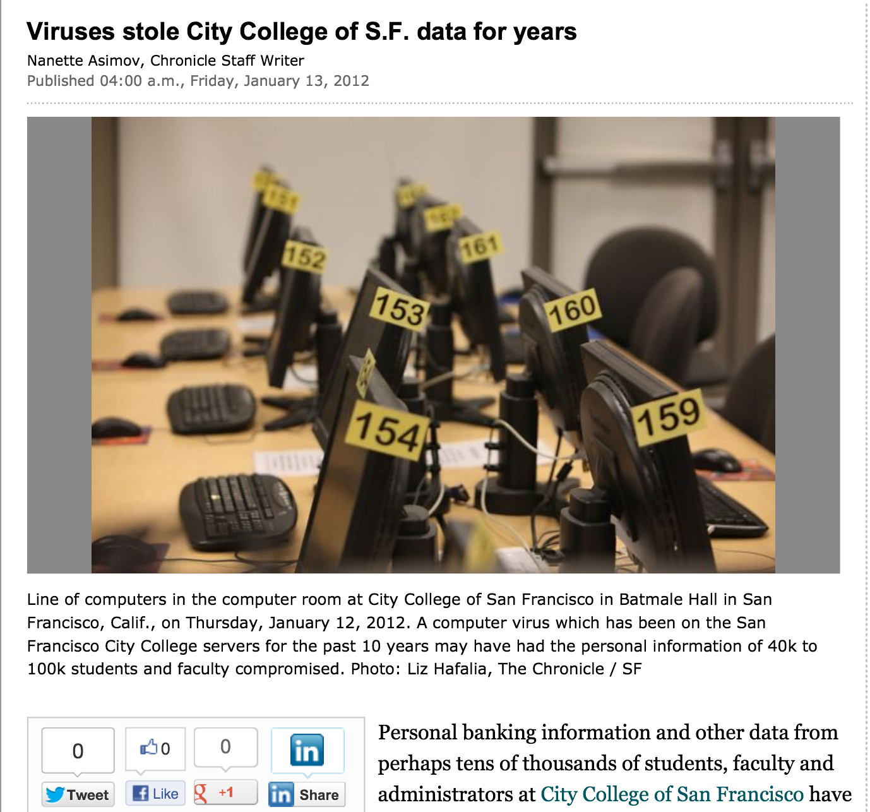

Slide 11
Outside attacks Insider threat Deluded Insider Threat

Slide 12
Security at CCSF
Two generations of complete hardware replacement in the last ten years
McAfee Enterprise antivirus
Deep Freeze
Palo Alto layer 7 firewall

Slide 13
Security Audits
There was a security audit and remediation process performed in 2007-2008 by a contractor
I did another security audit in 2010 with my CISSP students
No major problems found

Slide 14
Evidence for these "Viruses"
A report was supposedly prepared by USDN in Nov 2011, but we were never able to get a copy of it at all
The presentation from the CTO that went to the press was in Jan. 2011
We finally got a partial report on Jan. 31, lacking the appendices that were the evidence
"Proprietary and Confidential" but later published in the newspaper

Slide 15
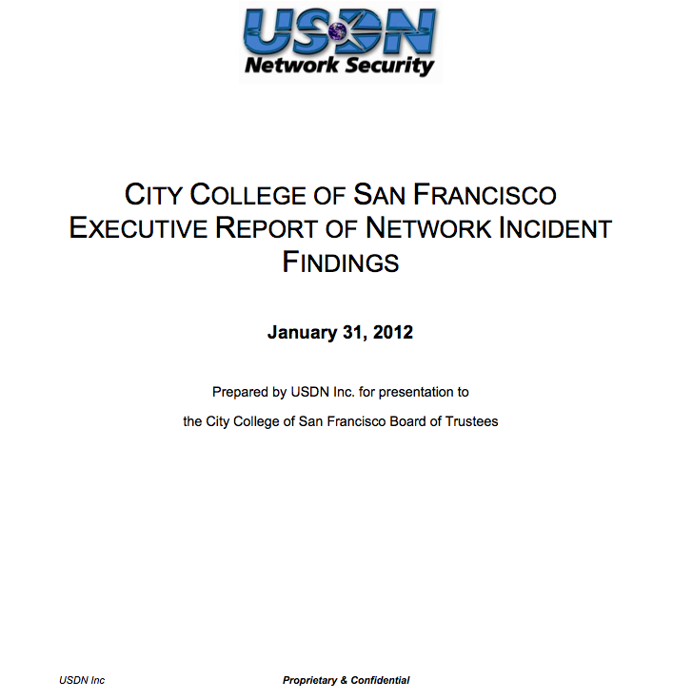

Slide 16
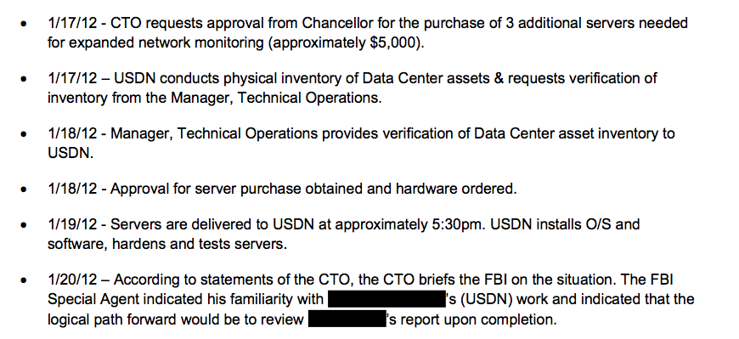

Slide 17
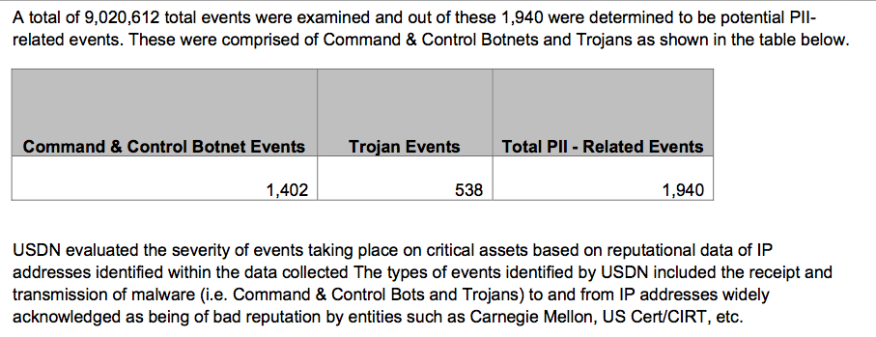

Slide 18
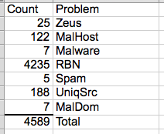
The List
On April 3, we finally got a list of the "infected machines"
Direct inspection of samples showed no real infections

Slide 19
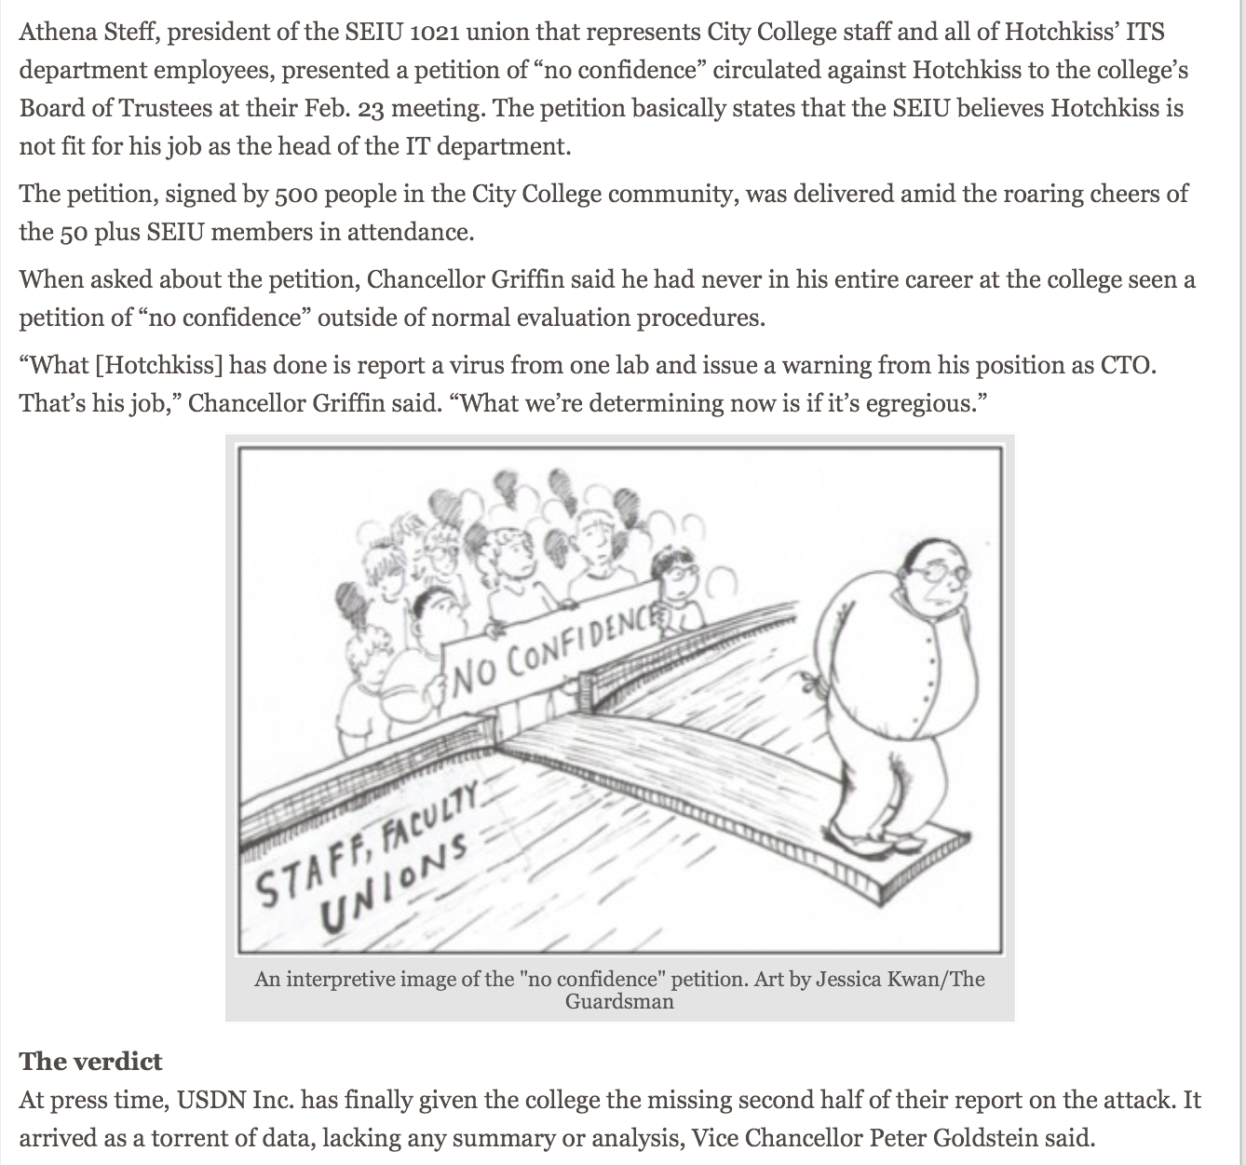

Slide 20
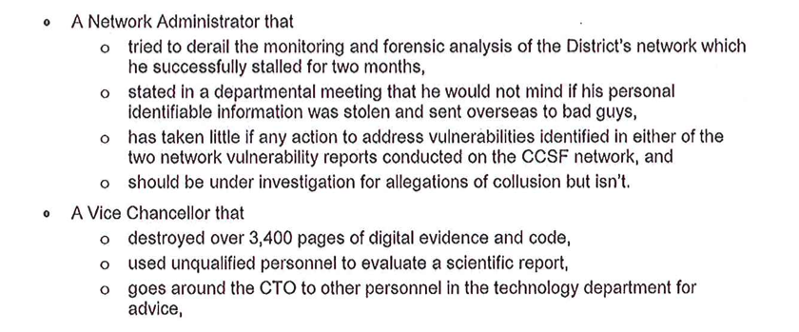
Letter to Trustees & Published in Newspaper

Slide 22
Falsified Breach in 2011

Slide 23
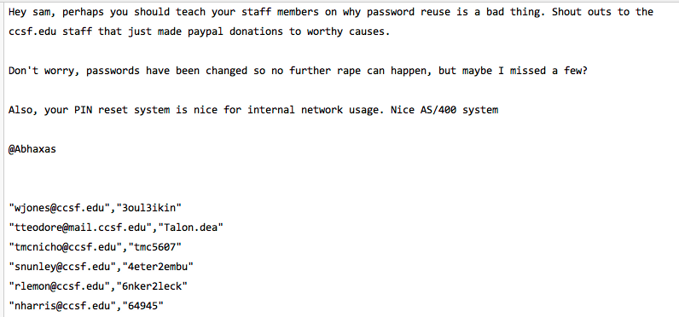
Proven False at the Time

Slide 24
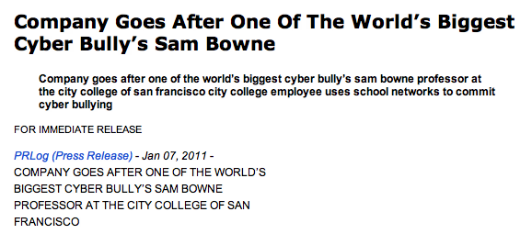
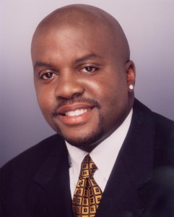
Cyber-Bullying

Slide 25
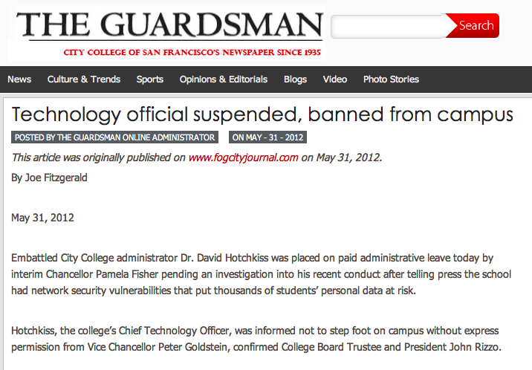

Slide 26
