Slide 1
Whitehat Vigilante and The Breach that Wasn't
HI-TEC
July 26, 2012

Slide 2
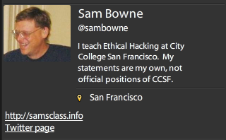
Bio

Slide 3
Levels of Security Knowledge
Theory
Book-learning
Practice
Controlled hands-on projects
Controlled cyber-contests
Underworld contacts
Dangerous knowledge
Accepting responsibility for real problems

Slide 4
Levels of Security Knowledge
Real-world Security Work
Security officer
Law enforcement contacts
Underworld contacts
Confidential information
Responsibility for real problems

Slide 5
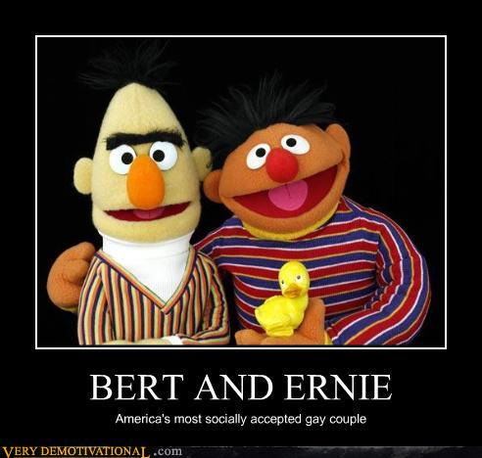

Slide 6
PBS Hacked

Slide 7
PBS Hacked

Slide 8
Attitudes

Slide 9
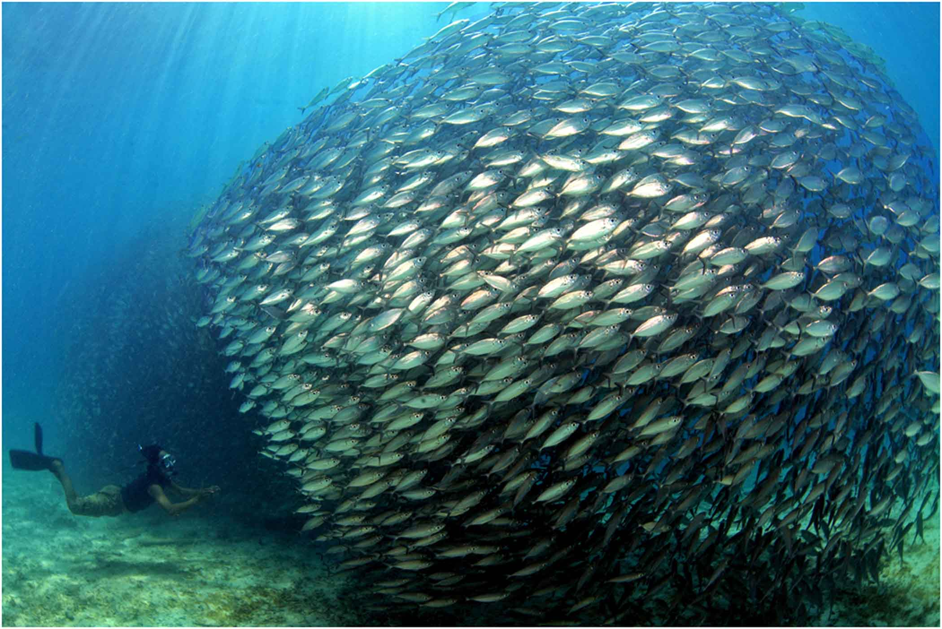
Blend In: Hide
Image from presenceinbusiness.com

Slide 10
Make Your Own Rules
Images from listentoleon.net & anpop.com

Slide 11
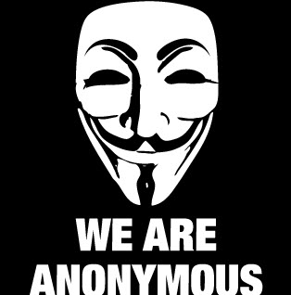
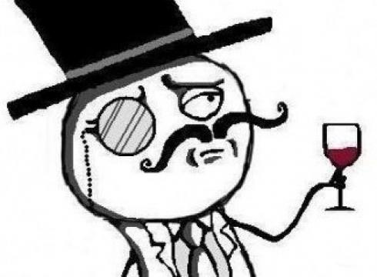
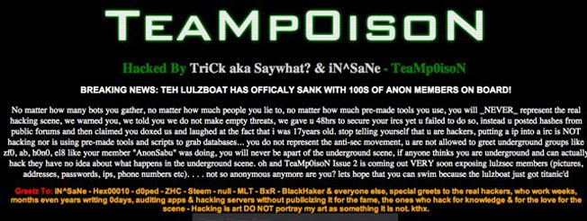
Cyber-Terrorists Masked Mobs
Create fear
Cause paranoia
Intimidate critics into silence

Slide 12
Lone Vigilantes

Slide 13
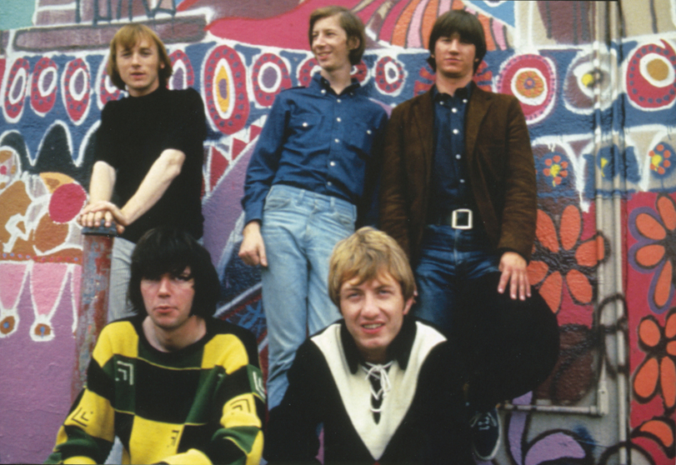
Nobody's Right if Everybody's Wrong
Buffalo Springfield image from freewebs.com

Slide 14
The Middle Way

Slide 15
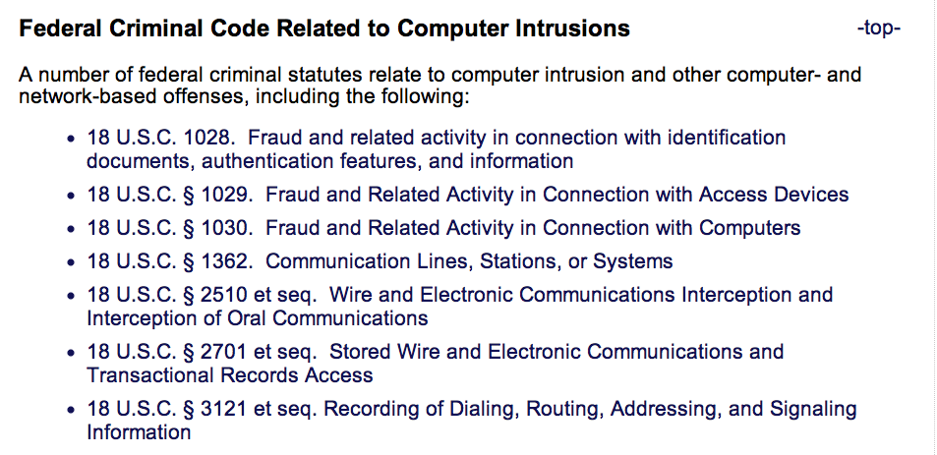
Laws
From cybercrime.gov

Slide 16
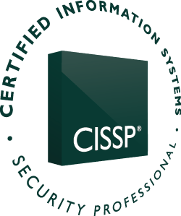
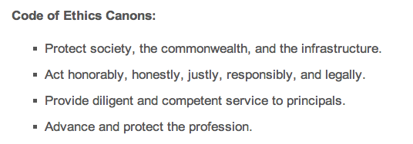
CISSP Code of Ethics

Slide 17
Cold Calls

Slide 18
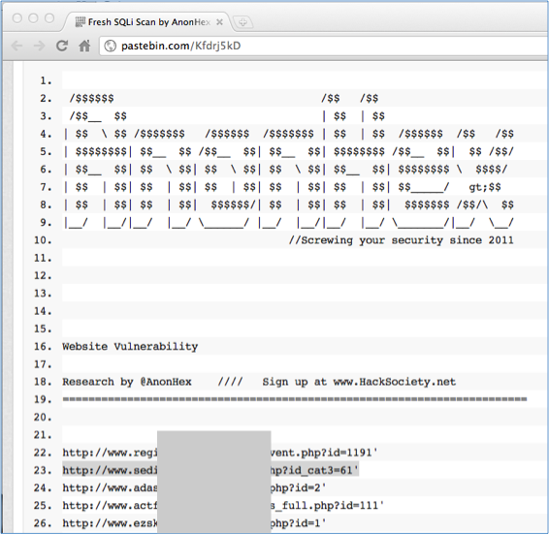
Find Vulnerable Sites Dumped on Pastebin

Slide 19
Verify the Vulnerability
Do NOT explore any further
Actually injecting commands is a crime

Slide 20
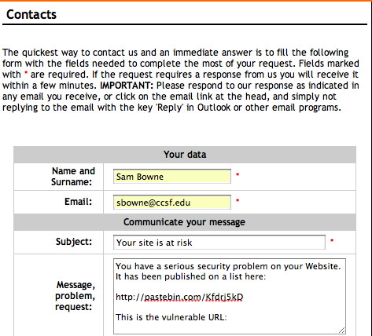
Find a Contact Address

Slide 21
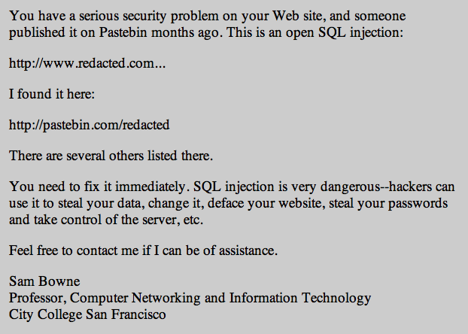
My Letter

Slide 22
Letter Design
Simple management-level summary of the problem
No technical details
Give your real name & contact information
Don't demand anything
Don't make any threats

Slide 23
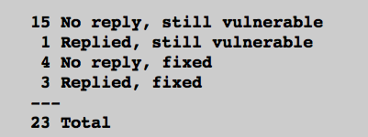
Pilot Study
3 days after notification
7/23 Fixed (30%)
http://samsclass.info/lulz/cold-calls.htm

Slide 24
Student Projects
Done by CISSP-prep students at CCSF
Contacted over 200 sites with SQL injections
> 15% of them were fixed

Slide 25
Major Breaches or Vulnerabilities

Slide 26
Breaches or Vulnerabilities I Reported
FBI (many times)
UK Supreme Court
Chinese Government
Police departments (many of them)
Other Courts
CNN, PBS
Apple
Schools (many of them)

Slide 27
I Sought Personal Contacts

Slide 28
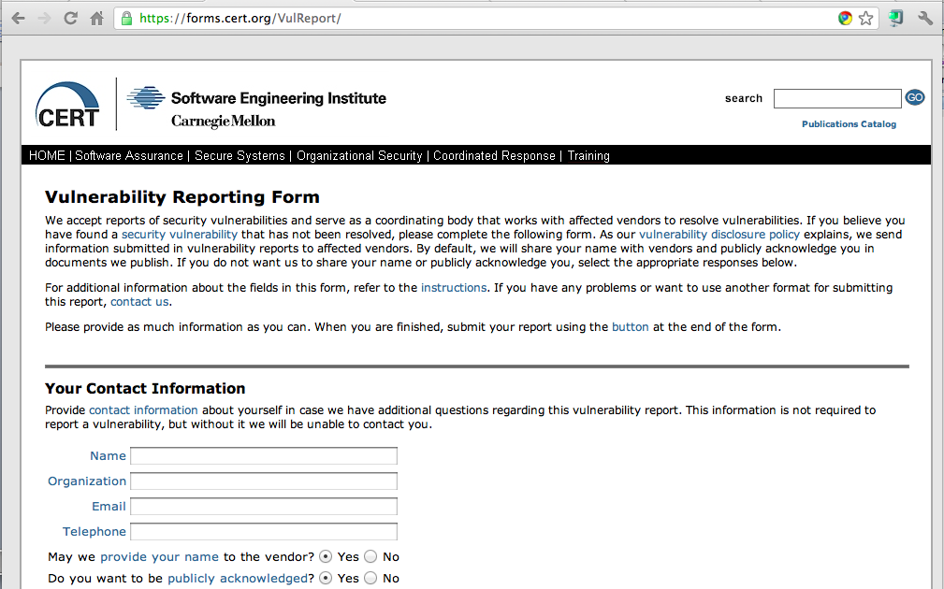
CERT

Slide 29
Positive Results
Several good security contacts inside corporations, law enforcement, and government agencies
Many problems fixed, several before they were exploited

Slide 30
Negative Results
A few of my Twitter followers were offended and suspicious when I found so many high-profile vulnerabilities so fast
Accusations
Performing unauthorized vulnerability scans
Peddling bogus security services
Betraying the USA
All 100% false & baseless

Slide 31
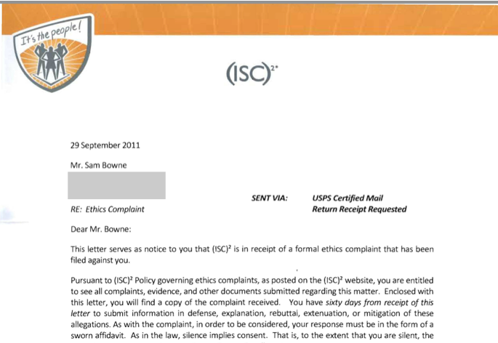
Ethics Complaint
http://samsclass.info/125/ethics/

Slide 32
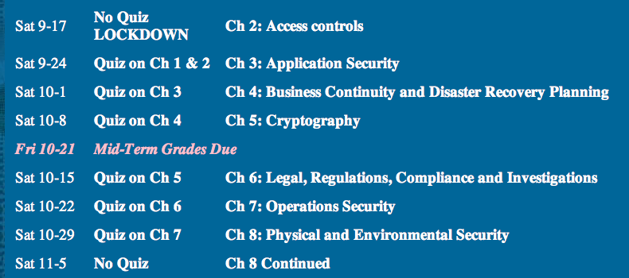
Fortuitous Timing

Slide 33
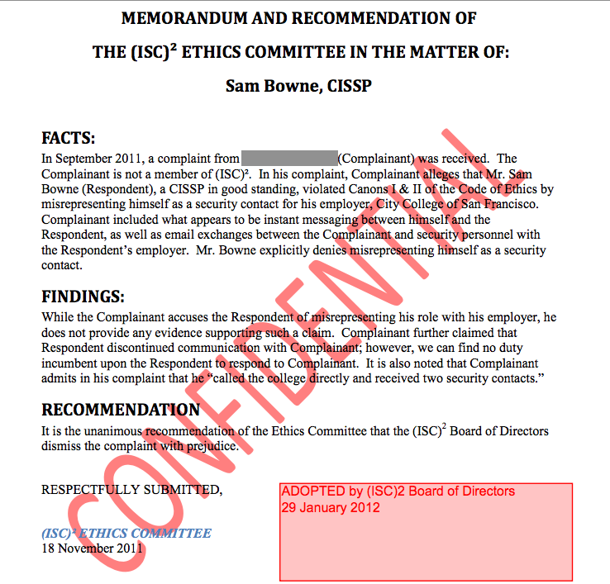

Slide 34
Recommendations for Cold Calls

Slide 35
Be Respectful
No abuse or criticism
Sincere desire to help
Accept being ignored without protest
Demand nothing
Respect their right to leave their servers unpatched

Slide 36
Be Right
Report clear-cut vulnerabilities, widely understood and important, like SQL Injection
Do nothing illegal or suspicious
No vulnerability scans
No intrusion or exploits
Report only vulnerabilities that are already published by others

Slide 37
Clarity of Purpose
Genuine desire to help the people you are contacting
No hidden agenda
Desire to sell a product
Desire to belittle or mock
Desire to dominate or control others
Plans to attack sites yourself
Revenge

Slide 38
Expect Abuse
If you become visible in the hacking community, you are a target
It doesn't matter what you say or do
Many hackers are arrogant, insecure, and emotionally immature
Cruelty, abuse, and bullying are common

Slide 39
Be Fearless
Understand the importance of the sites you are helping
Are they worth more than your
Inconvenience
Time expended
Exposure to criticism and humiliation

Slide 40
Acknowledgements
I am very grateful for the support of CNIT, MPICT, and CCSF
Especially
Carmen Lamha
Maura Devlin-Clancy
Pierre Thiry
James Jones
Tim Ryan
It would be much simpler to just fire me than to support my mad actions

Slide 41
The Breach that Wasn't

Slide 42
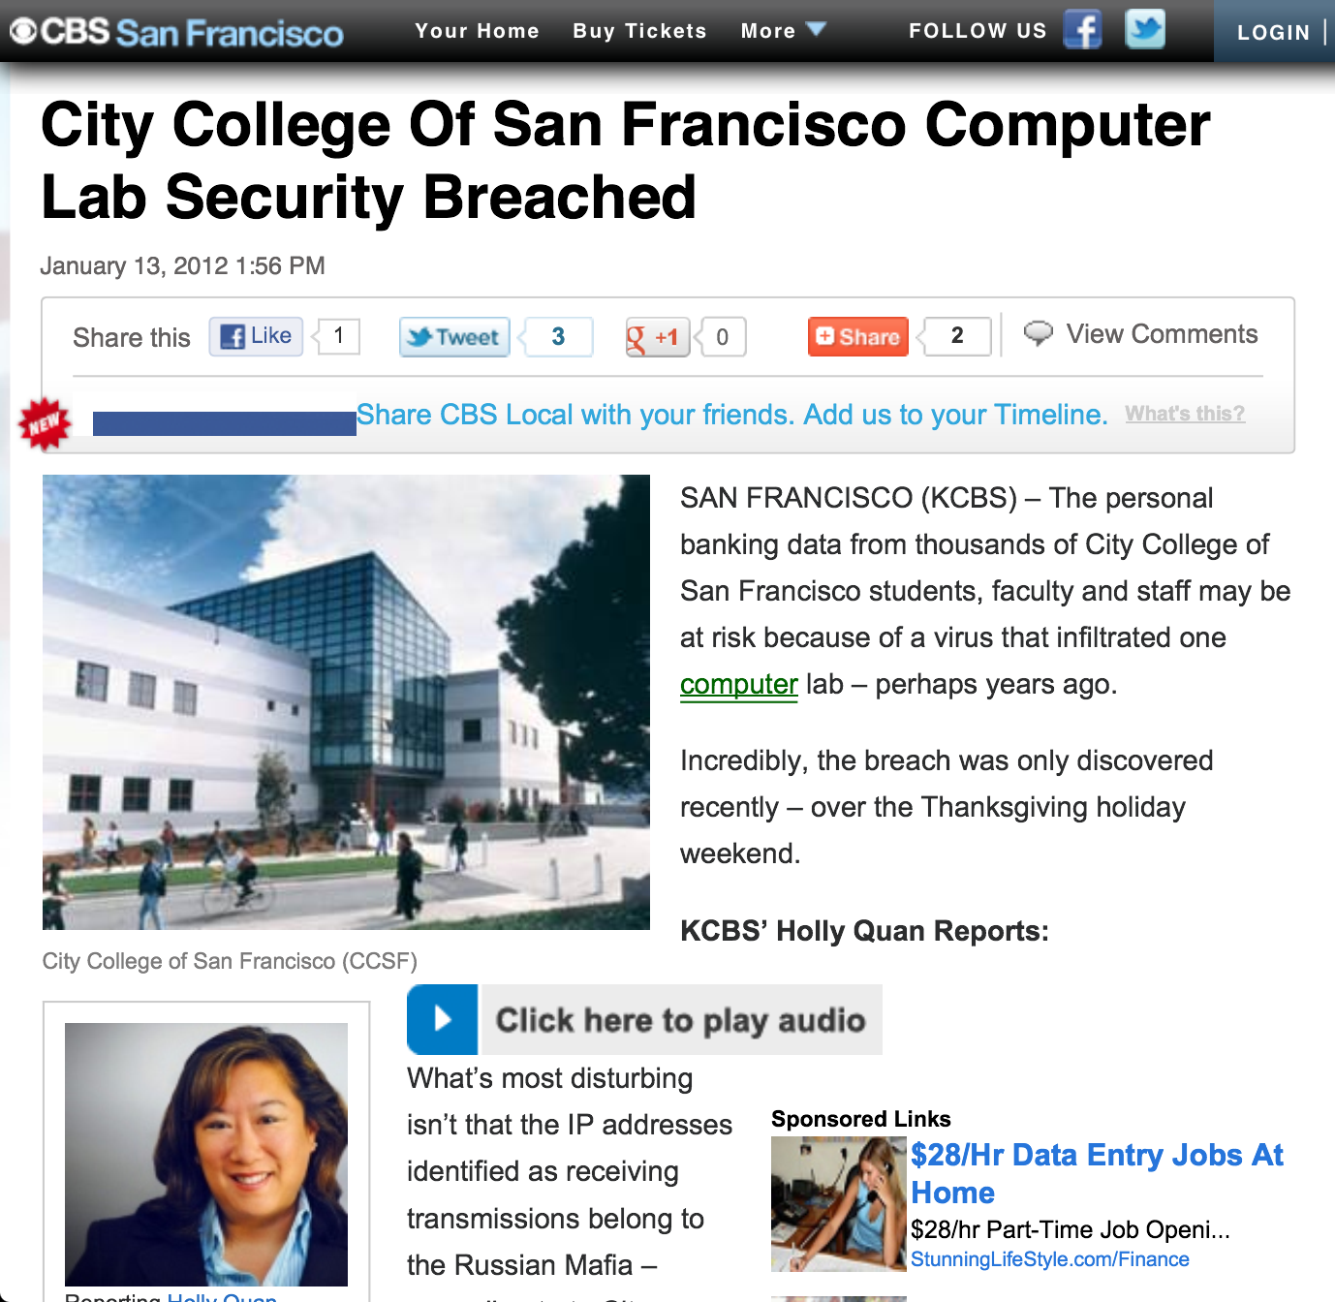

Slide 43
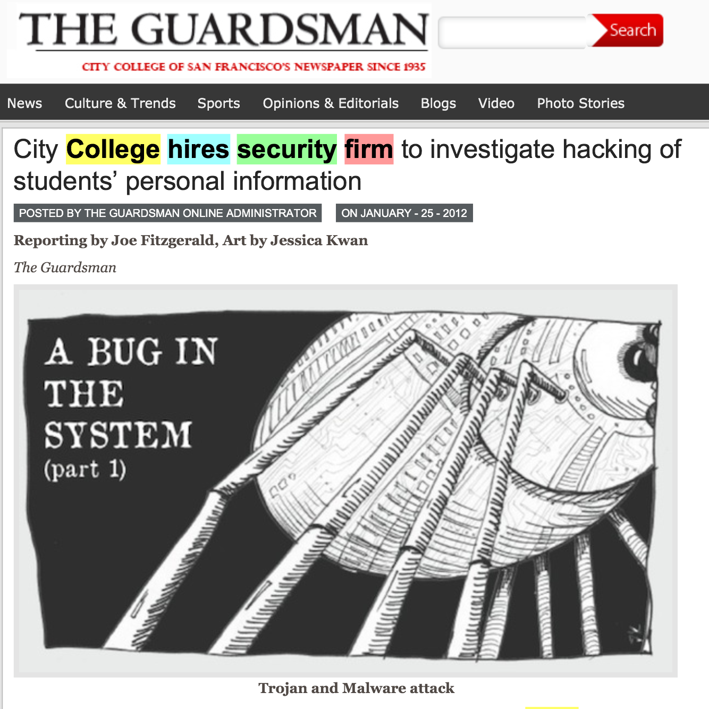

Slide 46
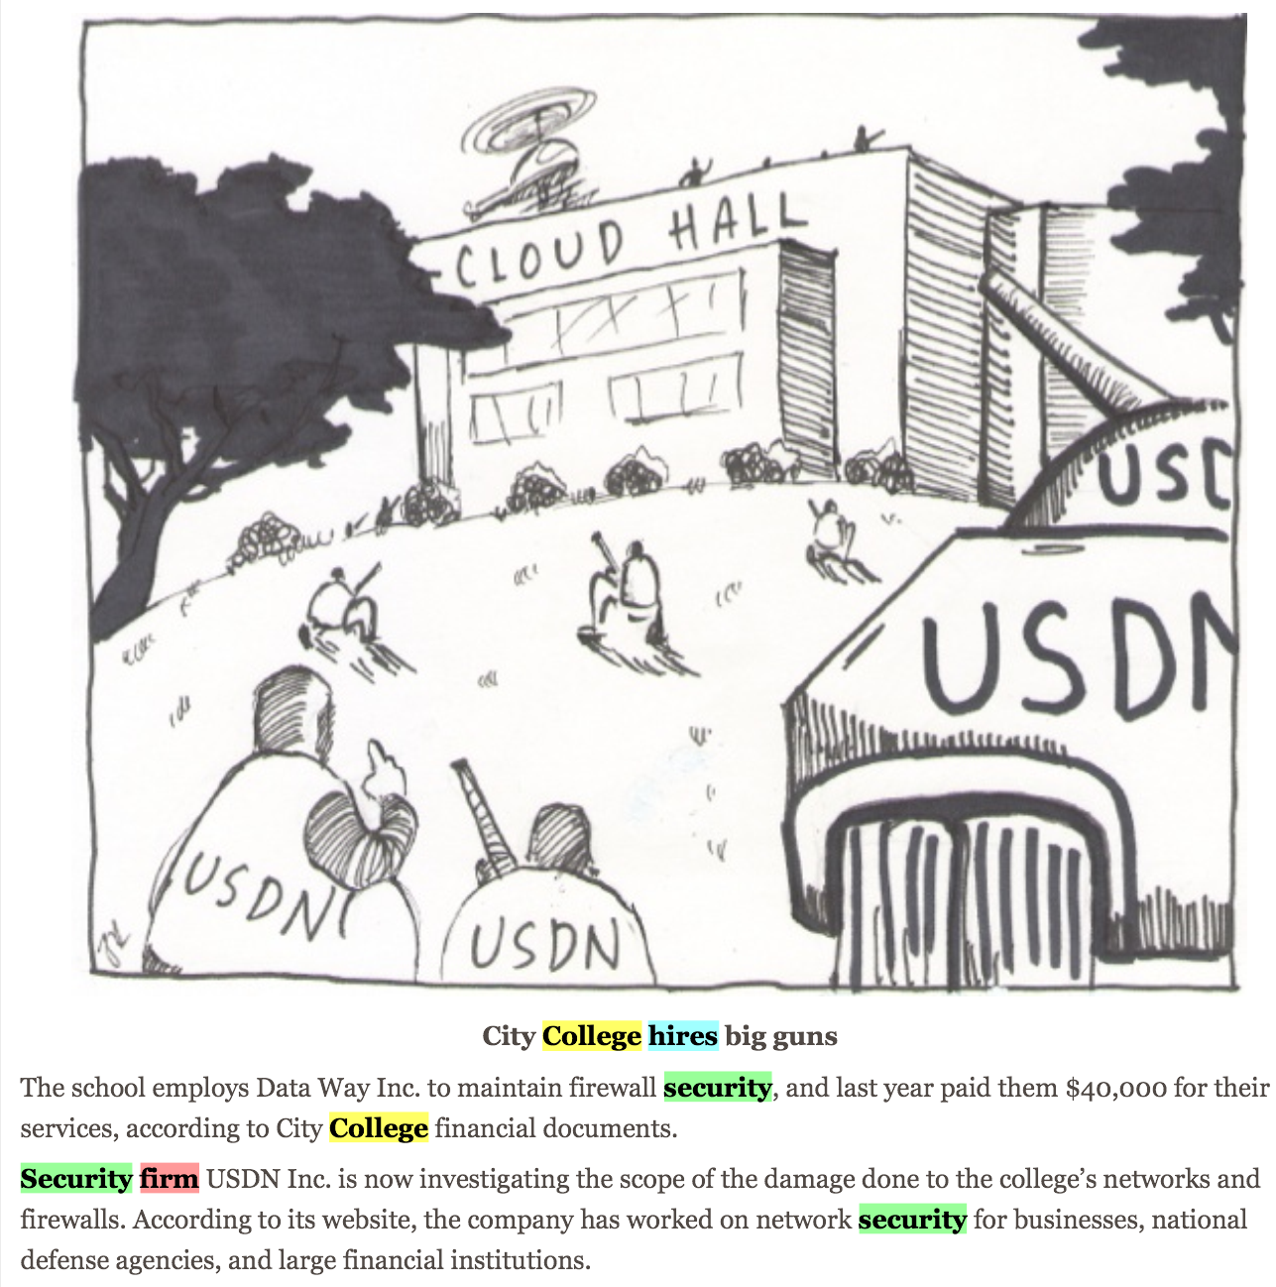

Slide 49
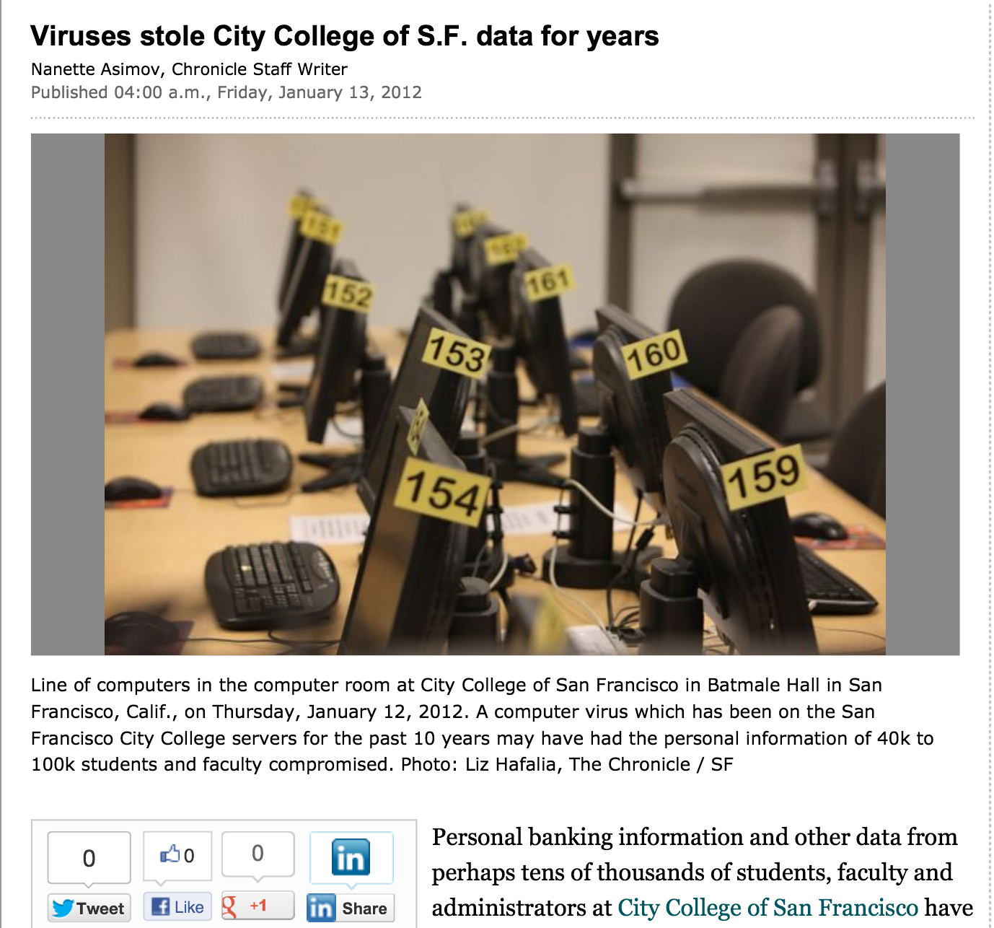

Slide 50
Outside attacks Insider threat Deluded Insider Threat

Slide 51
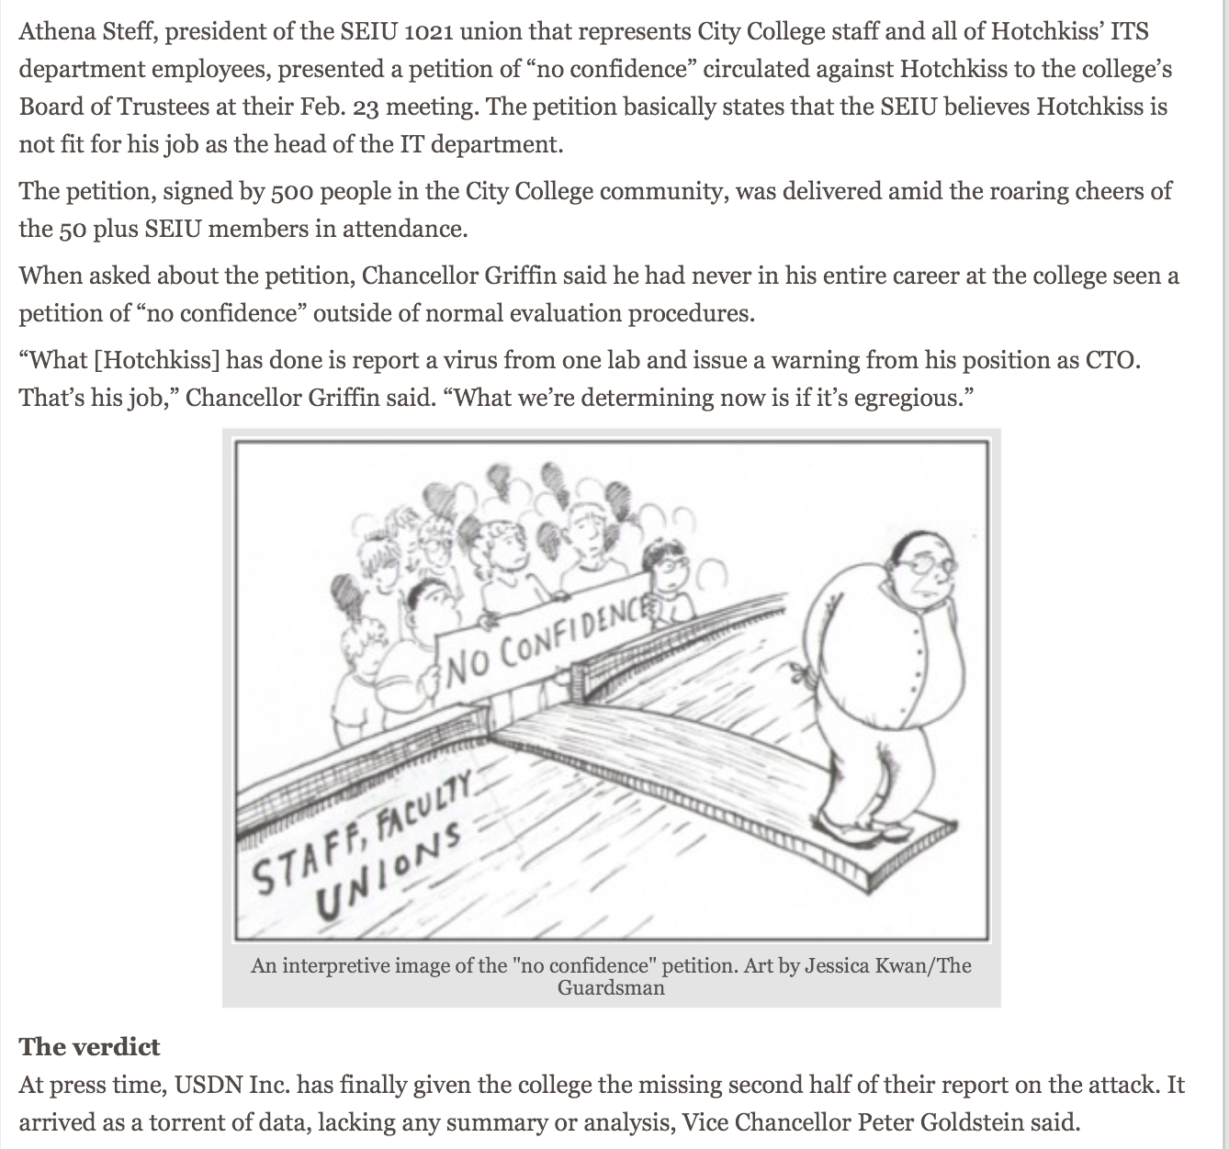

Slide 52
