Slide 1
Hands-on SQL Injection Attack and Defense
HI-TEC
July 21, 2013

Slide 2
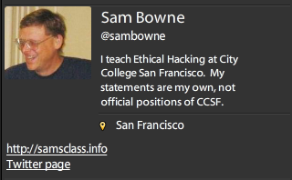
Bio

Slide 3
How Important is SQL Injection?

Slide 4
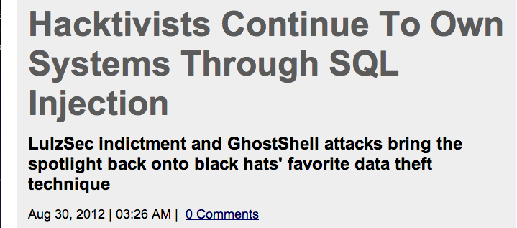
SQL injection continues to reign as hackers' most consistently productive technique for stealing massive dumps of sensitive information within corporate databases.
In fact, according to analysis done by database security firm Imperva of breach events between 2005 and July of this year, 82 percent of lost data due to hacking was courtesy of SQL injection.
http://www.darkreading.com/database-security/167901020/security/news/240006491/hacktivists-continue-to-own-systems-through-sql-injection.html

Slide 5
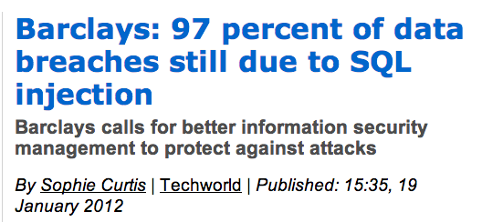
http://news.techworld.com/security/3331283/barclays-97-percent-of-data-breaches-still-due-to-sql-injection/

Slide 6
In 2008 SQL Injection became the leading method of malware distribution
16 percent of websites are vulnerable to SQL Injection
http://jeremiahgrossman.blogspot.com/2009/02/sql-injection-eye-of-storm.html

Slide 7
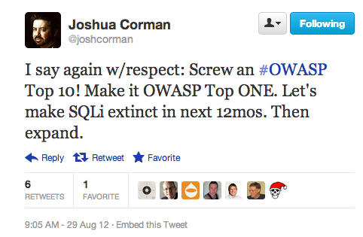

Slide 8
Are You Vulnerable?

Slide 9
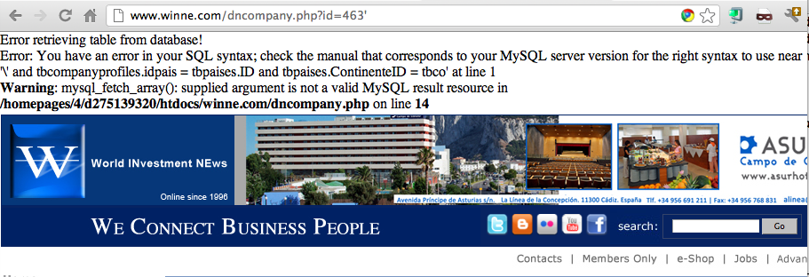
Example SQL Injection Vulnerability

Slide 11
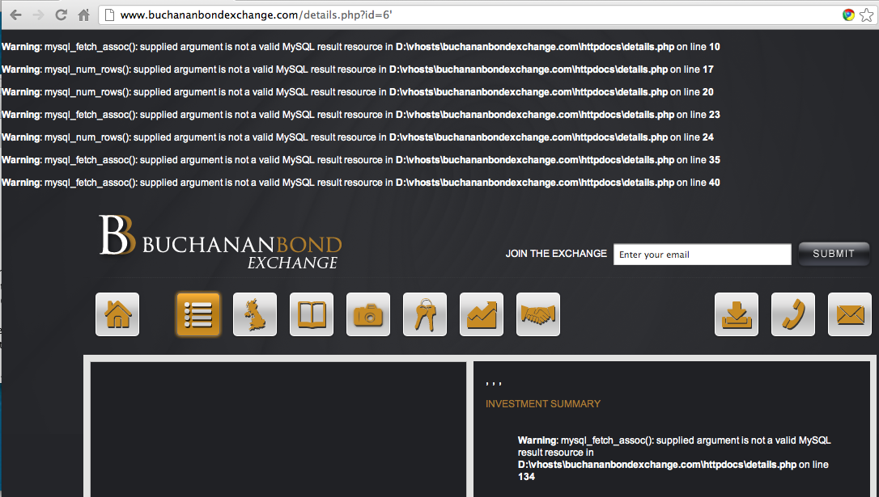

Slide 12
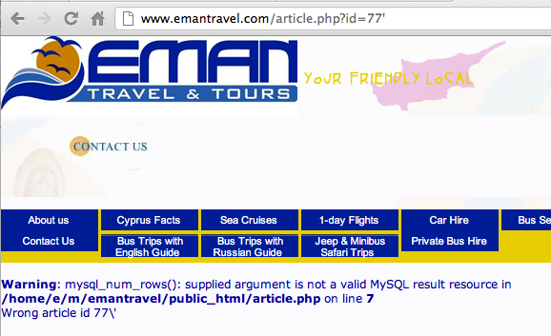

Slide 13
The Commands Used to Steal the Data

Slide 14
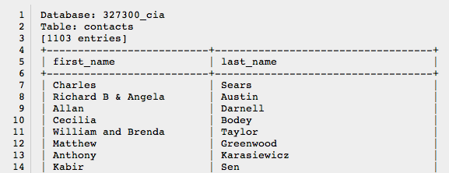
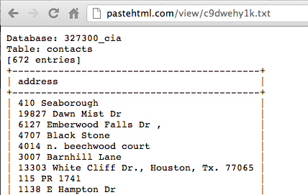
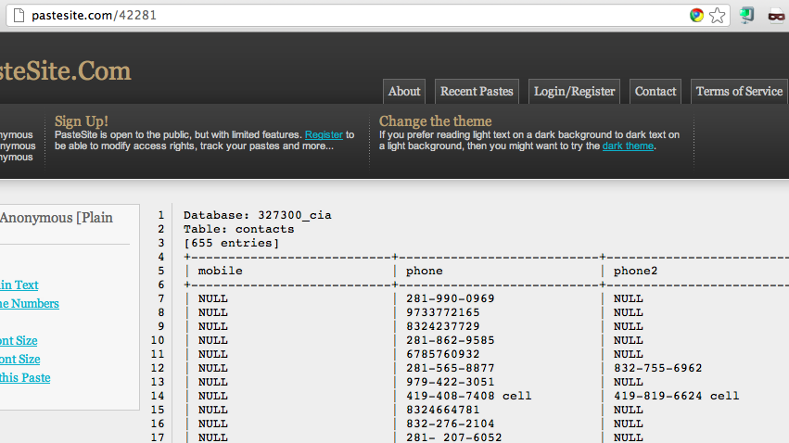
Data Breach

Slide 15
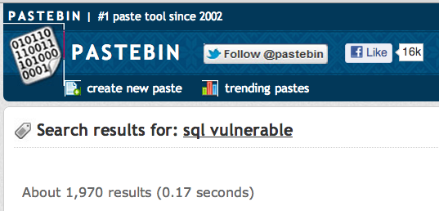
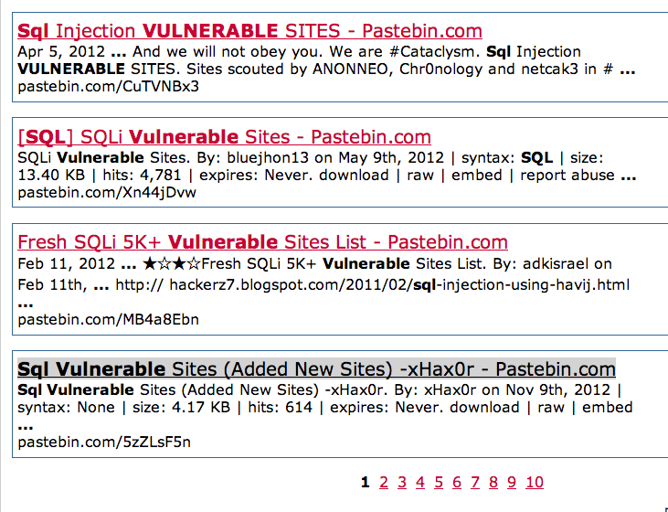

Slide 16
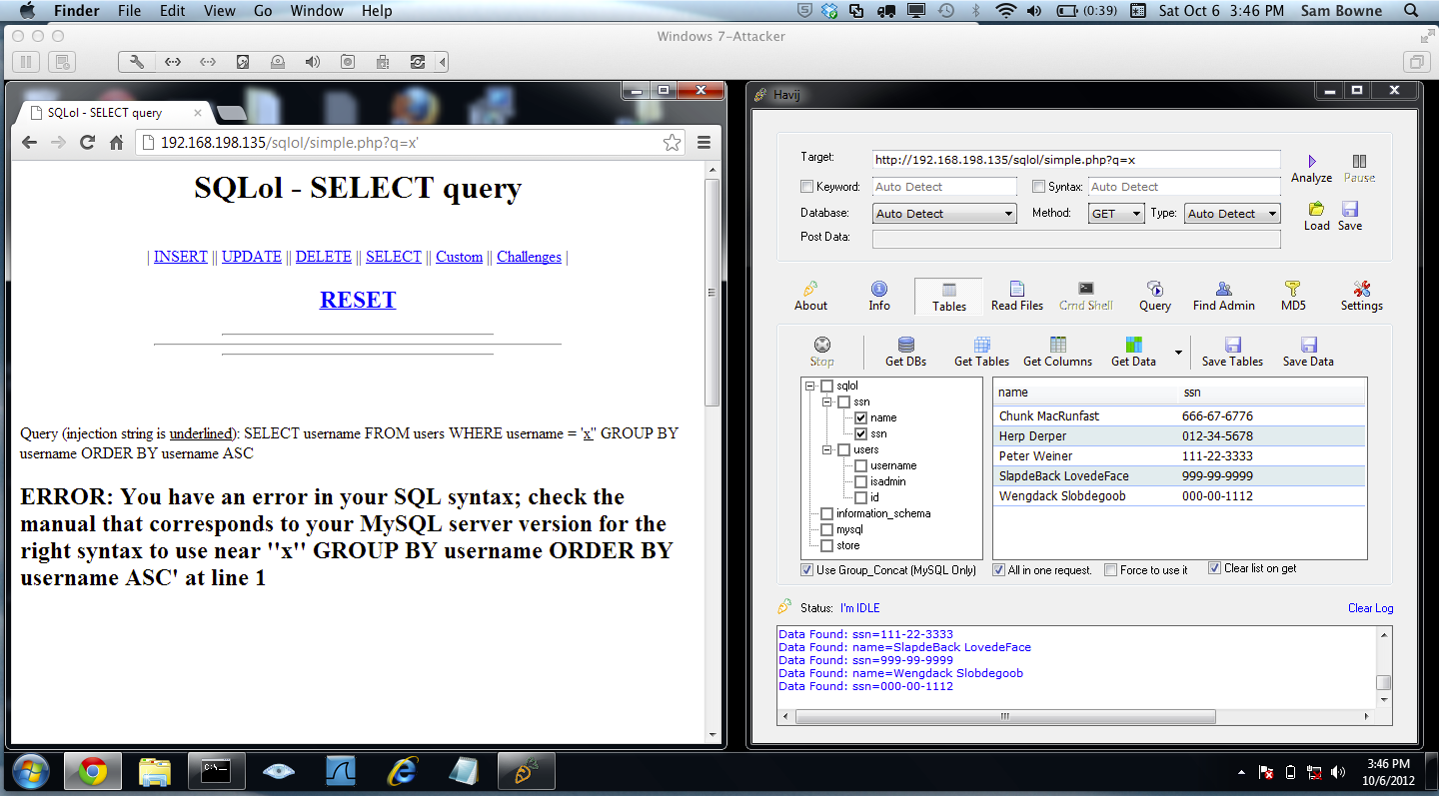
Hands-On SQL Injection Project
http://samsclass.info/124/proj11/SQLi-MPICT.htm

Slide 17
Series of Projects

Slide 18
Open Web Application Security Project (OWASP)
Open, not-for-profit organization dedicated to finding and fighting vulnerabilities in Web applications
Publishes the Ten Most Critical Web Application Security Vulnerabilities

Slide 19
Top-10 Web application vulnerabilities
Cross-site scripting (XSS) flaws
Attackers inject code into a web page, such as a forum or guestbook
When others user view the page, confidential information is stolen
See link Ch 10za
Command injection flaws
An attacker can embed malicious code and run a program on the database server
Example: SQL Injection

Slide 20
Top-10 Web application vulnerabilities
Malicious file execution
Users allowed to upload or run malicious files
Unsecured Direct Object Reference
Information in the URL allows a user to reference files, directories, or records
Cross-site Request Forgery (CSRF)
Stealing an authenticated session, by replaying a cookie or other token

Slide 21
Top-10 Web application vulnerabilities
Information Leakage and Incorrect Error Handling
Error messages that give away too much information
Broken Authentication and Session Management
Allow attackers to steal cookies or passwords

Slide 22
Top-10 Web application vulnerabilities
Unsecured cryptographic Storage
Storing keys, certificates, and passwords on a Web server can be dangerous
Unsecured Communication
Using HTTP instead of HTTPS
Failure to Restrict URL Access
Security through obscurity
Hoping users don't find the "secret" URLs

Slide 23
Cross-Site Scripting (XSS)
One client posts active content, with <script> tags or other programming content
When another client reads the messages, the scripts are executed in his or her browser
One user attacks another user, using the vulnerable Web application as a weapon

Slide 24
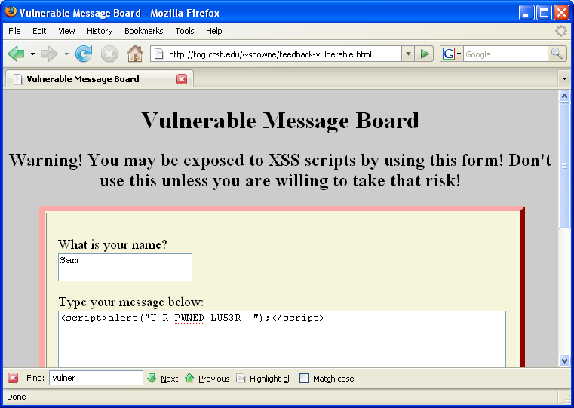
<script>alert("XSS vulnerability!")</script>
<script>alert(document.cookie)</script>
<script>window.location="http://www.ccsf.edu"</script>

Slide 25
XSS Scripting Effects
Steal another user's authentication cookie
Hijack session
Harvest stored passwords from the target's browser
Take over machine through browser vulnerability
Redirect Webpage
Many, many other evil things…

