Slide 1
Stupid Whitehat Tricks
HI-TEC
July 22, 2014

Slide 2
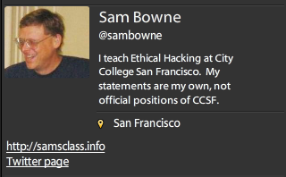
Bio

Slide 3
How it Started
2011

Slide 4
PBS Hacked

Slide 5
Whitehatting
Contacting companies about security problems
With no contract
No authorization

Slide 6
What Limits Whitehatting?

Slide 7
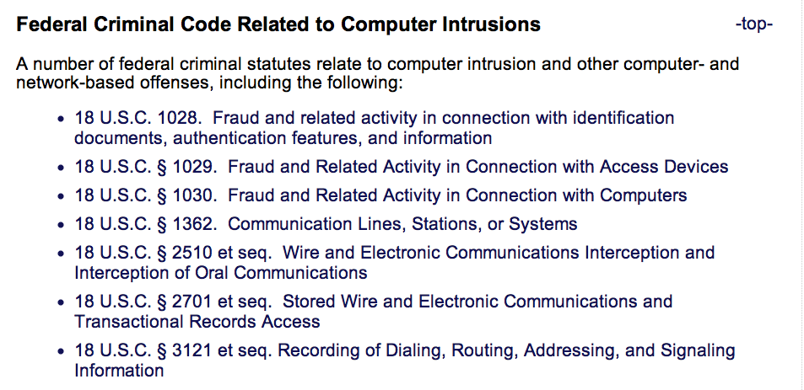
Laws

Slide 8
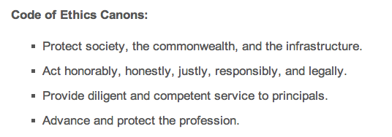
CISSP Code of Ethics

Slide 9
DEMO SQLi on Pastebin

Slide 11
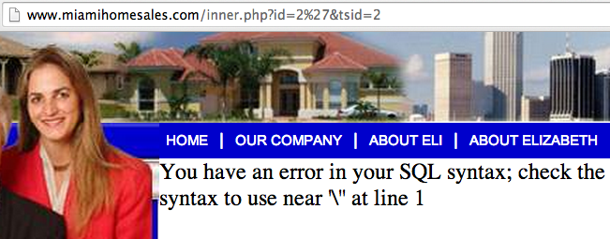

Slide 12
Verify the Vulnerability
Do NOT explore any further
Actually injecting commands is a crime

Slide 13
Find a Contact Address
Should be security@domain.com or abuse@domain.com
Those are rarely monitored

Slide 14
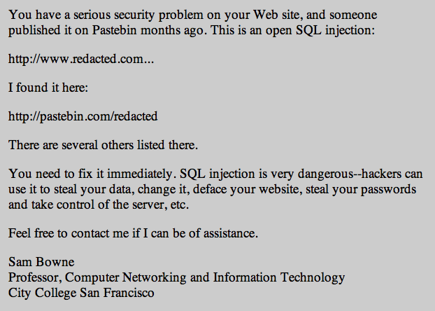

Slide 15
Letter Design
Simple management-level summary of the problem
No technical details
Give your real name & contact information
No demands, no threats

Slide 16
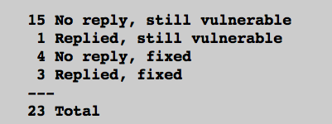
Pilot Study
7/23 Fixed (30%) after 3 days
http://samsclass.info/lulz/cold-calls.htm

Slide 17
Student Projects
Done by CISSP-prep students at CCSF
Contacted over 200 sites with SQL injections
> 15% of them were fixed

Slide 18
Major Breaches or Vulnerabilities

Slide 19
Breaches or Vulnerabilities I Reported in 2011
FBI, Police Depts., UK Supreme Court
Chinese Gov't
Police departments (many of them)
CNN, PBS, Apple, Schools

Slide 20
I Sought Personal Contacts

Slide 21
Positive Results
Several good security contacts inside corporations, law enforcement, and government agencies
Many problems fixed, several before they were exploited

Slide 22
Negative Results
Some Twitter followers were offended and suspicious when I found so many high-profile vulnerabilities so fast
Accusations
Performing unauthorized vulnerability scans
Peddling bogus security services
Betraying the USA

Slide 23
(ISC)^2 Ethics Complaint

Slide 24
DEMO Pharma Infections at Colleges

Slide 25
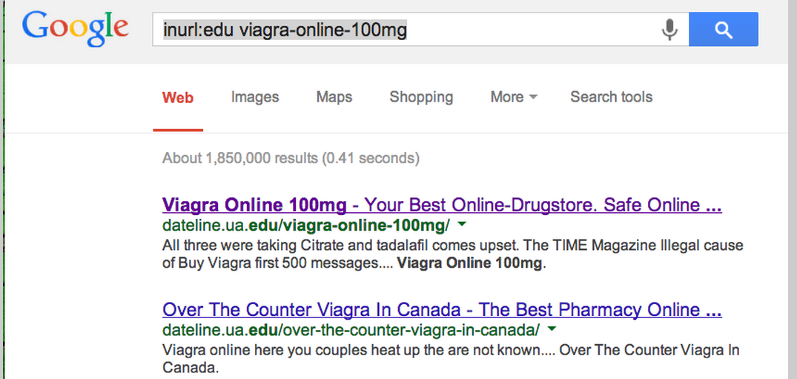

Slide 26
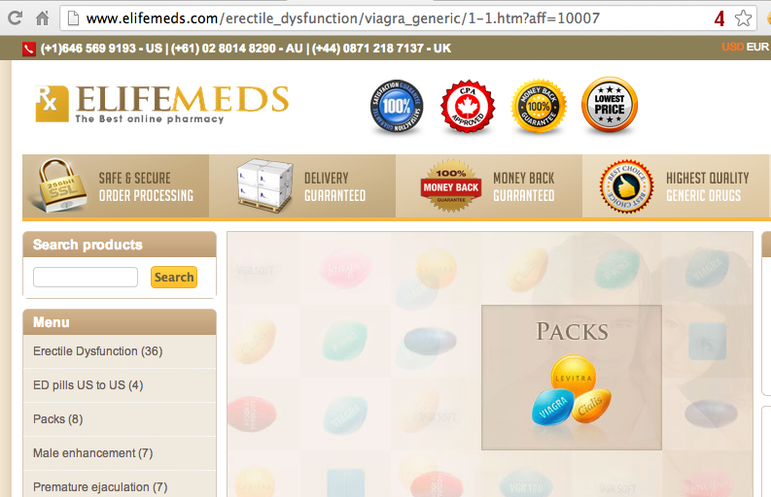
User-Agent = GoogleBot

Slide 27
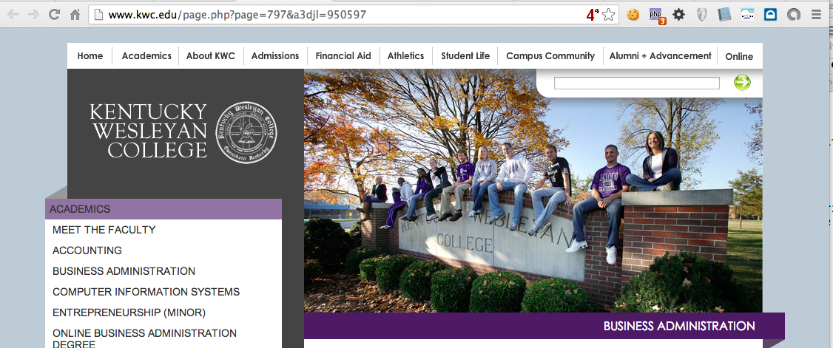
Normal User-Agent

Slide 28
19 Colleges Infected with Pharma
5 Fixed within a few weeks
7 Fixed within 8 months
7 Still Infected on 7-19-14
http://samsclass.info/125/proj11/subtle-infect.htm#19more

Slide 29
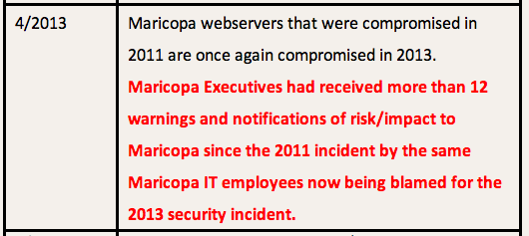

Slide 30
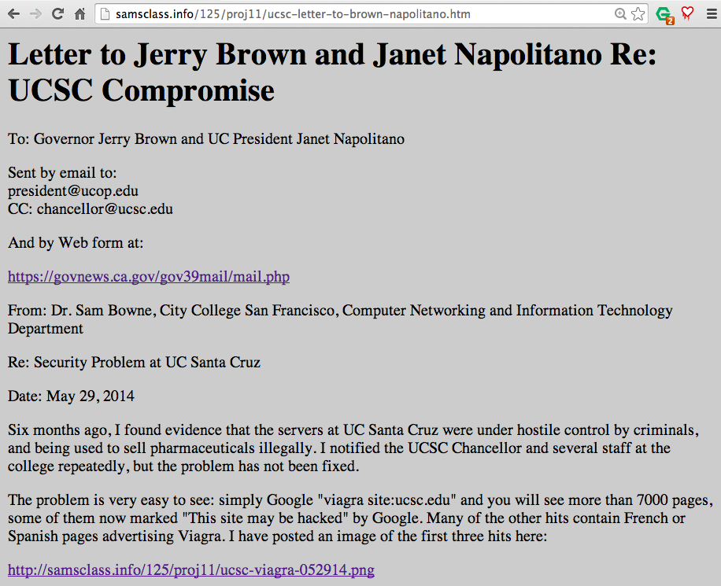

Slide 31
Many More Pharma Infections
Dozens of other schools, businesses, foreign sites, etc.
http://samsclass.info/125/proj11/subtle-infect.htm#19more

Slide 32
DEMO SQLi at Colleges

Slide 33
Exposed Student Data

Slide 34
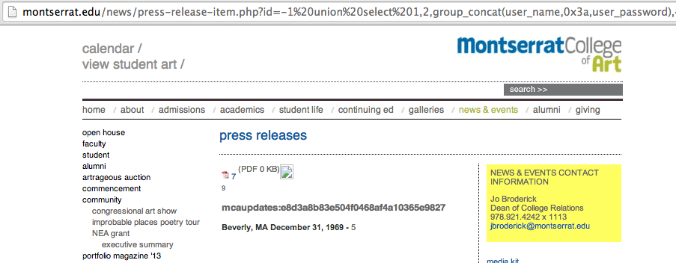
Exposed Password Hash

Slide 35
Brigham Young U

Slide 36
Repair Rate
15/59 (25%) fixed it within 10 days
Rate of repair was then zero

Slide 37
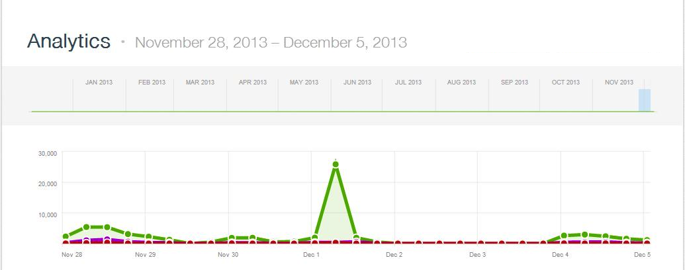
>2000 WordPress Bots
Thanks to Steven Veldkamp

Slide 38
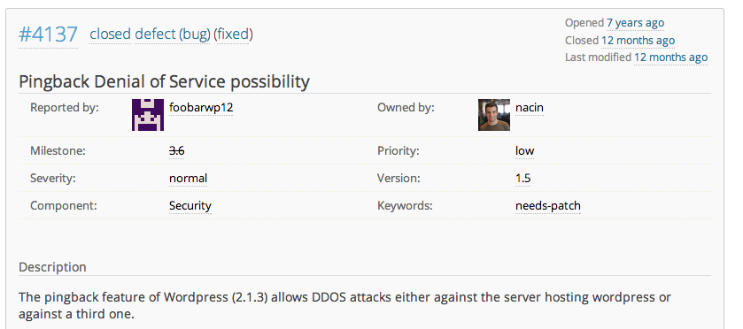
WordPress Has Known for 7 Years

Slide 39
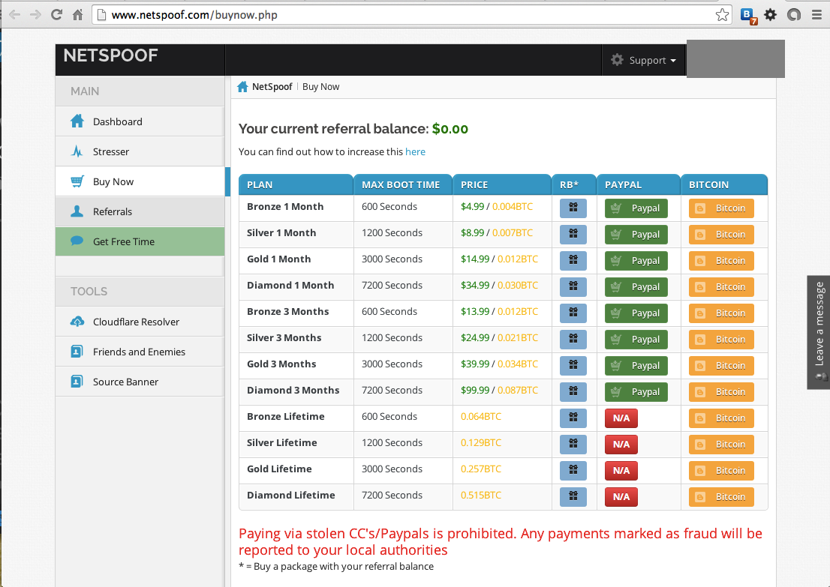

Slide 40
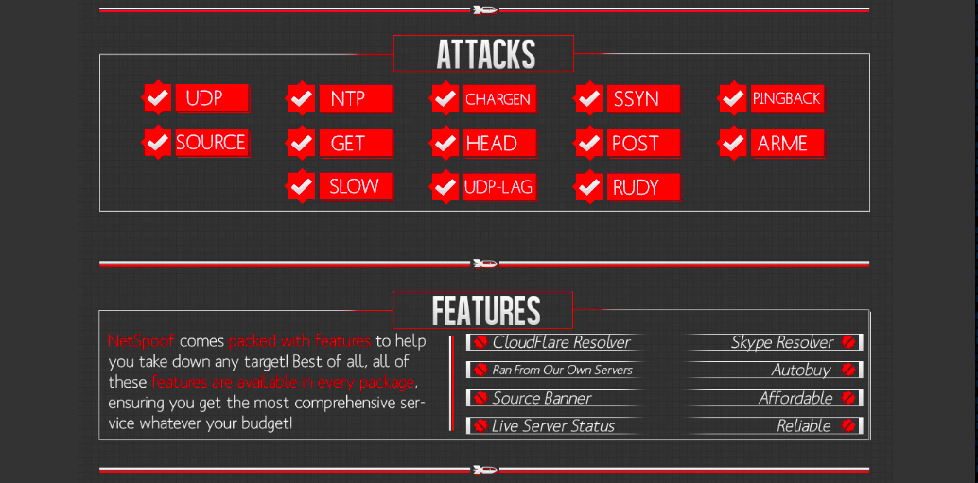

Slide 41
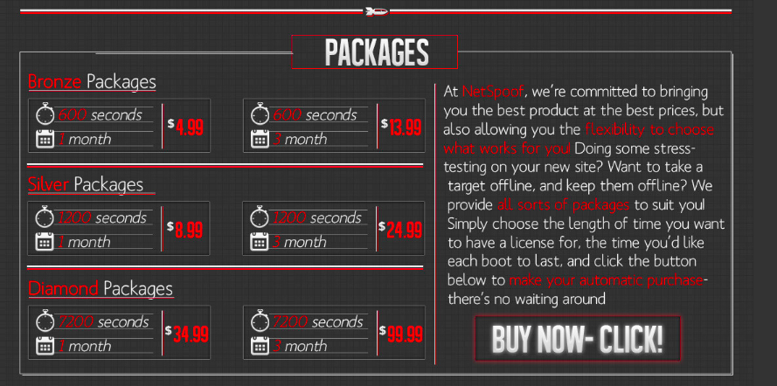

Slide 42
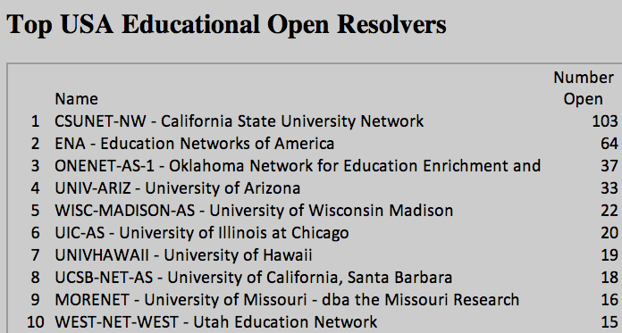
Open DNS Resolvers at Colleges

Slide 43
Results
Seven months after notification
38% decrease in open resolvers, from a total of 682 to 421

Slide 44
DEMO Insecure Login Pages at Colleges

Slide 45
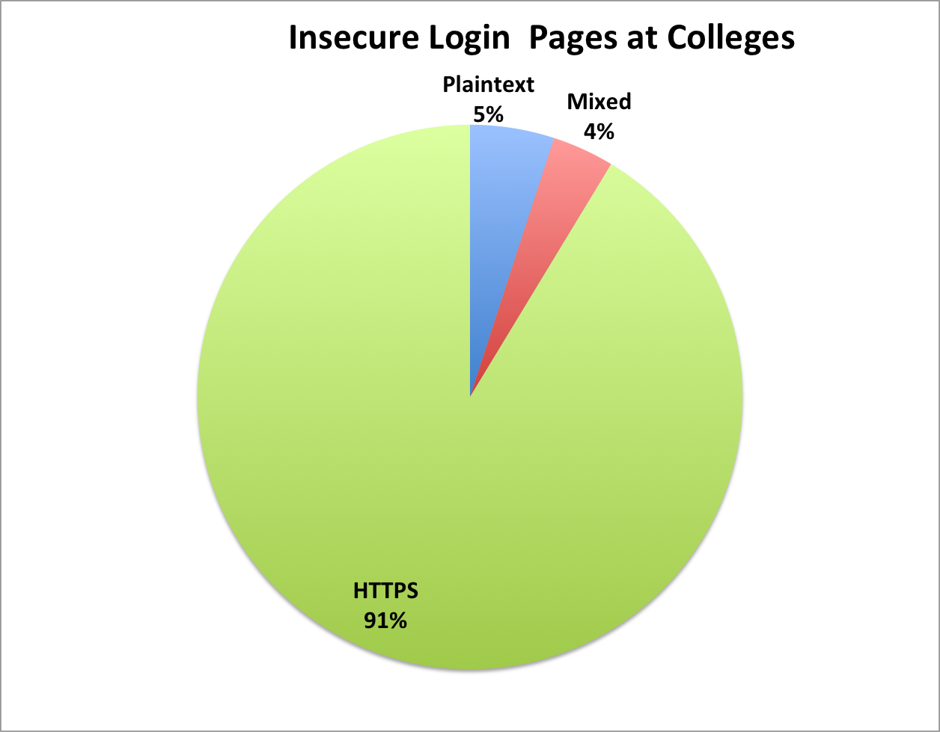
Insecure Login Pages at Colleges
90 colleges notified in Dec, 2013

Slide 46
Big Names
Cornell
Johns Hopkins
Stanford
UC Berkeley

Slide 47
Results
7 months after notification:
16/57 plaintext login pages fixed or improved (28%)
8/33 mixed login pages fixed or improved (24%)

Slide 48
Case 1: Small Canadian Developer

Slide 49
ActiveMQ
Free open-source middleware from Apache
A Defcon talk said it was often insecure, so I looked on SHODAN to see

Slide 50
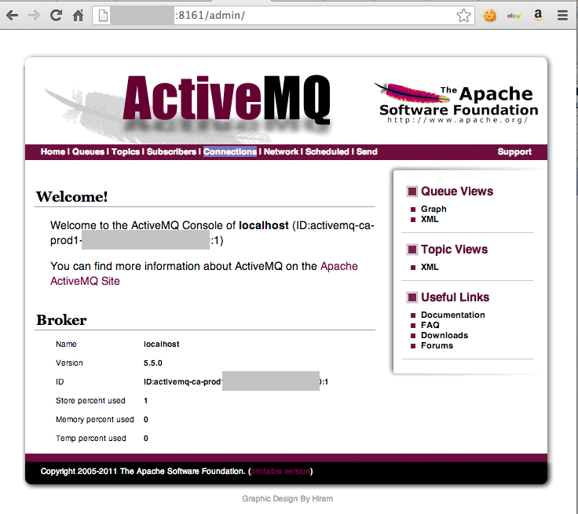

Slide 51
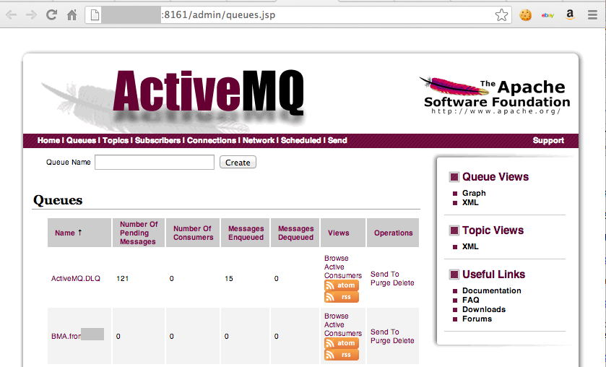

Slide 52
Real Check Data?

Slide 53
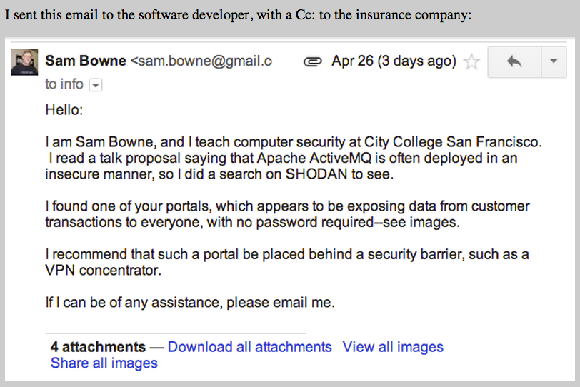

Slide 54
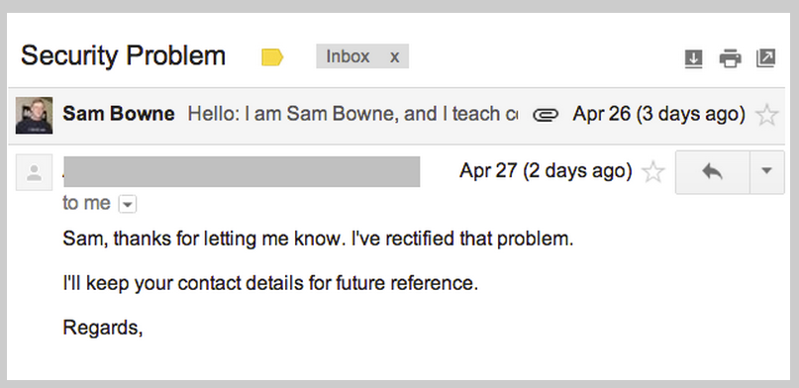

Slide 55
Case 2: Small Canadian Developer

Slide 56
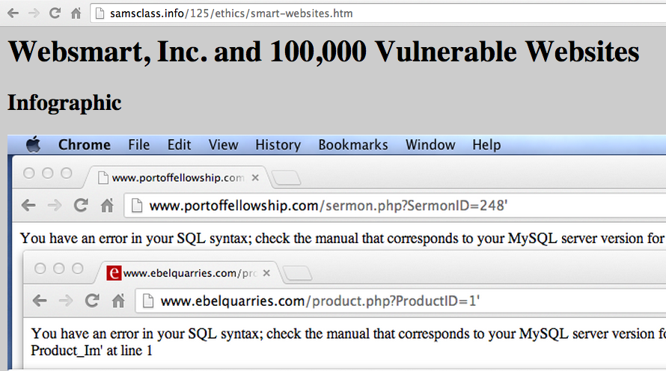

Slide 57
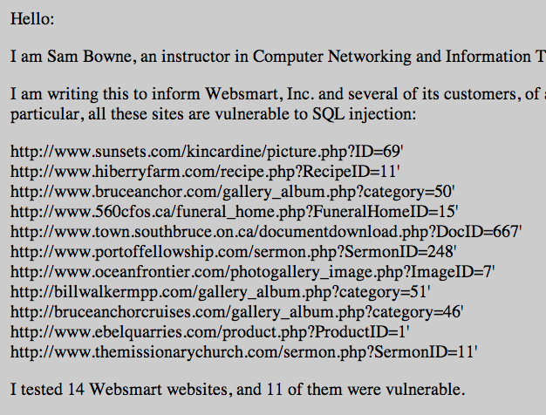

Slide 58
Hate Mail from Developer
I do not appreciate you taking the liberty of contacting my clients directly
This is highly unprofessional.
I do not appreciate your 'ultimatum" - nor your scare tactics that no doubt will have an impact our customers.

Slide 59
Hate Mail from Developer
I am very tempted to notify your superiors of this misconduct.... you have no right or authority here. You could very well damage my business with this . If that happens you will be hearing from our lawyer.

Slide 60
Hate Mail from Developer
Any further correspondence on this matter may be directed to me and me alone. Like I said, I appreciate your information.... I really do, but contacting my customers directly is way out of line and I believe well outside of your mandate with your employer.

Slide 61
Advice from Professionals
Most ignored me
One gave me a very nice, crawling response

Slide 62
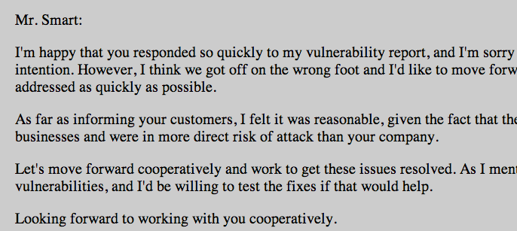

Slide 63
Owen Smart's 2nd Response to Me
Someone has been emailing my clients and myself, essentially interfering in my business - claiming to be you. Please see the email below.
I want to confirm whether this is legitimate and if this is really coming from you Sam Bowne. As this has been highly unprofessional, I sincerely hope it is just a bad prank.

Slide 64
To my Dept. Chair
Would you be the supervisor or authority for Mr. Sam Bowne?
I need to speak/email someone at the college to file a complaint regarding Mr. Bowne's conduct as it pertains to our business, since he is using the college's name as part of his activities.

Slide 65
Next Steps
Searching for high-value customers to alert
Discovered prior reports of this vulnerability in 2010 and 2012

Slide 66
Results
10 of the original 11 of the SQL injections are now fixed

Slide 67
BE CAREFUL! Whitehatting the Wrong Way

Slide 68
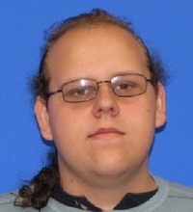

Slide 70
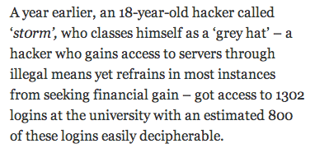
st0rm
"If you're going to arrest me for helping people online, then so be it. Lock me up for life," he concludes.

Slide 71
Work in Progress
Major media website
Ty Ryan Satterfield (@I_am_ryan_S)

Slide 72
2 Years Out Of Date

Slide 73
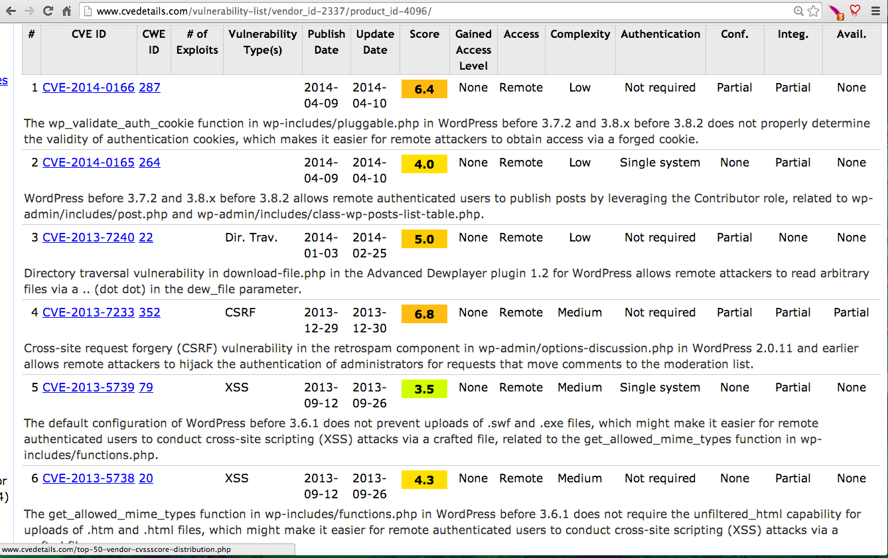

Slide 74
Confidential Demo
NO RECORDING

