Slide 1
Practical Malware Analysis
Ch 1: Malware Analysis Primer

Slide 2
The Goals of Malware Analysis

Slide 3
Incident Response
Case history
A medical clinic with 10 offices found malware on one of their workstations
Hired a consultant to clean & re-image that machine
All done—case closed?

Slide 4
Incident Response
After malware is found, you need to know
Did an attacker implant a rootkit or trojan on your systems?
Is the attacker really gone?
What did the attacker steal or add?
How did the attack get in
Root-cause analysis

Slide 5
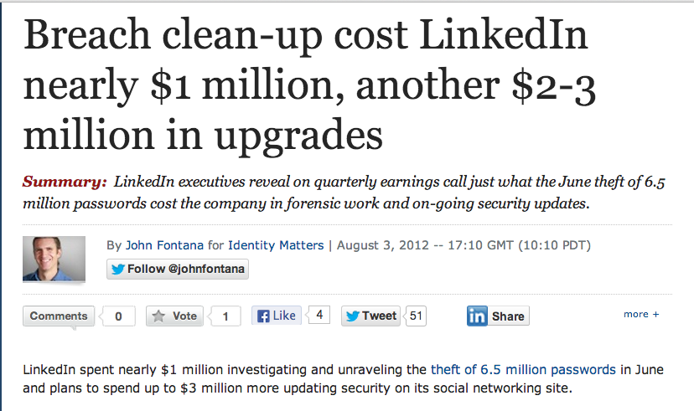
Link Ch 1a

Slide 6
Malware Analysis
Dissecting malware to understand
How it works
How to identify it
How to defeat or eliminate it
A critical part of incident response

Slide 7
The Goals of Malware Analysis
Information required to respond to a network intrusion
Exactly what happened
Ensure you’ve located all infected machines and files
How to measure and contain the damage
Find signatures for intrusion detection systems

Slide 8
Signatures
Host-based signatures
Identify files or registry keys on a victim computer that indicate an infection
Focus on what the malware did to the system, not the malware itself
Different from antivirus signature
Network signatures
Detect malware by analyzing network traffic
More effective when made using malware analysis

Slide 9
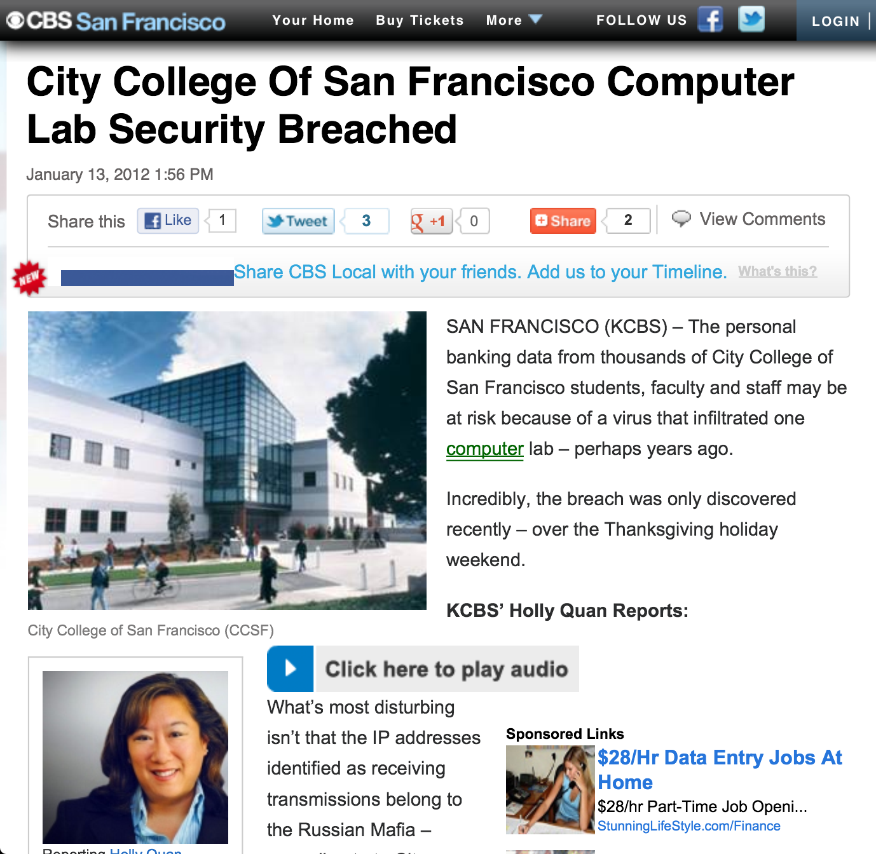
False Positives

Slide 10
Malware Analysis Techniques

Slide 11
Static v. Dynamic Analysis
Static Analysis
Examines malware without running it
Tools: VirusTotal, strings, a disassembler like IDA Pro
Dynamic Analysis
Run the malware and monitor its effect
Use a virtual machine and take snapshots
Tools: RegShot, Process Monitor, Process Hacker, CaptureBAT
RAM Analysis: Mandant Redline and Volatility

Slide 12
Basic Analysis
Basic static analysis
View malware without looking at instructions
Tools: VirusTotal, strings
Quick and easy but fails for advanced malware and can miss important behavior
Basic dynamic analysis
Easy but requires a safe test environment
Not effective on all malware

Slide 13
Advanced Analysis
Advanced static analysis
Reverse-engineering with a disassembler
Complex, requires understanding of assembly code
Advanced Dynamic Analysis
Run code in a debugger
Examines internal state of a running malicious executable

Slide 14
Types of Malware

Slide 15
Types of Malware
Backdoor
Allows attacker to control the system
Botnet
All infected computers receive instructions from the same Command-and-Control (C&C) server
Downloader
Malicious code that exists only to download other malicious code
Used when attacker first gains access

Slide 16
Types of Malware
Information-stealing malware
Sniffers, keyloggers, password hash grabbers
Launcher
Malicious program used to launch other malicious programs
Often uses nontraditional techniques to ensure stealth or greater access to a system
Rootkit
Malware that conceals the existence of other code
Usually paired with a backdoor

Slide 17
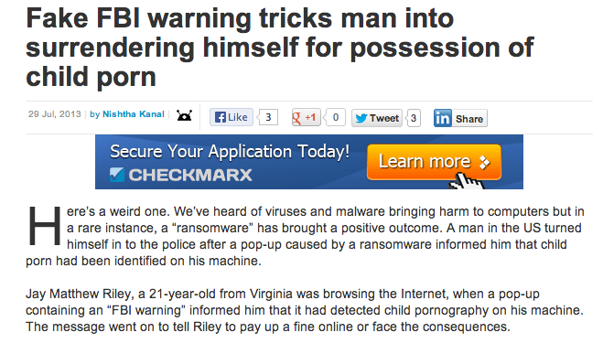
Types of Malware
Scareware
Frightens user into buying something
Link Ch 1b

Slide 18
Types of Malware
Spam-sending malware
Attacker rents machine to spammers
Worms or viruses
Malicious code that can copy itself and infect additional computers

Slide 19
Mass v. Targeted Malware
Mass malware
Intended to infect as many machines as possible
Most common type
Targeted malware
Tailored to a specific target
Very difficult to detect, prevent, and remove
Requires advanced analysis
Ex: Stuxnet

Slide 20
General Rules for Malware Analysis

Slide 21
General Rules for Malware Analysis
Don’t Get Caught in Details
You don’t need to understand 100% of the code
Focus on key features
Try Several Tools
If one tool fails, try another
Don’t get stuck on a hard issue, move along
Malware authors are constantly raising the bar

Slide 22
Ch 2: Basic Static Analysis

Slide 23
Techniques
Antivirus scanning
Hashes
A file’s strings, functions, and headers

Slide 24
Antivirus Scanning

Slide 25
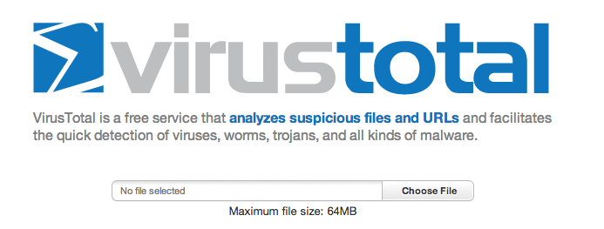
Only a First Step
Malware can easily change its signature and fool the antivirus
VirusTotal is convenient, but using it may alert attackers that they’ve been caught
Link Ch 2a

Slide 26
Hashing
A fingerprint for malware

Slide 27
Hashes
MD5 or SHA-1
Condenses a file of any size down to a fixed-length fingerprint
Uniquely identifies a file well in practice
There are MD5 collisions but they are not common
Collision: two different files with the same hash

Slide 28
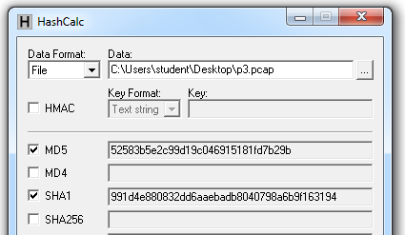
HashCalc

Slide 29
Hash Uses
Label a malware file
Share the hash with other analysts to identify malware
Search the hash online to see if someone else has already identified the file

Slide 30
Finding Strings

Slide 31
Strings
Any sequence of printable characters is a string
Strings are terminated by a null (0x00)
ASCII characters are 8 bits long
Now called ANSI
Unicode characters are 16 bits long
Microsoft calls them "wide characters"

Slide 32
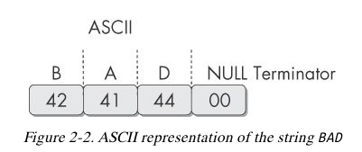

Slide 33
The strings Command
Native in Linux, also available for Windows
Finds all strings in a file 3 or more characters long

Slide 34
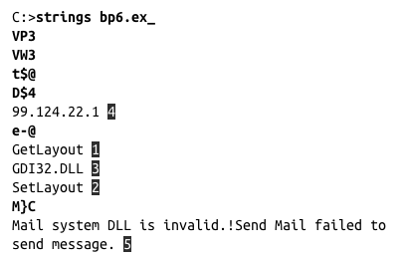
The strings Command
Bold items can be ignored
GetLayout and SetLayout are Windows functions
GDI32.DLL is a Dynamic Link Library

Slide 35
Packed and Obfuscated Malware

Slide 36
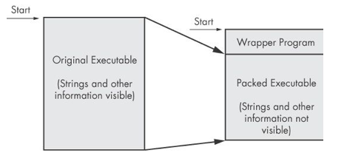
Packing Files
The code is compressed, like a Zip file
This makes the strings and instructions unreadable
All you'll see is the wrapper – small code that unpacks the file when it is run

Slide 37
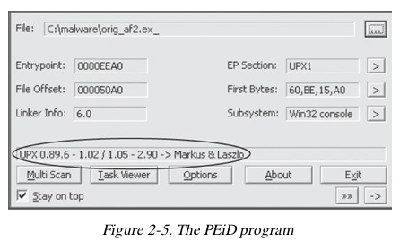
Detecting Packers with PEiD

Slide 38
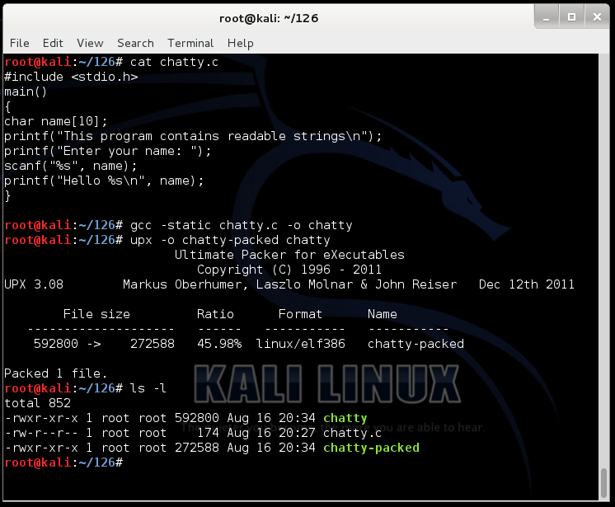
Demo: UPX

Slide 39
Packing Obfuscates Strings

Slide 40
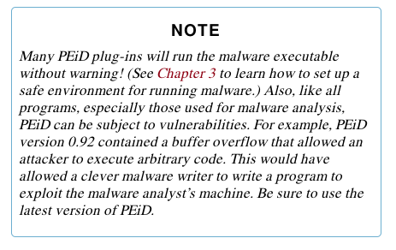

Slide 41
Portable Executable File Format
EXE Files

Slide 42
PE Files
Used by Windows executable files, object code, and DLLs
A data structure that contains the information necessary for Windows to load the file
Almost every file executed on Windows is in PE format

Slide 43
PE Header
Information about the code
Type of application
Required library functions
Space requirements

Slide 44
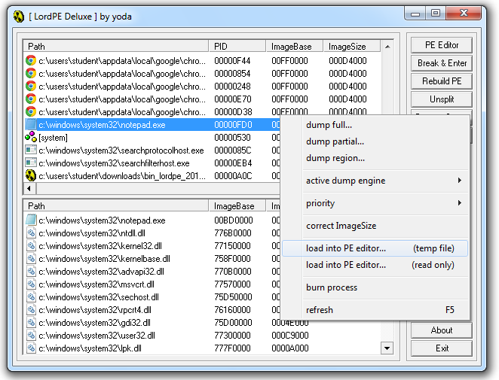
LordPE Demo

Slide 45
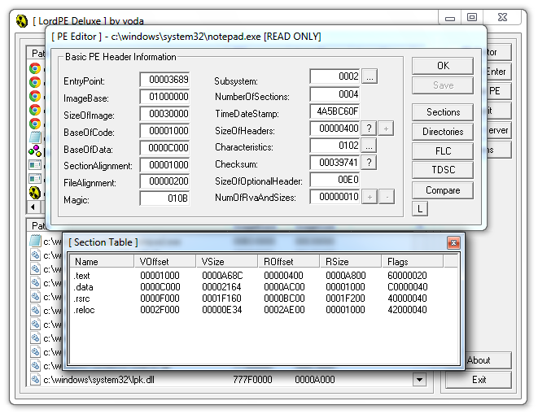
Main Sections

Slide 46
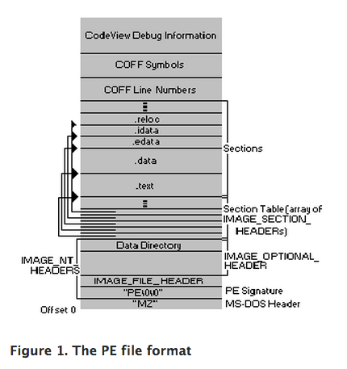
There are a lot more sections
But the main ones are enough for now
Link Ch 2c

Slide 47
Linked Libraries and Functions

Slide 48
Imports
Functions used by a program that are stored in a different program, such as library
Connected to the main EXE by Linking
Can be linked three ways
Statically
At Runtime
Dynamically

Slide 49
Static Linking
Rarely used for Windows executables
Common in Unix and Linux
All code from the library is copied into the executable
Makes executable large in size

Slide 50
Runtime Linking
Unpopular in friendly programs
Common in malware, especially packed or obfuscated malware
Connect to libraries only when needed, not when the program starts
Most commonly done with the LoadLibrary and GetProcAddress functions

Slide 51
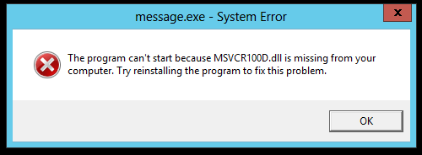
Dynamic Linking
Most common method
Host OS searches for necessary libraries when the program is loaded

Slide 52
Clues in Libraries
The PE header lists every library and function that will be loaded
Their names can reveal what the program does
URLDownloadToFile indicates that the program downloads something

Slide 53
Dependency Walker

Slide 54
Shows Dynamically Linked Functions
Normal programs have a lot of DLLs
Malware often has very few DLLs

Slide 55
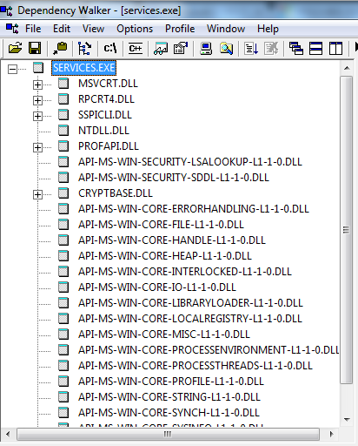
Services.exe

Slide 56
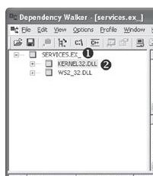
Services.ex_ (malware)

Slide 57
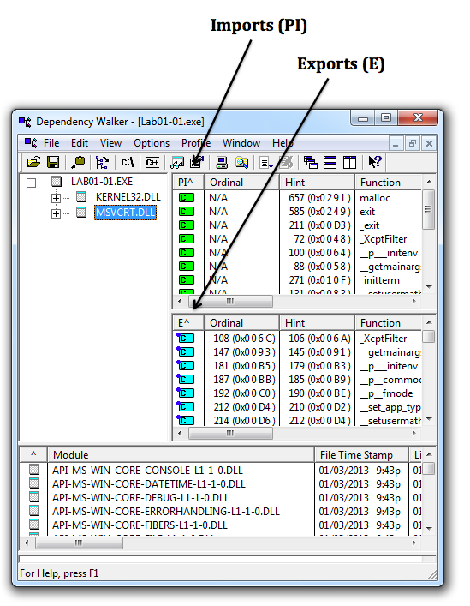
Imports & Exports in Dependency Walker

Slide 58
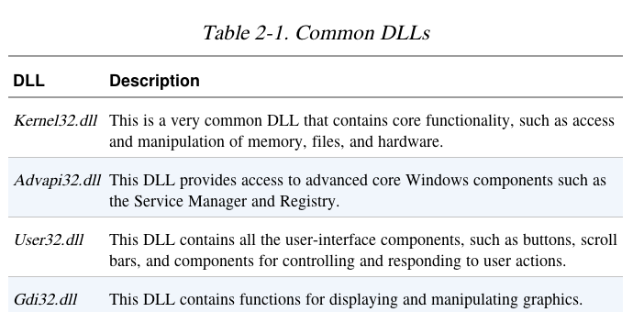

Slide 59
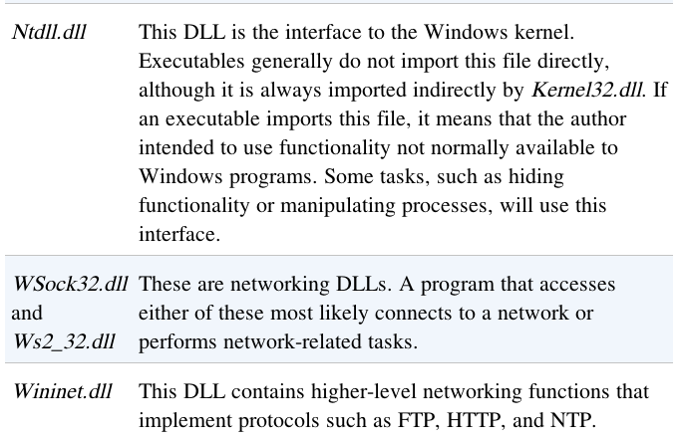

Slide 60
Exports
DLLs export functions
EXEs import functions
Both exports and imports are listed in the PE header
The book says exports are rare in EXEs, but I see a ton of exports in innocent EXEs

Slide 61
Example: Keylogger
Imports User32.dll and uses the function SetWindowsHookEx which is a popular way keyloggers receive keyboard inputs
It exports LowLevelKeyboardProc and LowLevelMouseProc to send the data elsewhere
It uses RegisterHotKey to define a special keystroke like Ctrl+Shift+P to harvest the collected data

Slide 62
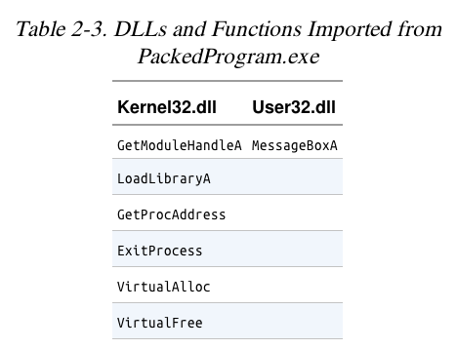
Ex: A Packed Program
Very few functions
All you see is the unpacker

Slide 63
The PE File Headers and Sections

Slide 64
Important PE Sections
.text -- instructions for the CPU to execute
.rdata -- imports & exports
.data – global data
.rsrc – strings, icons, images, menus

Slide 65
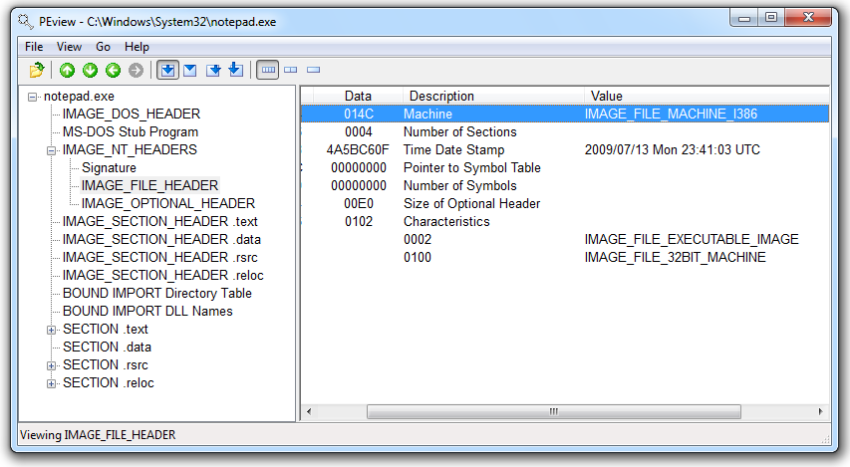
PEView (Link Ch 2e)

Slide 66
Time Date Stamp
Shows when this executable was compiled
Older programs are more likely to be known to antivirus software
But sometimes the date is wrong
All Delphi programs show June 19, 1992
Date can also be faked

Slide 67
IMAGE_SECTION_HEADER
Virtual Size – RAM
Size of Raw Data – DISK
For .text section, normally equal, or nearly equal
Packed executables show Virtual Size much larger than Size of Raw Data for .text section

Slide 68
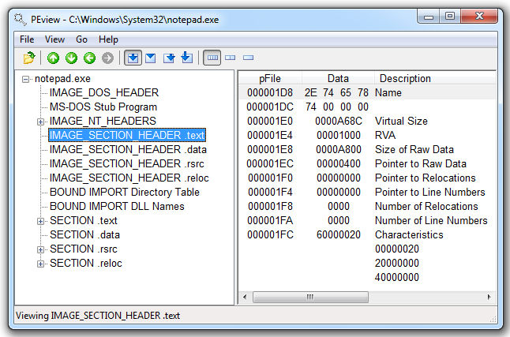
Not Packed

Slide 69
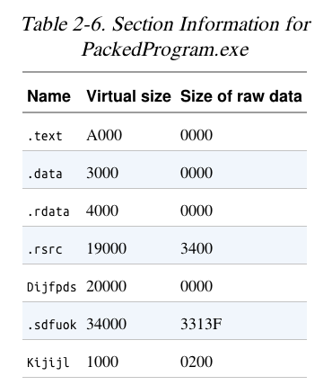

Slide 70
Resource Hacker
Lets you browse the .rsrc section
Strings, icons, and menus
Link Ch 2f

Slide 71
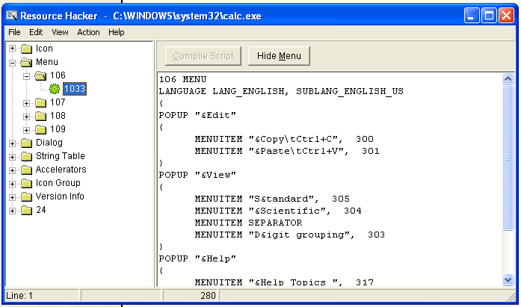
Resource Hacker in Windows XP

Slide 72
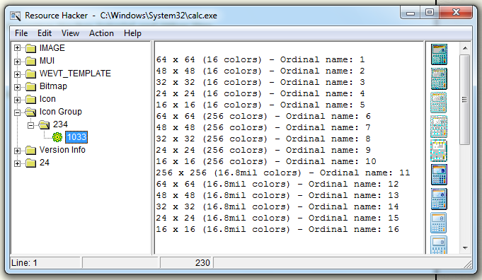
Resource Hacker in Windows 7

