Slide 1
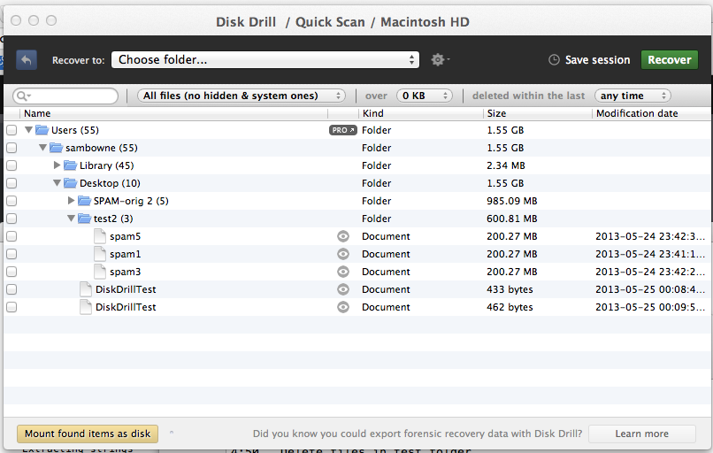
Demo on Mac: Disk Drill
Deleted files from desktop evaporate in 30-60 min

Slide 2
Computer Forensics Infosec Pro Guide
Ch 9
Nontraditional Digital Forensics

Slide 3
Topics
What is nontraditional forensics?
When and why to use nontraditional forensics
Understanding volatile system artifacts
Memory acquisition and analysis
Encrypted file systems and live system imaging
Dealing with mobile devices
Working with solid-state drives
Virtual machine forensics

Slide 4
What is Nontraditional Forensics?

Slide 5
Impact on the Evidence
Traditional, forensically sound, methods have no effect on the evidence during acquisition and analysis
Capture with a write-blocker
Examine only the captured data
Verify copy with a hash value, such as MD5 or SHA-1

Slide 6
Nontraditional Methods
Changes the evidence
Examiner attempts to minimize the changes
May be needed because
Technical issues
Organizational decision
Whim of a client

Slide 7
Communicate with Client
Get authorization from stakeholders before using nontraditional methods
Normal goals include
Minimize downtime of computer you're investigating
Preserve evidence perfectly with no changes
If you cannot do both of those, explain that to the stakeholders and decide how to proceed

Slide 8
Stakeholders
Corporate environment
Management
Legal
Working as a contractor
Customer
Never assume you are authorized
Get an explicit statement of authorization

Slide 9
Recordkeeping
Approach every investigation as if it were going to court
Preserve evidence properly
If you must deviate from traditional forensic procedures
Make sure you know the reasons for doing so
Back up your actions and decisions with documentation

Slide 10
When and Why to Use Nontraditional Forensics

Slide 11
Traditional Forensics
Power is off
Acquire hard disk image with write-blocker
Analyze the copy
Still most common type of forensics
However, it misses volatile artifacts
Running processes
Network connections
Routing table entries

Slide 12
Understanding Volatile System Artifacts

Slide 13
Volatile Artifacts
System artifacts that exist only when the system is up and running
Routing tables
Open and listening network ports
Established network connections
Cached login credentials
Passwords
Found in RAM or page file (swap space)
Must be collected before power-off

Slide 14
Incident Response and Malware Analysis
Rely heavily on state of a running compromised system
Must capture RAM image
Malware can add routes to the routing table which are not stored on the hard disk in the registry
They exist only in RAM

Slide 15
Types of Malware
Viruses
Embed themselves in files and spread
Worms
Spread through network connections
Trojan horses
Appear to be beneficial but actually do harm
Such as fake antivirus

Slide 16
Types of Malware
Spyware
Gather information and send it to a server
Example: keyloggers
Scareware
Scares user with messages asking for money
Example: 'Virus Detected"
Crimeware
Specifically designed for identity theft and fraud

Slide 17
Features of Malware
Persistence
Restarting computer does not stop the malware
Adds itself to a RUN registry key or some other Autostart Extensibility Point
Prevent Removal
Disable antivirus
Block antivirus updates, often by adding routes to blackhole their servers

Slide 18
Encrypted File Systems and Live System Imaging

Slide 19
Encrypted File Systems
Full Disk Encryption
Microsoft's BitLocker
Apple FileVault
Open source TrueCrypt
Pretty Good Privacy (PGP)
Check Point's Pointsec FDE
Main purpose: protect data when a laptop is lost or stolen
Sometimes also used on desktop computers
When physical access is not controlled

Slide 20
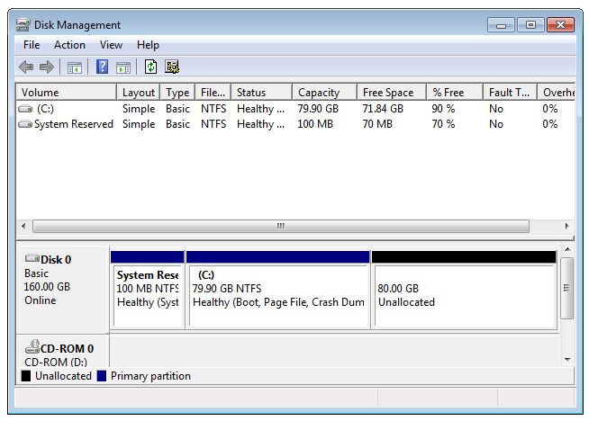
Unencrypted Boot Partition
Small partition (100 MB or so)
Contains a boot loader
Asks user for credentials
If they are correct, it decrypts the OS partition and starts the system
Image from https://kb.acronis.com/sites/default/files/content/2010/11/16249/vhd002.png

Slide 21
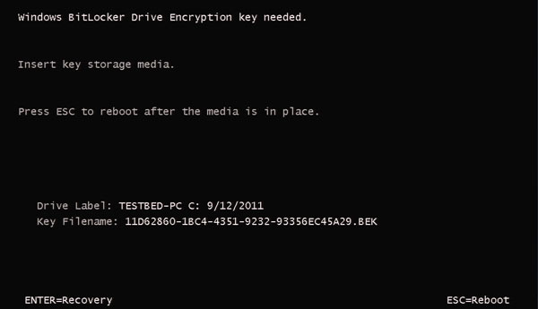
BitLocker with Startup Key
image from http://www.maximumpc.com/files/u139222/howtobitlocker-step03.jpg

Slide 22
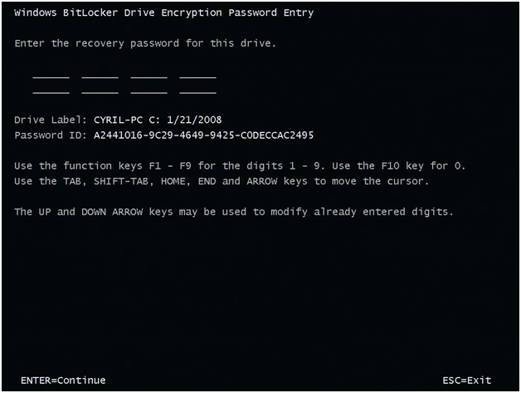
BitLocker with Recovery Password
Image from http://blogs.technet.com/cfs-file.ashx/__key/telligent-evolution-components-attachments/13-5628-00-00-03-05-41-37/Test_2D00_SecureStartup3.png

Slide 23
File and Folder-Level Encryption
May be used instead of, or in addition to, full disk encryption
Microsoft's Encrypting File System
Apple's FileVault
Pretty Good Privacy (PGP)
TrueCrypt
Winzip encryption
Microsoft office password protection
Many, many more

Slide 24
Self-Encrypting Drives
Hard drive firmware includes encryption
Custom firmware simulates an unencrypted boot partition
But the entire user-accessible portion of the disk is encrypted
User must enter a key to boot up
Forensic erase takes less than a second
Simply overwrite the key
Links Ch 9a, 9b

Slide 25
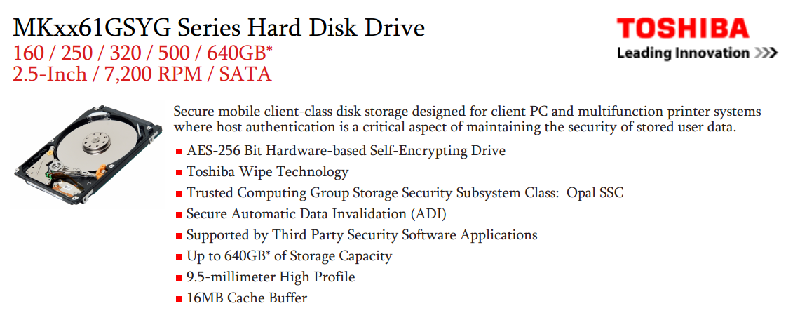
Self-Wiping Hard Drives
Wipes out the key when drive is moved to a different computer
Makes traditional acquisition impossible
Links Ch 9c, 9d

Slide 26
Challenges to Accessing Encrypted Data
Traditional approach
Image the encrypted drive
Use a forensic product to decrypt the drive (assuming you have the key)
But few tools are available that can decrypt drives
And they are not kept up-to-date with encryption process changes
Live acquisition
BitLocker makes the physical disk appear encrypted even when the system is on and logged in
All you can get is active data (link Ch 9f)

Slide 27
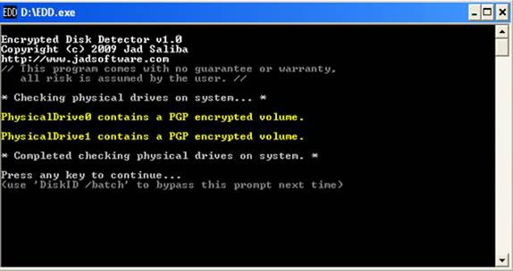
Encrypted Disk Detector
Link Ch 9e

Slide 28
Using Virtual Machines
In some cases, you can unencrypt volumes this way
Acquire the encrypted disk with dd
Use LiveVIew to mount the dd file as a VHD (read-only)
Boot VMware machine with a Pointsec recovery boot disk
Decrypt the disk with Pointsec (assuming you have the key)
Reboot with a forensic CD
Image the decrypted volume
Link Ch 9g

Slide 29
Simpler Way
Just decrypt the original drive with the recovery disk (assuming you have the key)
Then image it
Technically this alters the evidence, but in practice it's been accepted in court
Could keep an image of the original encrypted drive just as a precaution

Slide 30
If You Don't Have the Key
Your only option is to do a live acquisition
Get what you can
There are no known secret keys or backdoors into full disk encryption products

Slide 31
Dealing with Mobile Devices

Slide 32
Types of Mobile Devices
iPhone, iPad, iPod
Android phones
Windows mobile
Tablets
PDAs
Google Glasses
Many, many more

Slide 33
Evidence on Mobile Devices
Phone calls
Text messages
Email
GPS locations
Web browsing history
Much, much more

Slide 34
Traditional Techniques
Disassemble the device and extract the storage devices
Image them with a write-blocker
Not practical for most examiners, although DriveSavers can do that

Slide 35
Mount Device as a Removable Drive
Connect device via USB
Use USB write-blocker
Hardware or software
Image drive as usual

Slide 36
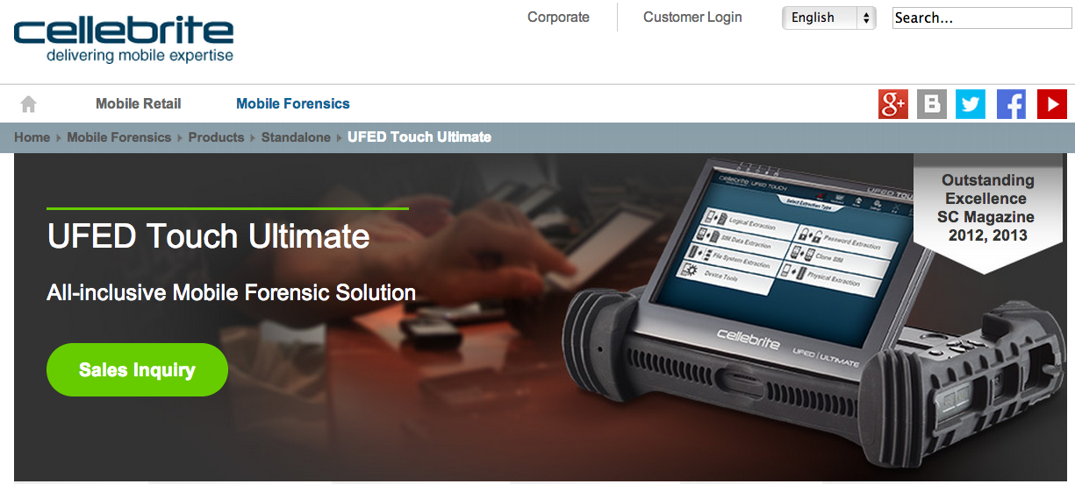
Commercial Devices
Link Ch 9i

Slide 37
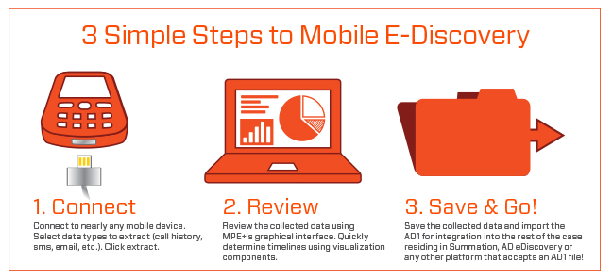
AccessData Mobile Phone Examiner
Link Ch 9l

Slide 38
Limitations of Physical Acquisition
To take a full physical image of a mobile device, it often must be "rooted" or "jailbroken"
It must also be powered on
It may receive calls or text messages
Calls or messages may be deleted
May be remote wiped
Recommended: work in a Faraday cage, tent, or bag

Slide 39
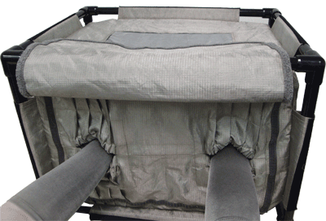
Paraben - Tabletop StrongHold Tent
Link Ch 9m

Slide 40
Forensic Soundness
None of these procedures are forensically sound
They all involve changing the evidence to some extent, because they are live acquisitions
Phones are constantly changing state while power is on
Timestamps, messages, phone calls, etc.

Slide 41
Working with Solid-State Drives

Slide 42
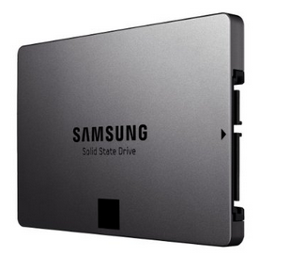
SSD Drives
Faster than hard drives
Consume less power
More expensive
Image from Amazon

Slide 43
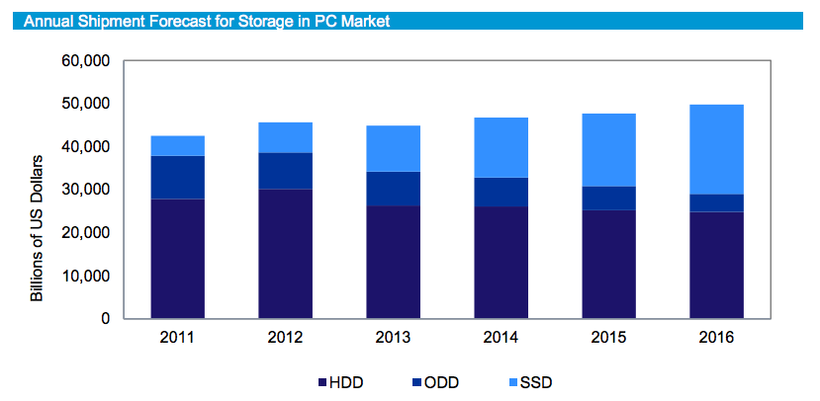
SSD Popularity
From http://www.isuppli.com/Abstract/P28276_20130322152341.pdf

Slide 44
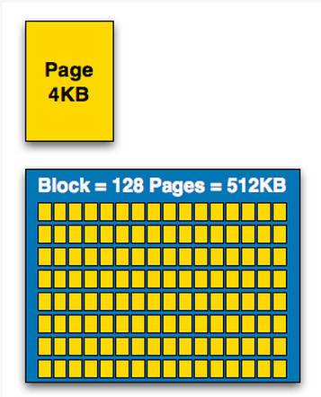
How SSDs Work
Data can be read and written one page at a time, but can only be erased a block at a time
Each erasure degrades the flash—it fails around 10,000 erasures
From http://www.anandtech.com/show/2738/5

Slide 45
Garbage Collection
SSD controller erases pages all by itself, when it knows they are empty
The TRIM command is sent to the SSD when a file is deleted
But only if you use a the correct OS, Partition type, and BIOS settings
Yuri Gubanov calls this “Self-Corrosion” – I call it Data Evaporation

Slide 46
Demo on Mac: Disk Drill
Deleted files from desktop evaporate in 30-60 min

Slide 47
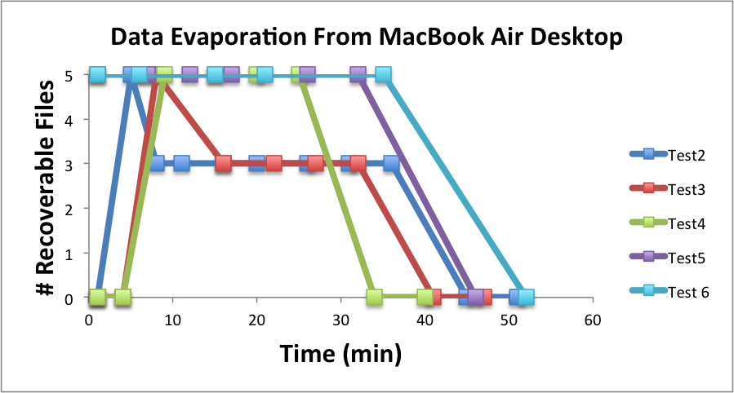

Slide 48
Demo on PC
Save data on an SSD
Watch it evaporate!
How to test TRIM
fsutil behavior query DisableDeleteNotify
Zero = TRIM enabled

Slide 49
When Does TRIM Work?
BIOS: Drive must be SATA in AHCI mode, not in IDE emulation mode
SSD must be new (Intel: 34 nm only)
Windows 7 or later
NTFS volumes, not FAT
Mac OS X 10.6.8 or later
Must be Apple-branded SSD

Slide 50
When Does TRIM Work?
External Drives must use SATA or SCSI, not USB
PCI-Express & RAID does not support TRIM
From http://forensic.belkasoft.com/en/why-ssd-destroy-court-evidence

Slide 51
Meaning for Forensics
Deleted data sometimes evaporates, so there is no forensically sound way to acquire it
The hash keeps changing
All you can do is document your procedure and take what you can get
Like a live acquisition
Active data is OK, but the deleted data may be largely lost

Slide 52
Chip-Off Forensics
Disassemble the SSD memory and image the material directly
Bypassing the SSD controller
This is a true static acquisition
Hash value doesn't change
Expensive, difficult, and may destroy the SSD
Drive Savers can do this

Slide 53
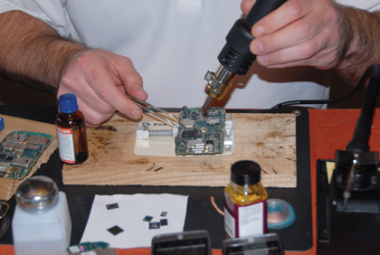
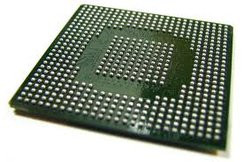
Chip-Off Forensics
Links Ch 9o, 9p

Slide 54
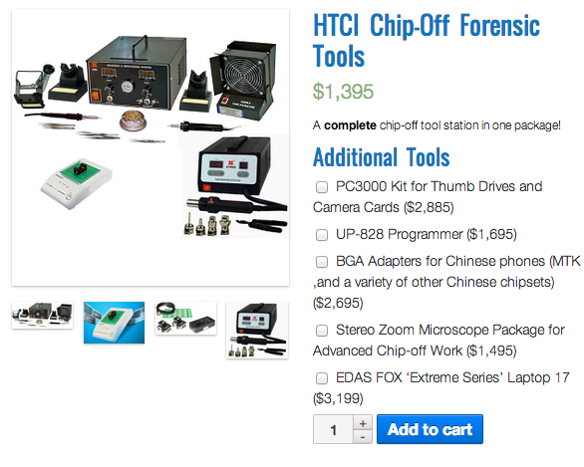
Link Ch 9q

Slide 55
Missing Artifacts
When Windows 7 is installed on an SSD, it disables some features
ReadyBoost
SuperFetch
Automatic defragmentation
So the Prefetch folder will be empty
Link Ch 9s, 9t
The book says UserAssist will be missing too
I'd like to test this

Slide 56
Virtual Machine Forensics

Slide 57
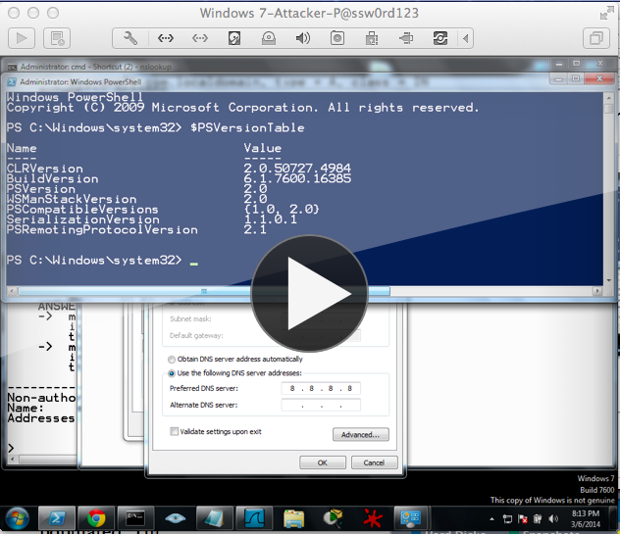
Suspend
Suspend a VM
Stops it, preserves HD and RAM
Like Hibernate
Copy the whole folder containing the VM

Slide 58
Live Acquisition of a VM
To get HD, copy the virtual hard disk files
VHD. VMDK. VDI, etc.
Capture RAM with FTK Imager or any other live acquisition tool

